Slide 1
Section 8.R.1
Absolute Value Equations

Slide 2
Objectives
Solve absolute value equations.
Solve equations with two absolute value
expressions.

Slide 3
Definition: Absolute Value
The absolute value of a number is its distance from 0 on a number line.

Slide 4
Definition: Solving Absolute Value Equations
For c > 0:
Note: If the absolute value expression is isolated on one side of the equation, we say that the equation is in standard form. You may need to manipulate the absolute value equation to get it into standard form before you can solve it. (See Example 1d.)

Slide 5
Example 1: Solving Absolute Value Equations₁
Solve each absolute value equation.
Solution
a. x = 5 or x = −5
b. 3x − 4 = 5
3x − 4 + 4 = 5 + 4
3x = 9
x = 3
or

Slide 6
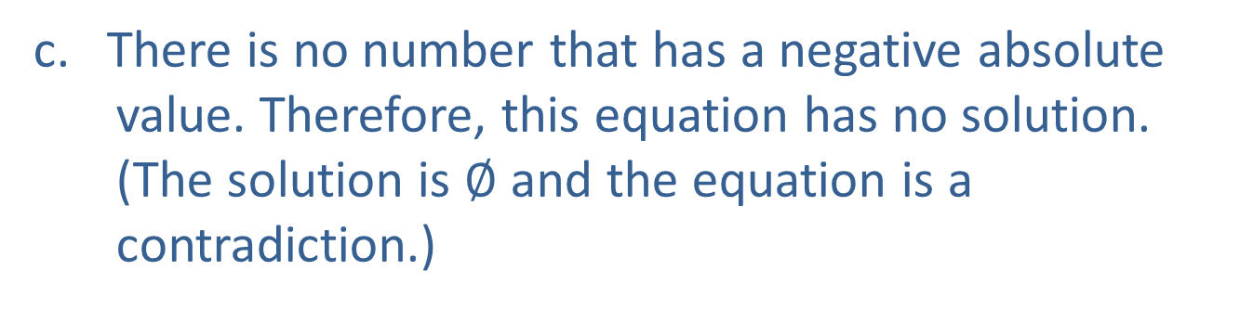
Example 1: Solving Absolute Value Equations₂
c. There is no number that has a negative absolute
value. Therefore, this equation has no solution.
(The solution is $∅$ and the equation is a contradiction.)

Slide 7
Example 1: Solving Absolute Value Equations₃
or

Slide 8
Definition: Solving Equations with Two Absolute Value Expressions
then either a = b or a = −b.
If
More generally,
If
then either a x + b = cx + d or

Slide 9
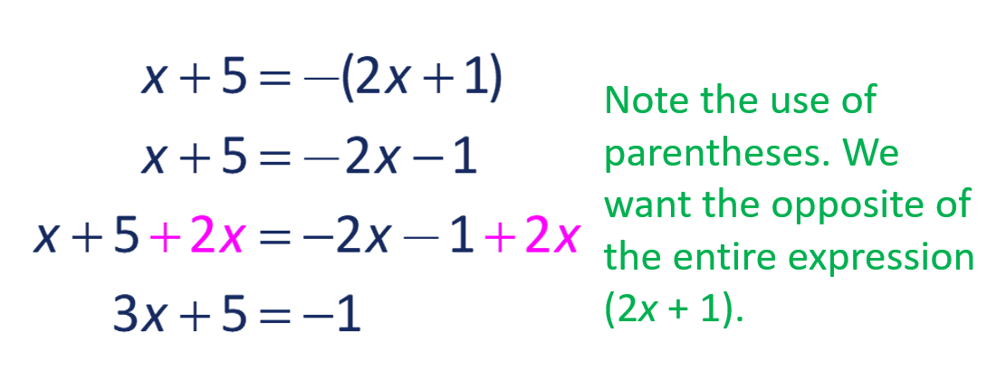
Example 2: Solving Equations with Two Absolute Value Expressions₁
Solve:
Solution
In this case, the two expressions (x + 5) and (2x + 1) are
equal to each other or are opposites of each other.
or

Slide 10
Example 2: Solving Equations with Two Absolute Value Expressions₂
Make sure to check that both 4 and −2 satisfy the original equation.
Check
So, x = −2 and x = 4 are both solutions.

