Slide 1
Section 6.R.1
Area

Slide 2
Objectives
Calculate the areas of polygons.

Slide 3
Finding the Area of a Polygon
Table 1: From the Metric System | From the US Customary System
square millimeters (mm²) | square inches (in.²)
square centimeters (cm²) | square feet (ft²)
square meters (m²) | square yards (yd²)
square kilometers (km²) | square miles (mi²)

Slide 4
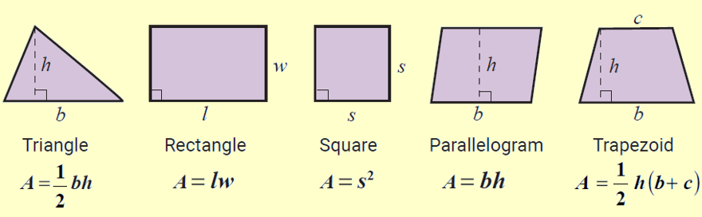
Formula: Area Formulas for Five Polygons
Note: The letter h is used to represent the height of the figure. The height is also called the altitude and is perpendicular to the base.

Slide 5
Example 1: Calculating the Area of a Triangle Using a Formula
Calculate the area of a triangle with height 4 in. and base 10 in. (Be sure to label the answer in square inches.)
Solution
Now, using the formula for the area of a triangle, we have the following.
The area of the triangle is 20 in.²

Slide 6
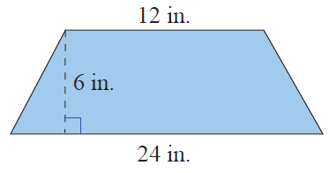
Example 2: Calculating the Area of a Trapezoid Using a Formula₁
Calculate the area of a trapezoid with altitude 6 in. and parallel sides of length 12 in. and 24 in.
Solution
First draw a figure and label the lengths of the known parts.

Slide 7
Example 2: Calculating the Area of a Trapezoid Using a Formula₂
Now, using the formula for the area of a
trapezoid, we have the following.
The area of the trapezoid is 108 in.²

Slide 8
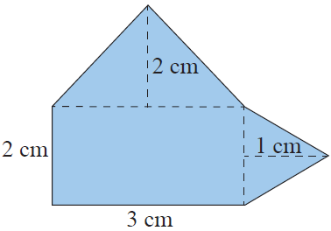
Example 3: Calculating the Area of a Composite Figure₁
Calculate the area of the composite figure made up of a rectangle and two triangles.
Solution
To find the area of this figure, calculate the area of each part and then add the three areas. The figure is made up of two triangles and one rectangle.

Slide 9
Example 3: Calculating the Area of a Composite Figure₂

Slide 10
Example 3: Calculating the Area of a Composite Figure₃
Total area = 6 cm² + 3cm² + 1cm² = 10 cm²
The area of the composite figure is 10 cm².

Slide 11
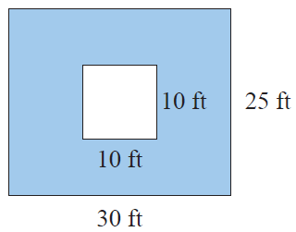
Example 4: Calculating Area₁
A square is cut out of a rectangle as shown. Calculate the area of the blue-shaded region.
Solution
There are three steps in calculating the area of the shaded region. First, calculate the area of the outer figure. Then, calculate the area of the inner figure. Finally,
calculate the difference between the areas.

Slide 12
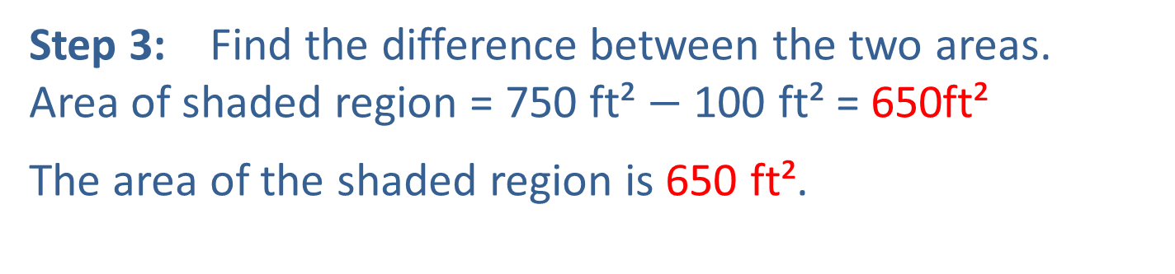
Example 4: Calculating Area₂
Step 1: Calculate the area of the rectangle.
A = lw
A = 30ft ⋅ 25ft = 750 ft²
Step 2: Calculate the area of the square.
A = s²
Step 3: Find the difference between the two areas.
Area of shaded region = 750 ft² $−$ 100 ft² = 650ft²
The area of the shaded region is 650 ft².

Slide 13
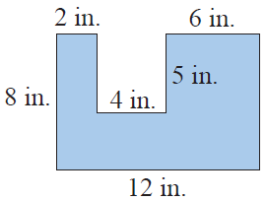
Example 5: Calculating Area₁
The polygon shown here is a rectangle with a rectangular piece missing. Find the area of the polygon.
Solution
There are several ways of finding the area of this figure. One way is to find the area of each of the three parts as illustrated here and then adding the three areas.

Slide 14
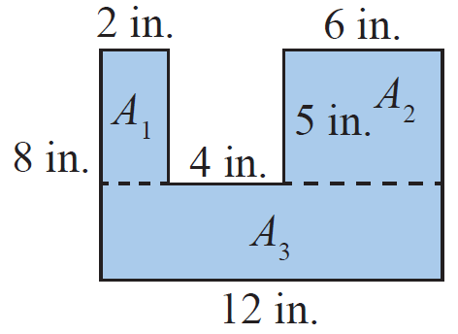
Example 5: Calculating Area₂
Note that the height of
The bottom rectangle is 8 in. − 5 in. = 3 in.
The area of the polygon is 76 in.²

Slide 15
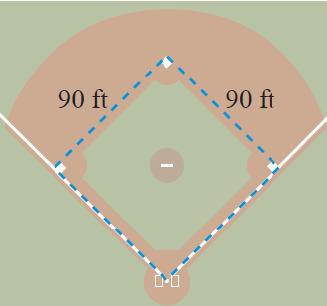
Example 6: Application: Calculating Perimeter and Area₁
A baseball infield is in the shape of a square 90 feet on each side.
a. What is the perimeter of the infield?
b. What is the area of the infield?

Slide 16
Example 6: Application: Calculating Perimeter and Area₂
Solution
a. P = 4 s
P = 4 ⋅ 90 ft = 360 ft
b. A = s²
The perimeter of the infield is 360 feet and the area is 8100 ft².

