Slide 1
Section 4.R.4
Addition and Subtraction with Fractions

Slide 2
Objectives
Add fractions with the same denominator.
Add fractions with different denominators.
Subtract fractions with the same denominator.
Subtract fractions with different denominators.

Slide 3
Procedure: To Add Fractions with the Same Denominator
1. Add the numerators.
2. Keep the common denominator.
3. Reduce, if possible.

Slide 4
Example 1: Adding Fractions with the Same Denominator
Add.
Solution

Slide 5
Example 2: Finding the Least Common Denominator (LCD)
Find the LCD for
Solution
Using prime factorization:

Slide 6
Procedure: To Add Fractions with Different Denominators
1. Find the least common denominator (LCD).
2. Change each fraction into an equivalent fraction with that denominator.
3. Add the new fractions.
4. Reduce, if possible.

Slide 7
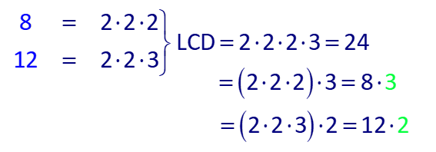
Example 3: Adding Fractions with Different Denominators₁
Add
Solution
Step 1: Find the LCD.

Slide 8
Example 3: Adding Fractions with Different Denominators₂
Note: You might not need to use prime factorizations to find the LCD. If the denominators are numbers that are familiar to you, then you might be able to find the LCD simply by inspection.
Step 2: Find fractions equivalent to
denominator 24.

Slide 9
Example 3: Adding Fractions with Different Denominators₃
Step 3: Add.
Step 4: Reduce, if possible.
The fraction cannot be reduced because 23 and 24 have only 1 as a common factor.

Slide 10
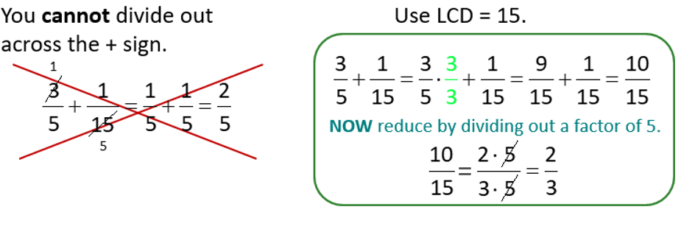
Adding Fractions with Different Denominators
Common Error
The following common error must be avoided.
Add:

Slide 11
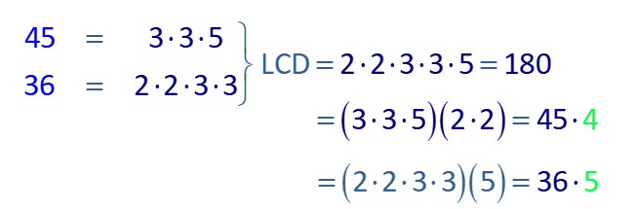
Example 4: Adding Fractions with Different Denominators₁
Add
Solution
Step 1: Find the LCD.

Slide 12
Example 4: Adding Fractions with Different Denominators₂
Step 2: Steps 2, 3, and 4 can be written in one step.

Slide 13
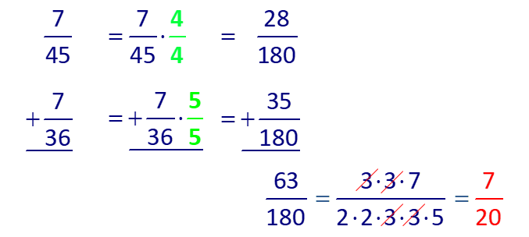
Example 4: Adding Fractions with Different Denominators₃
Note that in adding fractions, we also may choose to write them vertically. The process is the same.

Slide 14
Example 5: Adding Three Fractions with Different Denominators
Add:
Solution
Step 1: LCD = 12
You can simply observe this or use prime factorizations.
Step 2: Steps 2, 3, and 4 can be written in one step.

Slide 15
Example 6: Application: Adding Fractions₁
Rachel is mailing two letters at the post office. One
What is the combined weight of the letters?
Solution
Step 1: READ: Read the problem carefully. We want to find the total weight of the two letters.
Step 2: SET UP: To find the combined weight of the two

Slide 16
Example 6: Application: Adding Fractions₂
Step 3: SOLVE: The LCD of 3 and 7 is 21. Using this information, we can add the two fractions.
Thus, the total weight of the two letters is

Slide 17
Example 6: Application: Adding Fractions₃
Step 4: CHECK: Since each letter weighs less than half an ounce, the total will be less than one ounce. Thus,

Slide 18
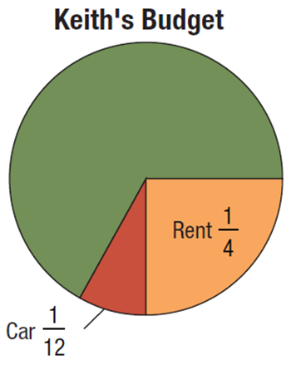
Example 7: Application: Adding Fractions₁
Keith’s total income for the year was $36,000, and he
his car. What portion (or fraction) of his income did he spend on these two items and what was the total amount spent?

Slide 19
Example 7: Application: Adding Fractions₂
Solution
Step 1: READ: Read the problem carefully. In this case, the diagram is helpful. There are two questions here: What portion (or fraction) of his income was spent on these two items and what was the total amount spent?
Step 2: SET UP: To find the fraction spent on these
amount spent, multiply $36,000 by the sum of the fractions.

Slide 20
Example 7: Application: Adding Fractions₃
Step 3: SOLVE: The LCD is 12.

Slide 21
Example 7: Application: Adding Fractions₄
Step 4: CHECK: Since he spent
of his income on these
two items, the answer of $12,000 is reasonable (and accurate).

Slide 22
Properties: Commutative Property of Addition
The order of the fractions being added can be reversed without changing the sum. Symbolically, if
fractions, then

Slide 23
Properties: Associative Property of Addition
The grouping of the fractions being added can be changed without changing the sum. Symbolically, if

Slide 24
Properties: To Subtract Fractions with the Same Denominator
1. Subtract the numerators.
2. Keep the common denominator.
3. Reduce, if possible.

Slide 25
Example 8: Subtracting Fractions with the Same Denominator
Subtract:
Solution
The difference is reduced just as any fraction is reduced.

Slide 26
Procedure: To Subtract Fractions with Different Denominators
1. Find the least common denominator (LCD).
2. Change each fraction into an equivalent fraction with that denominator.
3. Subtract the new fractions.
4. Reduce, if possible.

Slide 27
Example 9: Subtracting Fractions with Different Denominators₁
Subtract:
Solution
Step 1: Find the LCD.
Step 2: Find fractions equivalent to
denominator 30.

Slide 28
Example 9: Subtracting Fractions with Different Denominators₂
Step 3: Subtract.
Step 4: Reduce, if possible.
The fraction cannot be reduced because 23 and 30 have only 1 as a common factor.

Slide 29
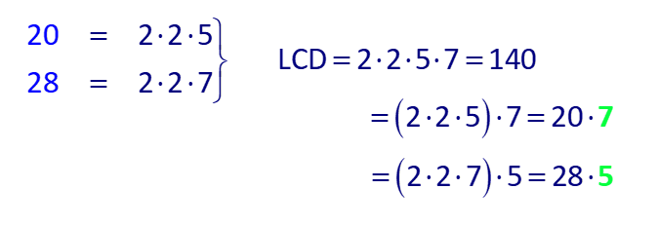
Example 10: Subtracting Fractions with Different Denominators₁
Subtract:
Solution
Step 1: Find the LCD.

Slide 30
Example 10: Subtracting Fractions with Different Denominators₂
Step 2: Steps 2, 3, and 4 can be written in one step.

Slide 31
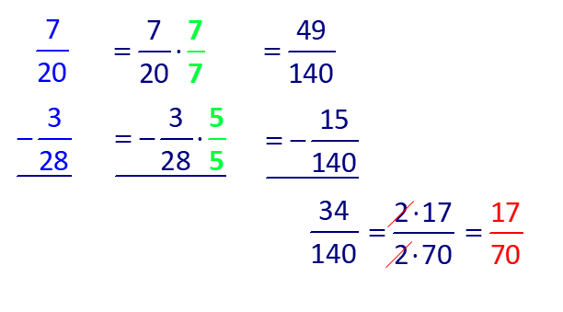
Example 10: Subtracting Fractions with Different Denominators₃
Or, we can write the fractions vertically.

Slide 32
Example 11: Subtracting Fractions with Different Denominators
Subtract:
Solution
Step 1: LCD = 8
Step 2: Steps 2, 3, and 4 can be written in one step.

Slide 33
Example 12: Application: Subtracting Fractions with Different Denominators₁
The Narragansett Grays baseball team lost 90 games in
one season. If
of their losses were by 1 or 2 runs and
of their losses were by 3 or fewer runs, what fraction
of their losses were by exactly 3 runs?
Solution
Step 1: READ: Read the problem carefully. We want to find the fraction of losses that were by exactly 3 runs.

Slide 34
Example 12: Application: Subtracting Fractions with Different Denominators₂
Step 2: SET UP: The losses that were by 3 or fewer runs include those that were by 1 or 2 runs. So, to find the fraction that were by exactly 3 runs, we need to
subtract:
Step 3: SOLVE: The LCD is 45.

Slide 35
Example 12: Application: Subtracting Fractions with Different Denominators₃
Step 4: CHECK:
reasonable.

