Slide 1
Section 4.R.1
Multiplication with Fractions

Slide 2
Objectives
Multiply fractions.
Reduce fractions to lowest terms.
Multiply and reduce fractions to lowest terms.

Slide 3
Procedure: To Multiply Fractions
1. Multiply the numerators.
2. Multiply the denominators.
For example,

Slide 4
Example 1: Multiplying Fractions
Find
Solution
Remember, to find a fraction of a number means to multiply the number by the fraction.

Slide 5
Example 2: Multiplying Fractions₁
Multiply.
Solution

Slide 6
Example 2: Multiplying Fractions₂

Slide 7
Example 3: Application: Multiplying Fractions₁
In a certain voting district,
of the eligible voters are
actually registered to vote. Of those registered voters,
are independents (have no party affiliation). What fraction of the eligible voters are registered independents?
Solution
Step 1: READ: Read the problem carefully. There are two types of voters to consider: registered voters and independent voters.

Slide 8
Example 3: Application: Multiplying Fractions₂
Step 2: SET UP: In looking for the fraction of registered
independent voters, we know that
of eligible voters are registered independents, so we will need to multiply
Step 3: SOLVE:
Thus,
of the eligible voters are registered as
independents.

Slide 9
Example 3: Application: Multiplying Fractions₃
Step 4: CHECK: The fraction
is a little more than
which means that approximately
of eligible voters are registered as independents.
Since
the fraction
seems like a
reasonable answer as it is a little more than

Slide 10
Properties: Commutative Property of Multiplication
The order of the fractions being multiplied can be reversed without changing the product. Symbolically, if
are fractions, then
For example,

Slide 11
Properties: Associative Property of Multiplication
The grouping of the fractions being multiplied can be changed without changing the product. Symbolically, if
are fractions, then
For example,

Slide 12
Example 4: Recognizing the Properties of Multiplication
Each of the properties of multiplication is illustrated.
As a check, we see that
As a check, we see that

Slide 13
Properties: To Reduce a Fraction to Lowest Terms
1. Factor the numerator and denominator into prime factors.
2. Use the fact that
and “divide out” all common factors.
Note: Reduced fractions may be improper fractions.

Slide 14
Example 5: Reducing Fractions to Lowest Terms
Reduce each fraction to lowest terms.
Solution
Note that the rules for divisibility quickly indicate that 5 is a factor of 15, 20, and 35, and 3 is a factor of 21.

Slide 15
Example 6: Reducing Fractions to Lowest Terms₁
Reduce
to lowest terms.
Solution
Remember that 1 is a factor of any whole number. So, if all of the factors in the numerator or denominator are divided out, 1 must be used as a factor.
Using prime factors, we get the following.

Slide 16
Example 6: Reducing Fractions to Lowest Terms₂
Or, if you see that 8 is a common factor, divide it out. But remember that 1 is a factor.

Slide 17
Completion Example 7: Reducing Fractions to Lowest Terms
Reduce
to lowest terms.
Solution
Finding a common factor could be difficult here. Prime factoring helps.

Slide 18
Example 8: Application: Reducing Fractions to Lowest Terms
Suppose you had $25 and you spent $15 to buy music.
a. What fraction of your money did you spend on music?
b. What fraction do you still have?
Solution
a. The fraction you spent is
b. Since you still have $25 − $15 = $10, the fraction you still have is

Slide 19
Example 9: Multiplying and Reducing Using Prime Factors
Multiply and reduce to lowest terms:
Solution
Do not start by multiplying the numerators and denominators. The results would simply be large numbers that would then need to be factored. Using prime factors, we have the following.
Note that we did not find the product in the numerator or denominator before factoring.

Slide 20
Example 10: Multiplying and Reducing Using Prime Factors
Multiply and reduce to lowest terms:
Solution
Using prime factors, we have

Slide 21
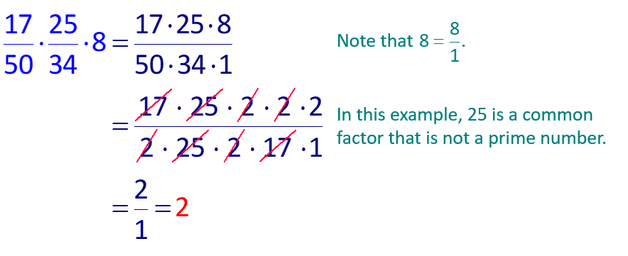
Example 11: Multiplying and Reducing Using Prime Factors
Multiply and reduce to lowest terms:
Solution

Slide 22
Completion Example 12: Multiplying and Reducing Using Prime Factors
Multiply and reduce to lowest terms:
Solution

Slide 23
Example 13: Application: Multiplying and Reducing Fractions₁
of the members of a public
A study showed that
service organization were in favor of a new set of bylaws. If the organization had a membership of 200 people, how many were in favor of the changes in the bylaws?
Solution
Step 1: READ: Read the problem carefully. Note we need to find a fraction of the membership.
Step 2: SET UP: To find
multiply.

Slide 24
Example 13: Application: Multiplying and Reducing Fractions₂
Step 3: SOLVE:
Step 4: CHECK: The fraction
is a little more than
which gives an approximation of 100 members in favor of the law. Therefore, the answer of 125 members is reasonable as it is a little more than 100.

Slide 25
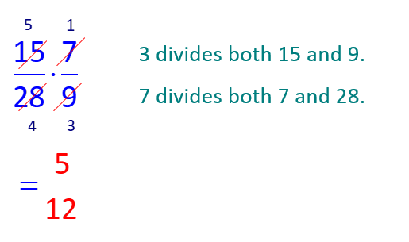
Example 14: Multiplying and Reducing Using the Division Method
Multiply and reduce to lowest terms:
Solution

Slide 26
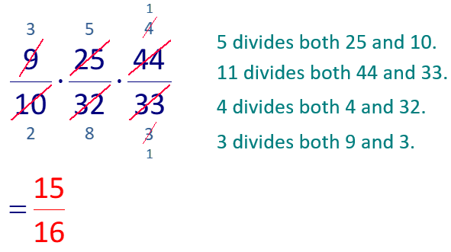
Example 15: Multiplying and Reducing Using the Division Method
Multiply and reduce to lowest terms:
Solution

Slide 27
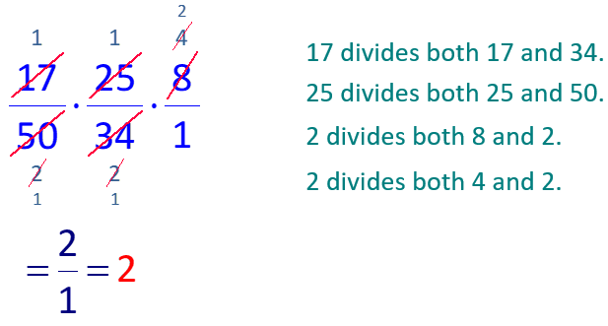
Example 16: Multiplying and Reducing Using the Division Method
Multiply and reduce to lowest terms:
Solution

Slide 28
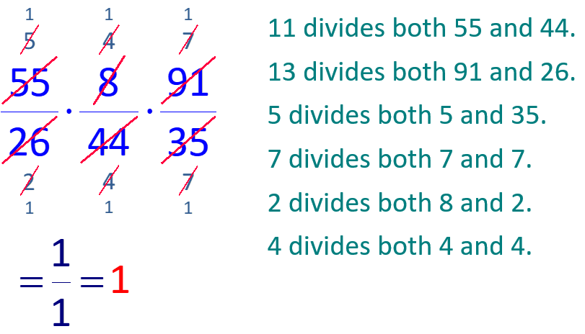
Example 17: Multiplying and Reducing Using the Division Method
Multiply and reduce to lowest terms:
Solution

