Slide 1
Section 3.R.2
Subtraction with Real Numbers

Slide 2
Objectives
Find the additive inverse (opposite) of a given number.
Subtract real numbers.
Find the change in value between two real numbers.

Slide 3
Definition: Additive Inverse
The opposite of a real number is called its additive inverse. The sum of a number and its additive inverse is zero. Symbolically, for any real number a,

Slide 4
Example 1: Finding Additive Inverses
Find the additive inverse (opposite) of each number.
Solution:
a. The additive inverse of 3 is −3, because
b. The additive inverse of −7.3 is (−7.3) + 7.3 = 0 Because
c. The additive inverse of 0 is −0 = 0. That is, 0 is its own opposite.

Slide 5
Definition: Subtraction
For any real numbers a and b,
In words, to subtract b from a, add the opposite of b to a.

Slide 6
Example 2: Subtracting Real Numbers₁
Subtract.

Slide 7
Example 2: Subtracting Real Numbers₂

Slide 8
Example 3: Application: Calculating Change in Value₁
At noon on Tuesday, the temperature was 34°F. By noon on Thursday, the temperature had changed to −5°F. How much did the temperature change between Tuesday and Thursday?

Slide 9
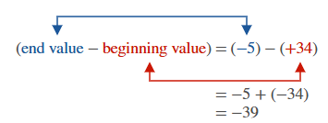
Example 3: Application: Calculating Change in Value₂
Solution
For change in value:
Between Tuesday and Thursday, the temperature changed −39°F (or dropped 39°F).

Slide 10
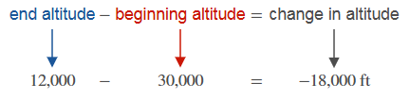
Example 4: Application: Calculating Change in Value
A jet pilot flew her plane from an altitude of 30,000 ft
to an altitude of 12,000 ft. What was the change in
altitude?
Solution
This means that the plane descended 18,000 ft.

Slide 11
Example 5: Application: Calculating Net Change₁
Susan is a salesperson for a shoe store. Last week her sales of pairs of shoes were as follows.
Day | Sales | Returns | Daily Net Sales
Monday | 7 | 1 | 6
Tuesday | 3 | 0 | 3
Wednesday | 2 | 4 | -2
Thursday | 6 | 1 | 5
Friday | 8 | 3 | 5

Slide 12
Example 5: Application: Calculating Net Change₂
What were Susan’s net sales for last
week?
Solution
Susan’s net sales for the week were 17 pairs of shoes.

Slide 13
Example 6: Application: Calculating Net Change₁
Robert weighed 230 lb when he started to diet. The first month he lost 7 lb, the second month he gained
2 lb, and the third month he lost 5 lb. What was his weight after 3 months of dieting? What was his net change in weight?
Solution
His weight after 3 months can be calculated as follows.

Slide 14
Example 6: Application: Calculating Net Change₂
His net change in weight was
230 − 220 = 10 lb.
Thus, Robert’s weight after 3 months of dieting was 220 lb which was a net change of 10 lb.

