Slide 1
Section 2.R.6
Constructing Graphs from Databases

Slide 2
Objectives
Construct a bar graph from a set of data.
Construct a circle graph from a set of data.

Slide 3
Procedure: Steps to Follow in Constructing a Vertical Bar Graph₁
1. Draw a vertical axis and a horizontal axis. Label these axes appropriately.
2. Mark an appropriate scale on the vertical axis to represent the frequency of each category. (The scale must be uniform. That is, the distance between consecutive marks must represent the same amount.)

Slide 4
Steps to Follow in Constructing a Vertical Bar Graph₂
3. Mark the categories of data along the horizontal axis.
4. Draw the vertical bar for each category so that the height of the bar reaches the frequency of the data in that category. (Note: Make sure the bars have the same width.)
5. Give the graph a title.

Slide 5
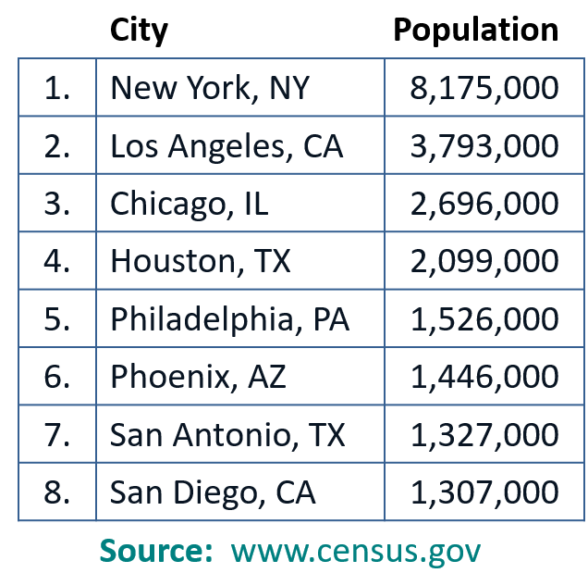
Example 1: Constructing a Bar Graph₁
Construct a bar graph that represents the following population data.

Slide 6
Example 1: Constructing a Bar Graph₂
Steps 1 and 2: Draw the vertical axis and horizontal axis and mark a scale on the vertical axis that will encompass the numbers from 0 to 8.175 million people. (On this graph, we have chosen to mark the numbers from 0 to 9.0 in a scale of 1 unit.)

Slide 7
Example 1: Constructing a Bar Graph₃
Steps 3 and 4: The horizontal axis marks are labeled with the names of the cities represented in alphabetical order. The height of each vertical bar corresponds to the population (in millions) of each city as given.

Slide 8
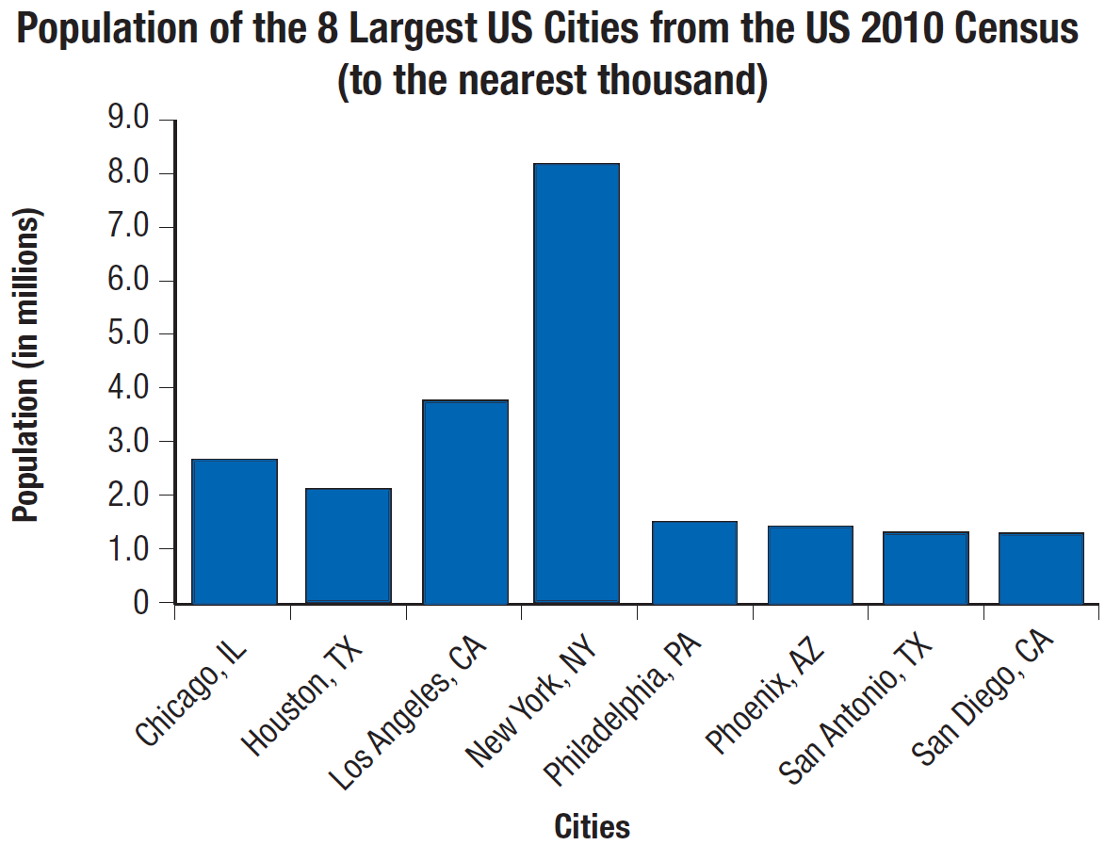
Example 1: Constructing a Bar Graph₄
Step 5: Give the graph a title.

Slide 9
Procedure: Steps to Follow in Constructing a Circle Graph
1. Find the central angle (angle at the center of the circle) for each category by multiplying the corresponding percent (in decimal form) by 360°.
2. Draw a circle.
3. Draw each central angle (use a protractor).
4. Label each sector with the name and corresponding percent of each category.
5. Give the graph a title.

Slide 10
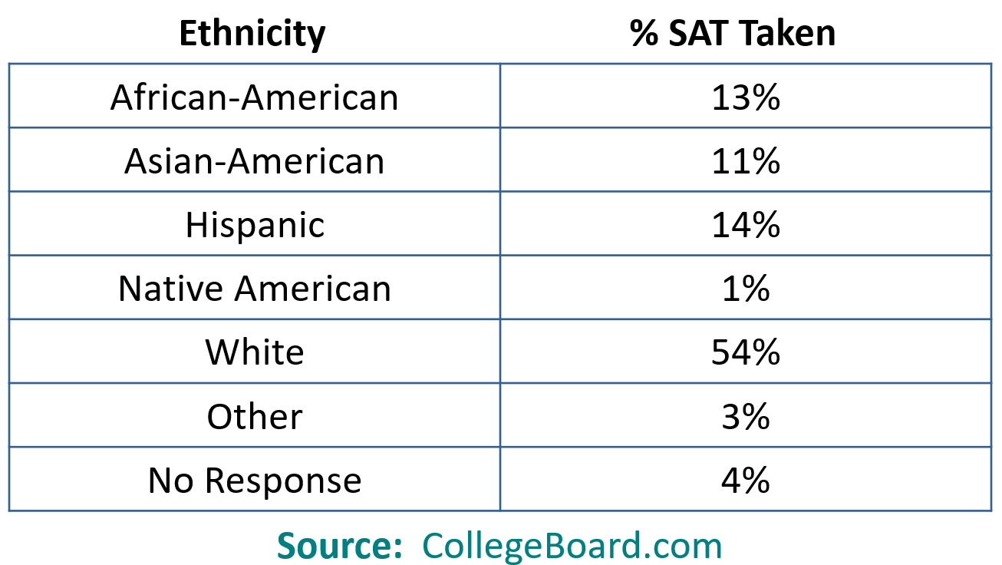
Example 2: Constructing a Circle Graph₁
Construct a circle graph that represents the following data.
Ethnic Breakdown of Students Who Took the SAT (Scholastic Assessment Test), Nationwide, 2010.

Slide 11
Example 2: Constructing a Circle Graph₂
Step 1: Find the central angle for each category by multiplying the corresponding percent (in decimal form) by 360°.
African-American | 13% of 360° = 0.13 × 360° = 46.8°
Asian-American | 11% of 360° = 0.11 × 360° = 39.6°
Hispanic | 14% of 360° = 0.14 × 360° = 50.4°
Native American | 1% of 360° = 0.01 × 360° = 3.6°
White | 54% of 360° = 0.54 × 360° = 194.4°
Other | 3% of 360° = 0.03 × 360° = 10.8°
No Response | 4% of 360° = 0.04 × 360° = 14.4°

Slide 12
Example 2: Constructing a Circle Graph₃
Steps 2 and 3 and 4: Draw a circle, mark the central angles as close to the actual degrees as is practical, and label each sector. Note that the order of the sectors (pie slices) is not important.
Step 5: Give the graph a title.

Slide 13
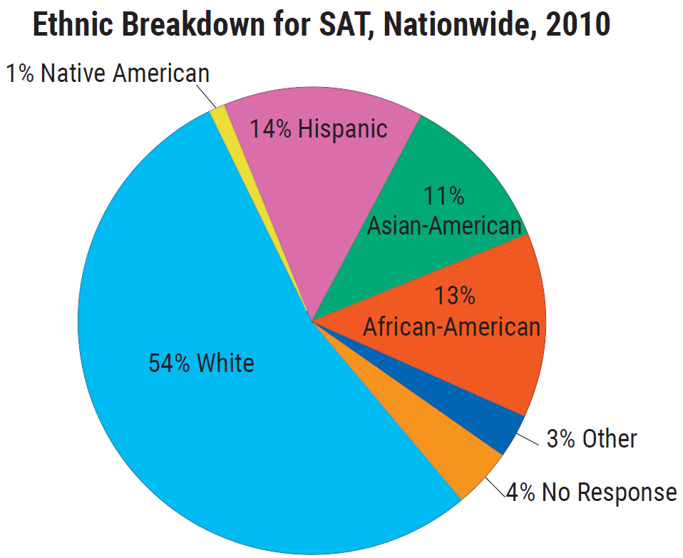
Example 2: Constructing a Circle Graph₄

