Slide 1
Section 2.R.5
Reading Graphs

Slide 2
Objectives
Learn the purposes and properties of graphs.
Read bar graphs.
Read circle graphs.
Read line graphs.
Read histograms.

Slide 3
Definition: Four Types of Graphs and Their Purposes
1. Bar Graphs: To emphasize comparative amounts.
2. Circle Graphs: To help in understanding percents or parts of a whole. (Circle graphs are also called pie charts.)
3. Line Graphs: To indicate tendencies or trends over a period of time.
4. Histograms: To indicate data in classes (a range or interval of numbers).

Slide 4
Properties: Properties of Graphs
Every graph should:
1. be clearly labeled.
2. be easy to read.
3. have an appropriate title.

Slide 5
Example 1: Reading a Bar Graph₁
Examine the bar graph and answer the questions given. Note that the scale on the left (sales) and the categories at the bottom (months) are clearly labeled and the graph itself has a title.

Slide 6
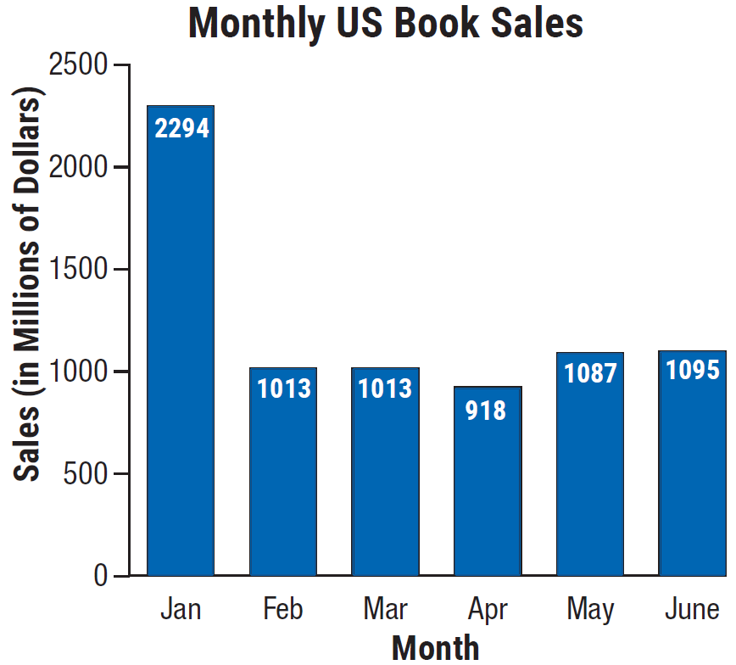
Example 1: Reading a Bar Graph₂
a. What were the sales in February?
Solution
To find the sales amount for February,
use the corresponding value from the
vertical axis or the labeled data.
Note that the scale on the left of
the graph says that sales are in
millions of dollars. This gives an
answer of $1013 million.

Slide 7
Example 1: Reading a Bar Graph₃
b. During what month were sales lowest?
Solution
To determine which month had the lowest amount of sales, compare the values for each month. The month that sales were lowest is April.

Slide 8
Example 1: Reading a Bar Graph₄
c. During what month were sales highest?
Solution
To determine which month had the highest amount of sales, compare the values associated with each month. The month that sales were highest is January.

Slide 9
Example 1: Reading a Bar Graph₅
d. What were sales during the highest sales month?
Solution
Sales were highest in January. based on the data provided. Using the position on the vertical axis, the sales amount is $2294 million.

Slide 10
Example 1: Reading a Bar Graph₆
e. What were the sales in June?
Solution
To find the sales in June, locate the bar labeled June and determine its corresponding value using the vertical axis. Doing this gives an answer of $1095 million.

Slide 11
Example 1: Reading a Bar Graph₇
f. What was the amount of increase in sales between April and May?
Solution
To determine the amount of increase in sales from April to May, first read the sales for April ($918 million). Then read the sales for May ($1087 million).
Subtracting April sales from May sales gives a difference of $169 million.

Slide 12
Example 1: Reading a Bar Graph₈

Slide 13
Example 1: Reading a Bar Graph₉
g. What was the percent increase in sales from April to May (to the nearest tenth of a percent)?
Solution
To find the percent of increase in sales from April to May take the amount of increase in sales (found in part f.) and divide by the sales in April.

Slide 14
Example 1: Reading a Bar Graph₁₀

Slide 15
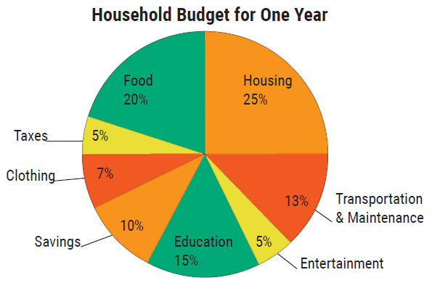
Example 2: Reading a Circle Graph₁
Examine the circle graph. This graph shows the percent of a household's annual income they plan to budget for various expenses. Suppose the household has an annual income of $45,000. Use the information in the graph to calculate how much money will be budgeted for each expense.

Slide 16
Example 2: Reading a Circle Graph₂
Solution
To calculate the budget amount for each item multiply the corresponding percent by the total household income.

Slide 17
Example 2: Reading a Circle Graph₃
Item Amount
Housing | 0.25 X $45,000 = | $11,250
Food | 0.20 X $45,000 = | $9000
Taxes | 0.05 X $45,000 = | $2250
Clothing | 0.07 X $45,000 = | $3150
Savings | 0.10 X $45,000 = | $4500
Education | 0.15 X $45,000 = | $6750
Entertainment | 0.05 X $45,000 = | $2250
Transportation & Maintenance | 0.13 X $45,000 = | $5850
What is the total of all amounts? $45,000

Slide 18
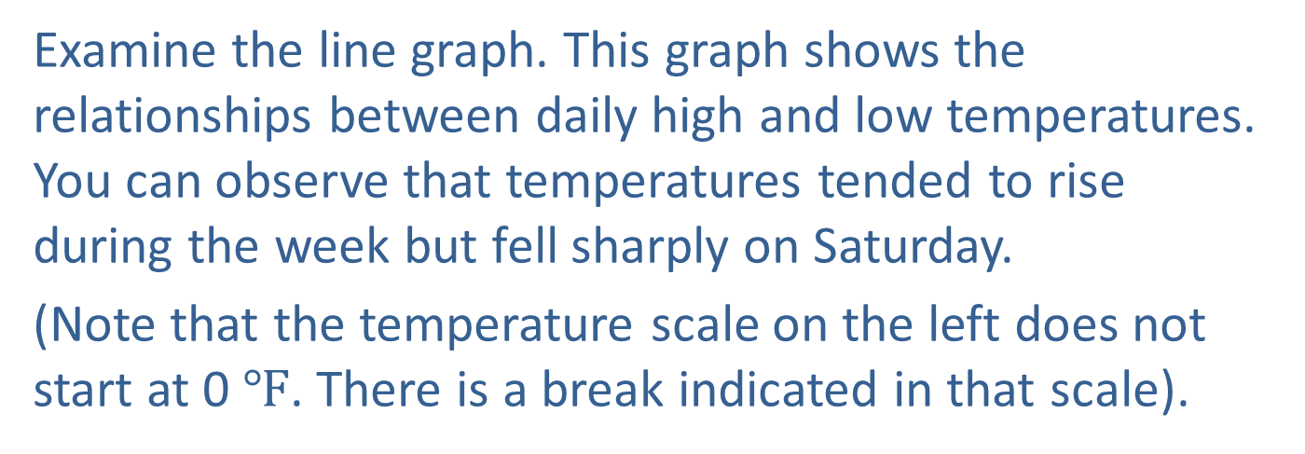
Example 3: Reading a Line Graph₁
Examine the line graph. This graph shows the relationships between daily high and low temperatures. You can observe that temperatures tended to rise during the week but fell sharply on Saturday.
(Note that the temperature scale on the left does not start at 0 $℉$. There is a break indicated in that scale).

Slide 19
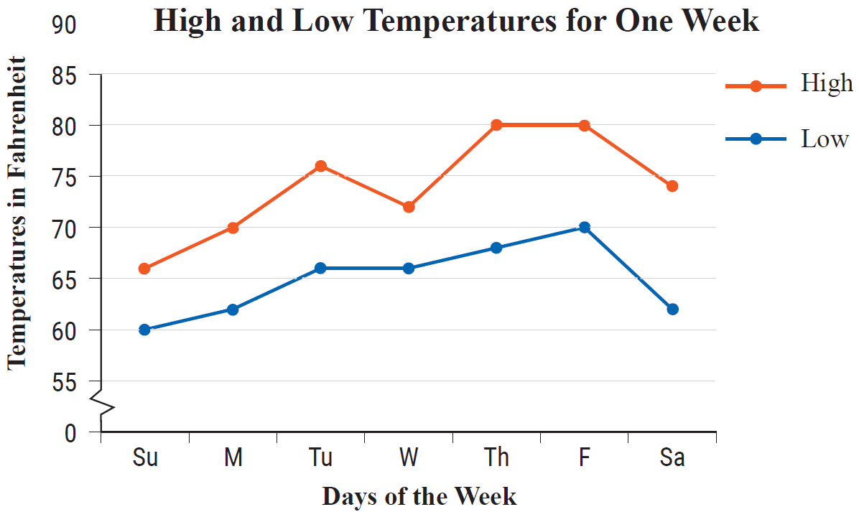
Example 3: Reading a Line Graph₂

Slide 20
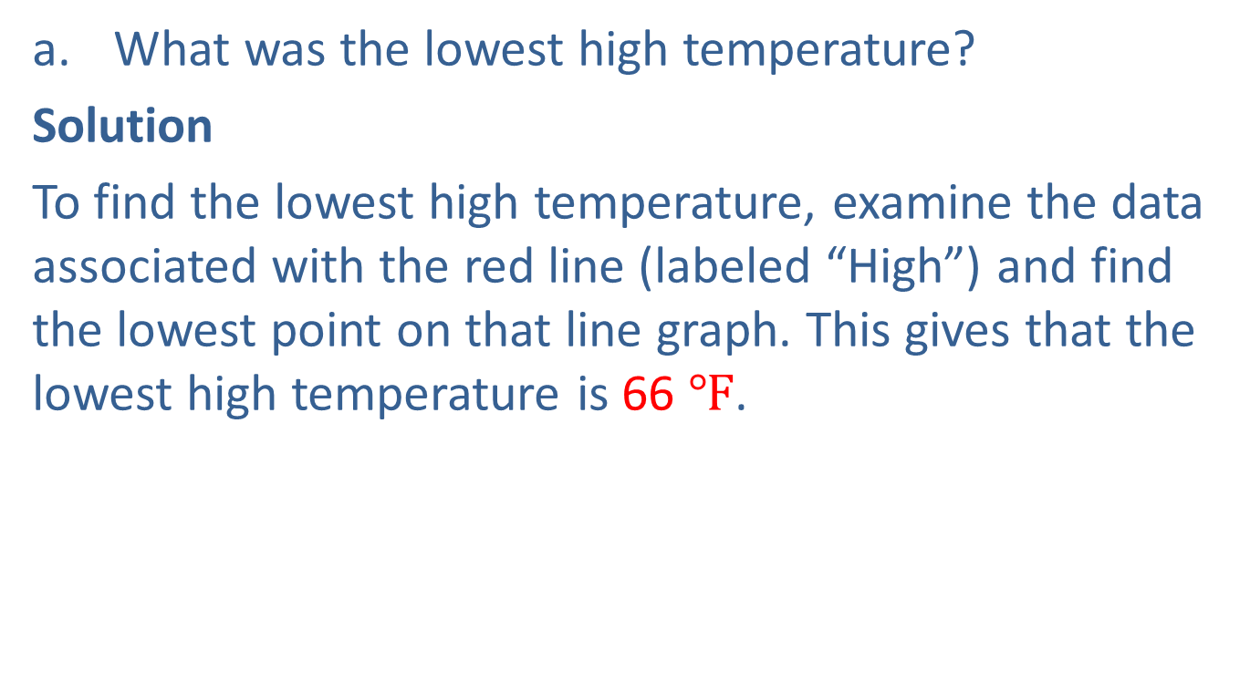
Example 3: Reading a Line Graph₃
a. What was the lowest high temperature?
Solution
To find the lowest high temperature, examine the data associated with the red line (labeled “High”) and find the lowest point on that line graph. This gives that the lowest high temperature is 66 $℉$.

Slide 21
Example 3: Reading a Line Graph₄
b. On what day did this occur?
Solution
Based on the position of the point located in Part a., we identify that the lowest high temperature occurred on Sunday.

Slide 22
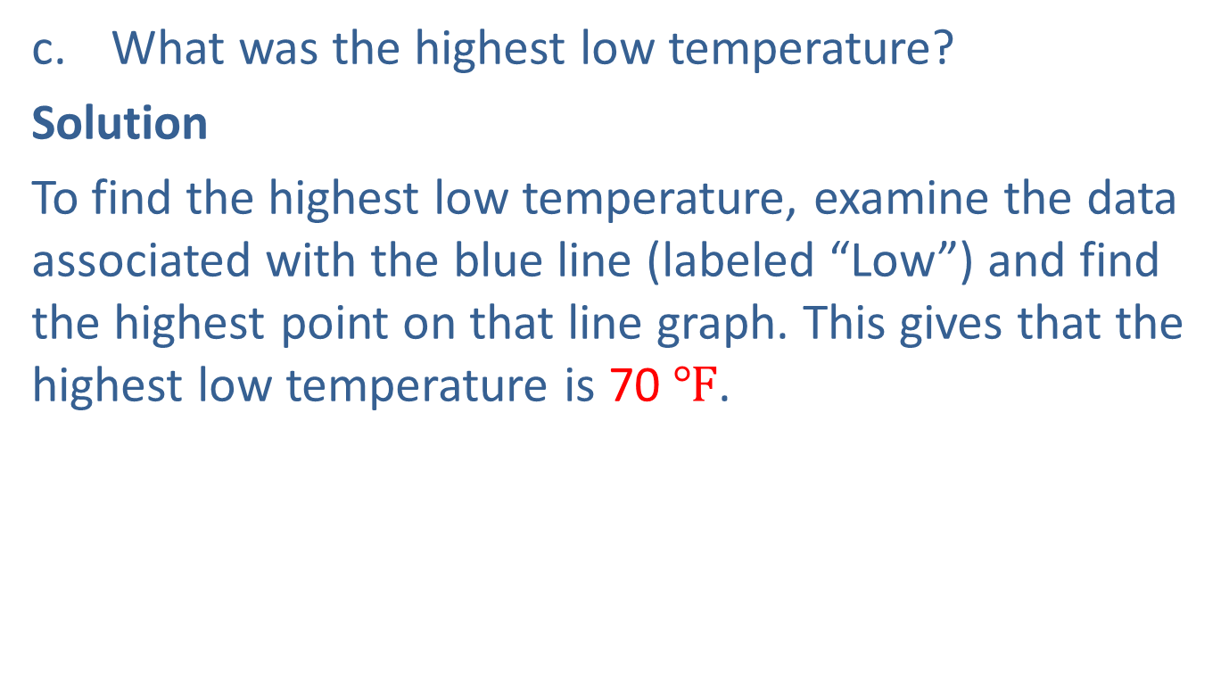
Example 3: Reading a Line Graph₅
c. What was the highest low temperature?
Solution
To find the highest low temperature, examine the data associated with the blue line (labeled “Low”) and find the highest point on that line graph. This gives that the highest low temperature is 70 $℉$.

Slide 23
Example 3: Reading a Line Graph₆
d. On what day did this occur?
Solution
Based on the position of the point located in Part d., we identify that the highest low temperature occurred on Friday.

Slide 24
Example 3: Reading a Line Graph₇
e. Find the mean difference between the daily high and low temperatures for the week shown (to the nearest hundredth).
Solution
Find the mean difference between the daily high and low temperatures for the week shown (to the nearest hundredth).

Slide 25
Example 3: Reading a Line Graph₈
First, find the sum of the differences:
Sunday: | 66 − 60 = 6 °F
Monday: | 70 − 62 = 8 °F
Tuesday: | 76 − 66 = 10 °F
Wednesday: | 72 − 66 = 6 °F
Thursday: | 80 − 68 = 12 °F
Friday: | 80 − 70 = 10 °F
Saturday: | 74 − 62 = 12 °F
 | 64 °F Sum of differences

Slide 26
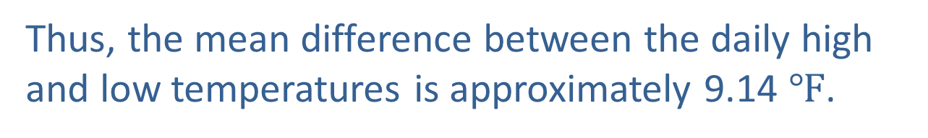
Example 3: Reading a Line Graph₉
Then divide the sum of the differences by the number of days to find the mean of these differences.
Thus, the mean difference between the daily high and low temperatures is approximately 9.14 $℉$.

Slide 27
Definition: Terms Related to Histograms₁
Class: A range (or interval) of numbers that contains data items.
Lower class limit: The smallest whole number that belongs to a class.
Upper class limit: The largest whole number that belongs to a class.
Class boundaries: Numbers that are halfway between the upper limit of one class and the lower limit of the next class.

Slide 28
Definition: Terms Related to Histograms₂
Class width: The difference between the class boundaries of a class (the width of each bar).
Frequency: The number of data items in a class.

Slide 29
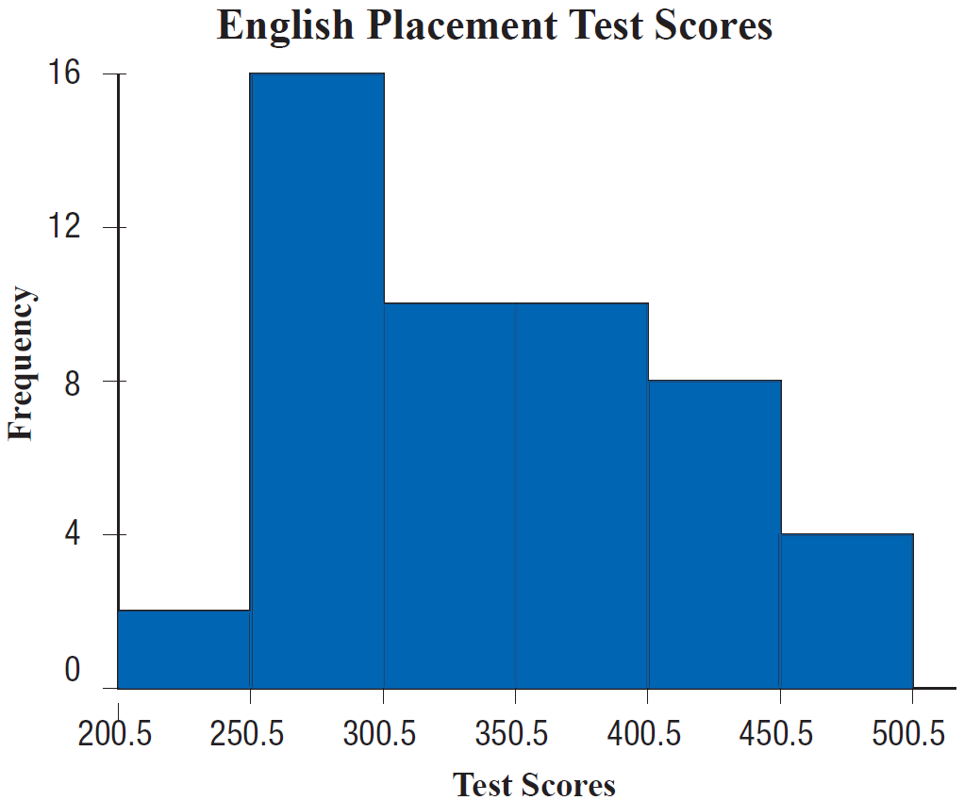
Example 4: Reading a Histogram₁
Examine the following histogram. This histogram summarizes the scores of 50 students on an English placement test. Refer to the graph to answer the given questions.

Slide 30
Example 4: Reading a Histogram₂
a. How many classes are represented?
Solution
Each bar on the histogram represents a class. Thus, in this histogram, there are 6 classes.

Slide 31
Example 4: Reading a Histogram₃
b. What are the class limits of the first class?
Solution
The class limits consist of the smallest number and the largest number that belong to a class. The first class has a lower class limit of 201 and an upper class limit of 250.

Slide 32
Example 4: Reading a Histogram₄
c. What are the class boundaries of the second class?
Solution
The class boundaries are listed on the horizontal axis of the graph. For the second class, or second bar, we identify that the lower class boundary is 250.5 and the upper class boundary is 300.5.

Slide 33
Example 4: Reading a Histogram₅
d. What is the width of each class?
Solution
Each class has the same width and this is found by subtracting the lower class boundary from the upper class boundary of any class. Using the class boundaries just found for the second class gives 300.5 − 250.5 = 50. Thus, the class width of each class is 50.

Slide 34
Example 4: Reading a Histogram₆
e. Which class has the greatest frequency?
Solution
To find the class with the greatest frequency, identify for the tallest bar. We identify that the second class has the greatest frequency.

Slide 35
Example 4: Reading a Histogram₇
f. What is this frequency?
Solution
The frequency for the second class is determined by its corresponding value on the vertical axis. Then we identify that the frequency of the second class is 16.

Slide 36
Example 4: Reading a Histogram₈
g. What percent of the scores are between 200.5 and 250.5?
Solution
The graph shows that there are 2 scores between 200.5 and 250.5. We want to divide this number by the total number of scores: 2 + 16 + 10 + 10 + 8 + 4 = 50.
Now dividing 2 by 50 gives

Slide 37
Example 4: Reading a Histogram₉
h. What percent of the scores are above 400.5?
Solution
If we observe the fifth and sixth classes represent scores above 400.5. The frequencies of these classes are 8 and 4. Now dividing the total of these classes by the total number of scores gives the percent of scores greater than 400.5:

