Slide 1
Section 2.R.4
Fractions and Percents

Slide 2
Objectives
Change fractions to percents.
Change percents to fractions.
Notes:
2

Slide 3
Procedure: To Change a Fraction to a Percent
1. Change the fraction to a decimal number. (Divide the numerator by the denominator.)
2. Change the decimal number to a percent.

Slide 4
Example 1: Changing Fractions to Percents₁
Solution
Note that 8 is not a factor of 100, so we divide using long division (or using a calculator).

Slide 5
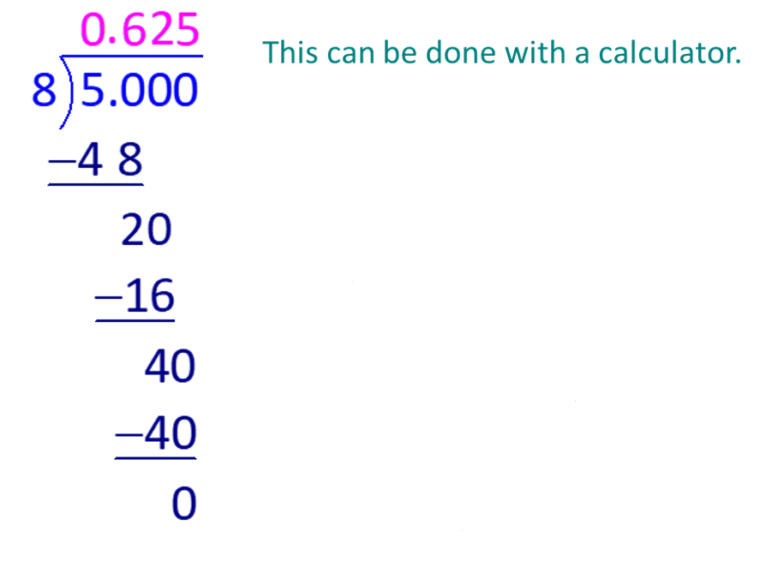
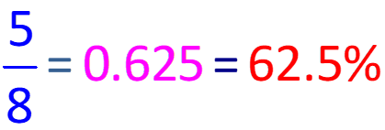
Example 1: Changing Fractions to Percents₂
Now change 0.625 to a percent. Move the decimal point two places to the right
and write the % sign.

Slide 6
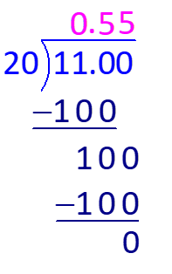
Example 2: Changing Fractions to Percents
Solution
Divide.
Or, we can note that 20 is a factor of 100 and write

Slide 7
Example 3: Changing Mixed Numbers to Percents
Solution
number to a percent as follows.

Slide 8
Example 4: Changing Mixed Numbers to Percents
Solution
is larger than 1, the percent will be more than
100%.
to decimal form, then change the decimal
number to a percent.

Slide 9
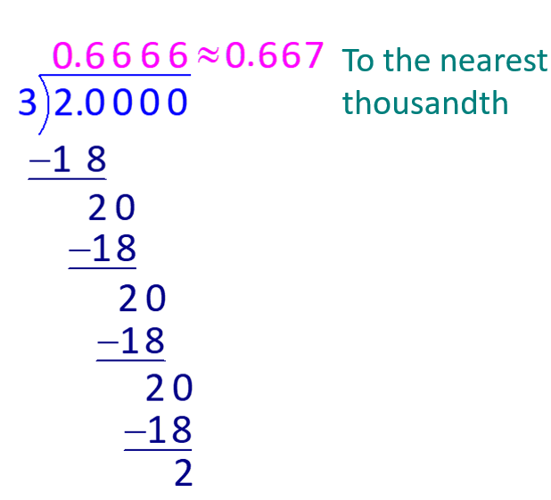
Example 5: Changing Fractions to Percents
Change
to a percent (rounded to the nearest tenth of
a percent).
Solution
Divide. To find the solution to the nearest tenth of a percent, we must round the decimal quotient to the nearest thousandth.

Slide 10
Example 6: Application: Changing Fractions to Percents₁
During the years 1921 to 2012, the Los Angeles Dodgers baseball team played in 18 World Series Championships and won 6 of them. What percent of these championships did the Dodgers win (rounded to the nearest tenth of a percent)?
Solution
The percent won can be found by changing the fraction
to decimal form and then changing the
decimal number to a percent.

Slide 11
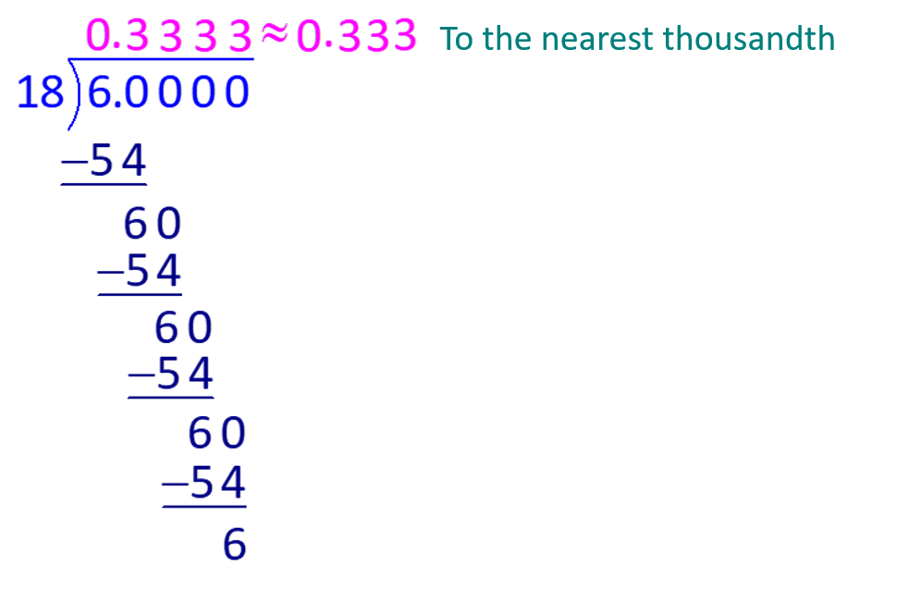
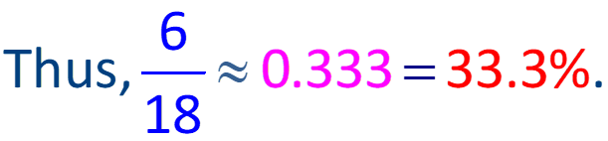
Example 6: Application: Changing Fractions to Percents₂
The Dodgers won 33.3% of these championships.

Slide 12
Procedure: To Change a Percent to a Fraction or a Mixed Number
1. Write the percent as a fraction with 100 as the denominator and delete the % sign.
2. Reduce the fraction, if possible.

Slide 13
Example 7: Changing Percents to Fractions
Change 60% to a fraction and reduce, if possible.
Solution

Slide 14
Example 8: Changing Percents to Mixed Numbers
Change 130% to a mixed number and reduce, if possible.
Solution

Slide 15
Caution: Common Misunderstanding Concerning Percents₁
are often confused with the
The differences can be clarified
by using decimal numbers.

Slide 16
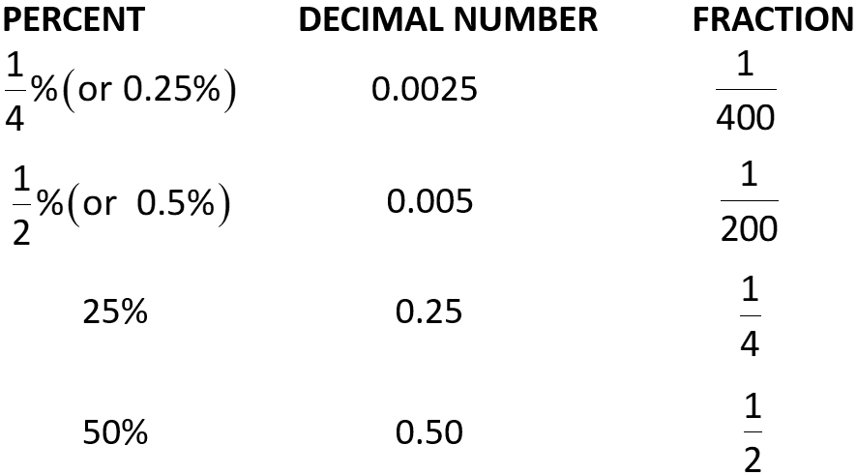
Caution: Common Misunderstanding Concerning Percents₂

Slide 17
Caution: Common Misunderstanding Concerning Percents₃
Thus
Similarly,

Slide 18
Caution: Common Misunderstanding Concerning Percents₄
as being one-fourth of a dollar
as being one-fourth of a penny.
can be thought of as one-half of a dollar
as one-half of a penny.

Slide 19
Properties: Common Equivalent Percent, Decimal Number, and Fraction Values₁

Slide 20
Changing Percents to Fractions₂

