Slide 1
Section 2.R.3
Comparisons and Order of Operations with Fractions

Slide 2
Objectives
Compare fractions.
Use the order of operations to simplify expressions containing fractions.
Find the average of a set of fractions.

Slide 3
Procedure: To Compare Two Fractions
1. Find the least common denominator (LCD).
2. Change each fraction to an equivalent fraction with that denominator.
3. Compare the numerators.

Slide 4
Example 1: Comparing Fractions₁
Solution
Step 1:
Step 2:
denominator 24.

Slide 5
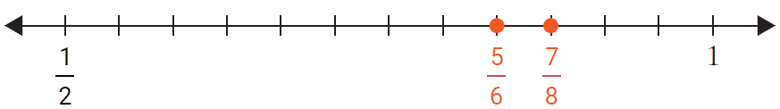
Example 1: Comparing Fractions₂
Step 3:
since 21 > 20.
Graphing these values on a number line, we have

Slide 6
Example 2: Comparing Fractions₁
Which is larger,
How much larger?
Solution
Step 1:
Step 2:
Step 3:
since 33 > 32.

Slide 7
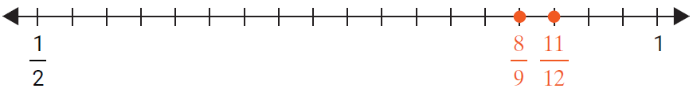
Example 2: Comparing Fractions₂
Graphing these values on a number line, we have

Slide 8
Example 3: Comparing Fractions₁
in order from smallest to
largest. Then find the difference between the smallest and the largest.
Solution
Step 1:
Step 2:

Slide 9
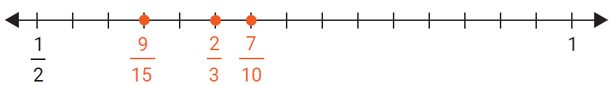
Example 3: Comparing Fractions₂
Step 3: Smallest to largest:
(since 18 < 20 < 21)
Graphically, we have
The difference between the largest and smallest

Slide 10
Properties: Rules for Order of Operations₁
1. Simplify within grouping symbols, such as parentheses ( ), brackets [ ], or braces { }. (If there are more than one pair of grouping symbols, start with the innermost grouping symbols.)
2. Evaluate any exponential expressions.

Slide 11
Properties: Rules for Order of Operations₂
3. Moving from left to right, perform any multiplications or divisions in the order in which they appear.
4. Moving from left to right, perform any additions or subtractions in the order in which they appear.

Slide 12
Example 4: Using the Order of Operations with Fractions₁
Evaluate the expression:
Solution

Slide 13
Example 4: Using the Order of Operations with Fractions₂

Slide 14
Example 5: Using the Order of Operations with Fractions₁
Solution

Slide 15
Example 5: Using the Order of Operations with Fractions₂

Slide 16
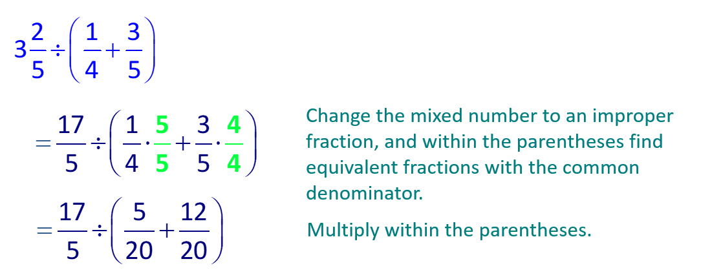
Example 6: Using the Order of Operations with Fractions₁
Solution

Slide 17
Example 6: Order of Operations with Fractions₂

Slide 18
Example 7: Using the Order of Operations
Solution

Slide 19
Example 8: Finding the Average₁
Solution
Finding the average is the same as evaluating the expression

Slide 20
Example 8: Finding the Average₂
Find the sum first. The LCD = 8.

Slide 21
Example 8: Finding the Average₃
Now divide by 3.

