Slide 1
Section 2.R.2
Decimal Numbers and Fractions

Slide 2
Objectives
Change decimal numbers to fractions.
Change fractions to decimal numbers.
Simplify expressions with both decimal numbers and fractions.
Notes:
2

Slide 3
Procedure: To Change from Decimal Numbers to Fractions
A decimal number less than 1 (digits are to the right of the decimal point) can be written in fraction form by writing a fraction with:
1. A numerator that consists of the whole number formed by all the digits of the decimal number to the right of the decimal point, and
2. A denominator that is the power of 10 that corresponds to the rightmost digit. (For example, a denominator of 100 corresponds to hundredths.)

Slide 4
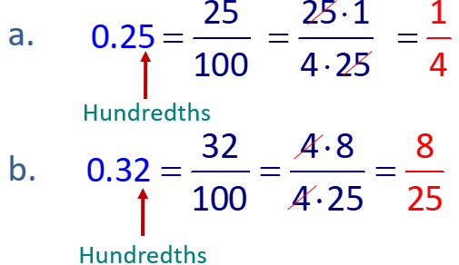
Example 1: Changing Decimal Numbers to Fractions
Change each decimal number to a fraction in lowest terms.
a. 0.25, b. 0.32
Solution

Slide 5
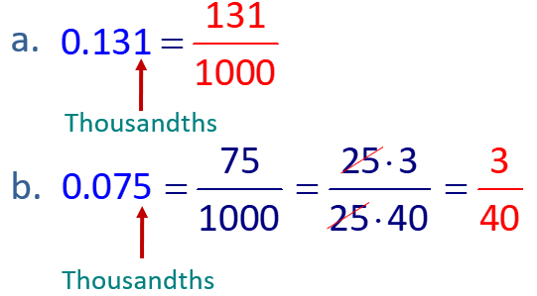
Example 2: Changing Decimal Numbers to Fractions
Change each decimal number to a fraction in lowest terms.
a. 0.131, b. 0.075
Solution

Slide 6
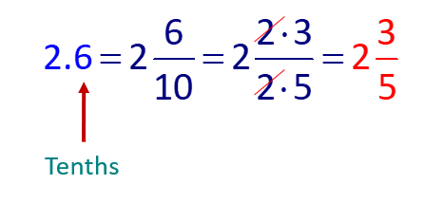
Example 3: Changing Decimal Numbers to Fractions
Change 2.6 to a mixed number with the fraction in lowest terms.
Solution
As a mixed number,

Slide 7
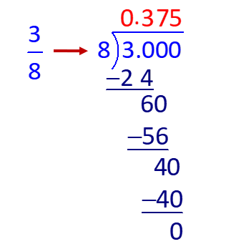
Example 4: Changing Fractions to Decimal Numbers
Solution

Slide 8
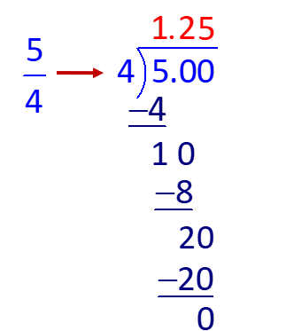
Example 5: Changing Fractions to Decimal Numbers
Solution

Slide 9
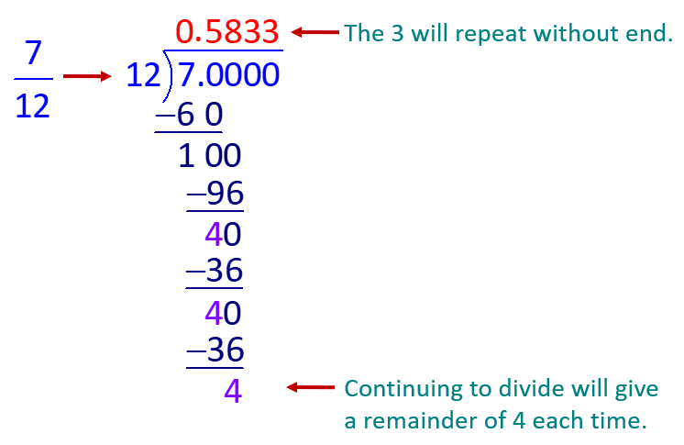
Example 6: Changing Fractions to Decimal Number₁
Solution

Slide 10
Example 6: Changing Fractions to Decimal Number₂
We write
where the three dots (called an ellipsis) mean “and so on” or to continue the pattern without stopping. Or, if we agree to round, we can write
(to the
nearest thousandth).

Slide 11
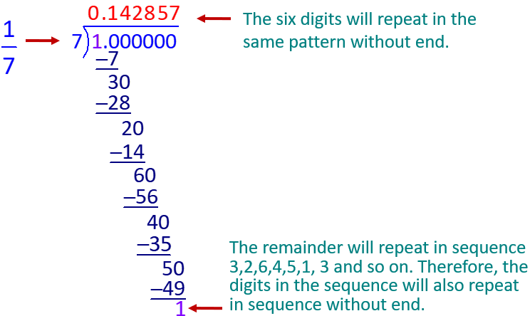
Example 7: Changing Fractions to Decimal Number
Solution
We write

Slide 12
Example 8: Simplifying Expressions with Decimals and Fractions
Solution

Slide 13
Example 9: Comparing Decimal Numbers and Fractions₁
Determine which is larger,
is the larger number?
Solution
to decimal form.

Slide 14
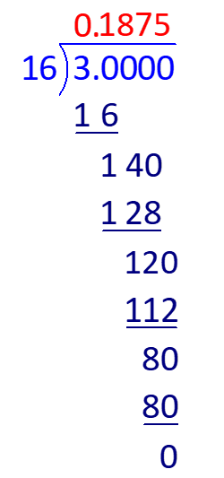
Example 9: Comparing Decimal Numbers and Fractions₂

Slide 15
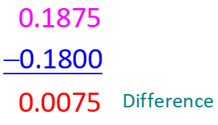
Example 9: Comparing Decimal Numbers and Fractions₃
Comparing, we see that 0.1875 is larger than 0.18. Now subtract the smaller number from the larger number.

Slide 16
Example 10: Application: Decimal and Fraction Expressions₁
An auto mechanic charges $35.60 per hour of labor. How much would he charge for a job which would take
hours of labor and required $273.49 for parts?
Solution
Step 1: READ: Read the problem carefully. In this case, we need to combine his charge for labor with the cost of the parts.

Slide 17
Example 10: Application: Decimal and Fraction Expressions₂
Step 2: SET UP: To find the charge for labor, multiply the cost per hour times the number of hours:
Then add the cost of the parts: $273.49

Slide 18
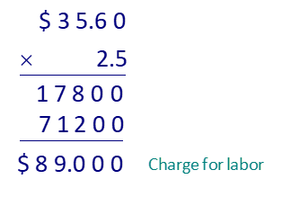
Example 10: Application: Decimal and Fraction Expressions₃
Step 3:
and multiply by $35.60.

Slide 19
Example 10: Application: Decimal and Fraction Expressions₄
Now add the cost of the parts to the cost of labor.
The total charge for the job would be $362.49.

Slide 20
Example 10: Application: Decimal and Fraction Expressions₅
Step 4: CHECK: The cost of labor per hour is approximately $40. This means that
hours of labor will cost approximately $100. Considering that the parts alone cost $273.49, the answer of $362.49 seems reasonable.

