Slide 1
Section 2.R.1
Introduction to Fractions and Mixed Numbers

Slide 2
Objectives
Understand the basic concepts of fractions.
Graph fractions on a number line.
Understand the basic concepts of mixed numbers.
Graph mixed numbers on a number line.
Change mixed numbers to improper fractions.
Change improper fractions to mixed numbers.

Slide 3
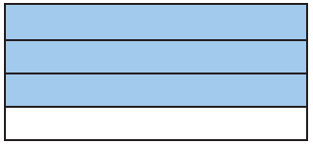
Example 1: Understanding Fractions
Write a fraction indicating
a. the shaded part of the rectangle and
b. the unshaded part of the rectangle.
Solution

Slide 4
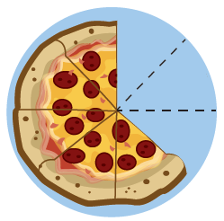
Example 2: Understanding Fractions
Write a fraction indicating
a. the remaining portion of the pizza and
b. the missing portion of the pizza.
Solution

Slide 5
Definition: Proper Fractions and Improper Fractions₁
A proper fraction is a fraction in which the numerator
is less than the denominator. (Proper fractions have
values less than 1.)
Examples of proper fractions:

Slide 6
Definition: Proper Fractions and Improper Fractions₂
An improper fraction is a fraction in which the
numerator is greater than or equal to the
denominator. (Improper fractions have values greater
than or equal to 1.)
Examples of improper fractions:

Slide 7
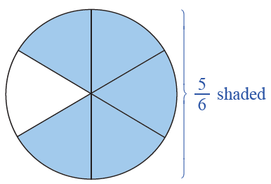
Example 3: Understanding Proper Fractions
Draw a figure to represent the fraction
Solution
represent this fraction, we divide a circle into 6 equal sections and shade 5 of them. (Note: Figures other than circles can be used.)

Slide 8
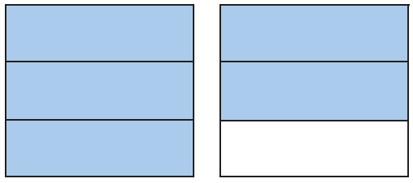
Example 4: Understanding Improper Fractions
Write a fraction that indicates the shaded parts of the figure.
Solution
There are two squares, each separated into 3 equal parts.
This means that the denominator is 3. The shading here indicates 5 of these equal parts, which means the numerator is 5. Thus, the shaded part of the figure can
be represented by the improper fraction

Slide 9
Definition: Variable
A variable is a symbol (generally a letter of the alphabet) that is used to represent an unknown number.

Slide 10
Definition: The Number 0 in Fractions

Slide 11
Example 5: Evaluating Fractions Involving 0
Find the value of each expression.
Solution

Slide 12
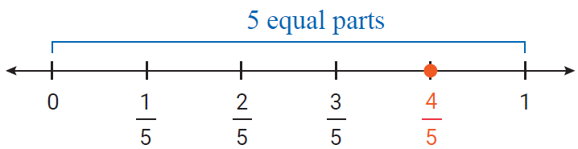
Example 6: Graphing Proper Fractions₁
Graph each proper fraction on a number line.
Solution
a.

Slide 13
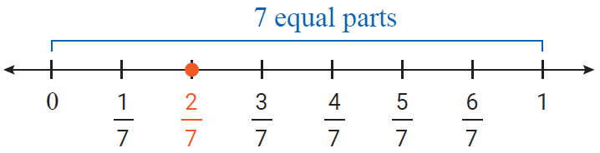
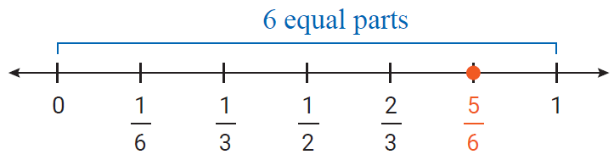
Example 6: Graphing Proper Fractions₂

Slide 14
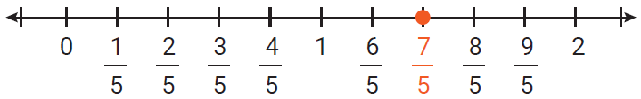
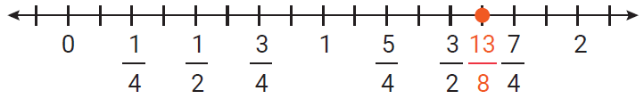
Example 7: Graphing improper Fractions
Graph each of the following improper fractions on a number line.
Solution
a.
b.

Slide 15
Example 8: Identifying Types of Fractions and Mixed Numbers
Identify each number as a proper fraction, an improper fraction, or a mixed number.
Solution
a. improper fraction,
b. mixed number,
c. proper fraction

Slide 16
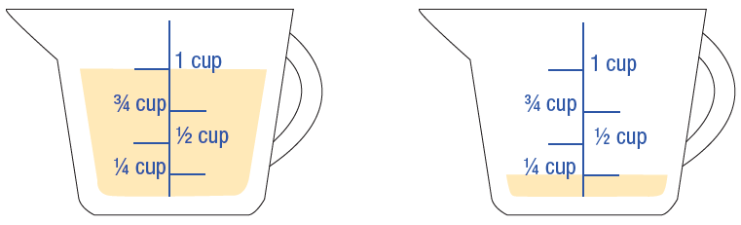
Example 9: Application: Understanding Mixed Numbers₁
A recipe calls for the amount of oil indicated in the figure.
a. Write a mixed number indicating the amount of oil in the measuring cups.
b. Write this amount as an improper fraction.

Slide 17
Example 9: Application: Understanding Mixed Numbers₂
Solution

Slide 18
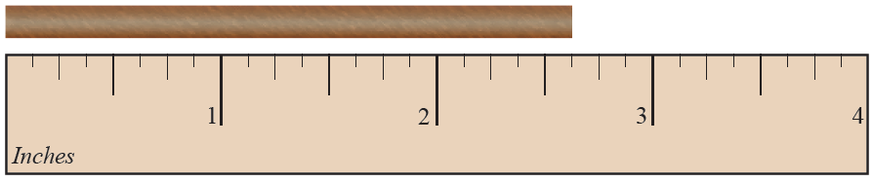
Example 10: Application: Understanding Mixed Numbers
A wooden rod is cut to the length indicated in the figure. Write the length of the rod as a mixed number.
Solution

Slide 19
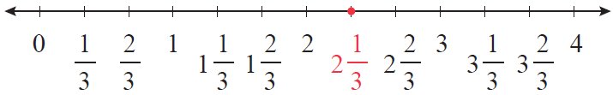
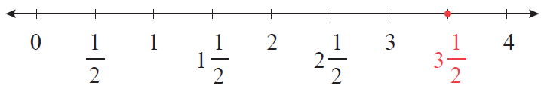
Example 11: Graphing Mixed Numbers
Graph each of the following mixed numbers on a number line.
Solution
a.
b.

Slide 20
Procedure: To Change a Mixed Number to an Improper Fraction
1. Multiply the whole number by the denominator of the proper fraction.
2. Add the numerator of the proper fraction to this product.
3. Write this sum over the denominator of the fraction.

Slide 21
Example 12: Changing Mixed Numbers to Improper Fractions
Solution
Step 1: Multiply the whole number by the denominator:
Step 2: Add the numerator: 80 + 9 = 89.
Step 3: Write this sum over the denominator:

Slide 22
Example 13: Mixed Numbers to Improper Fractions
Solution
Step 1: Multiply the whole number by the denominator:
Step 2: Add the numerator: 33 + 2 = 35
Step 3: Write this sum over the denominator:

Slide 23
Procedure: To Change an Improper Fraction to a Mixed Number
1. Divide the numerator by the denominator. The quotient is the whole number part of the mixed number.
2. Write the remainder over the denominator as the fraction part of the mixed number.

Slide 24
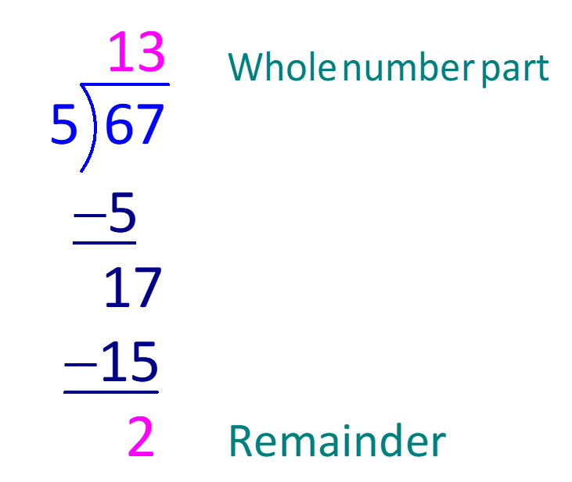
Example 14: Changing Improper Fractions to Mixed Numbers₁
Solution
Step 1:
Divide the numerator by the
denominator. The quotient
is the whole number part
of the mixed number.

Slide 25
Example 14: Changing Improper Fractions to Mixed Numbers₂
Step 2:
Write the remainder over the denominator as the fraction part of the mixed number:

Slide 26
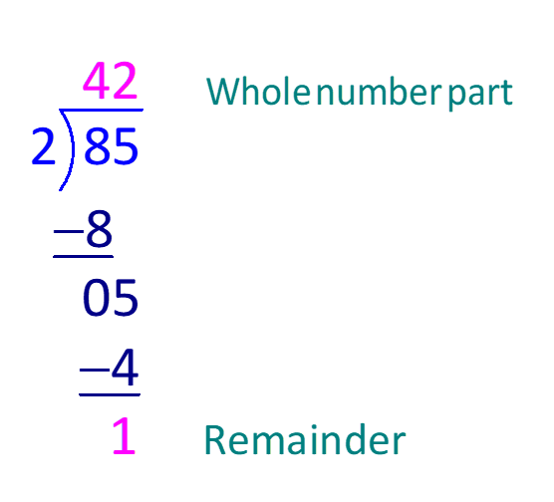
Example 15: Changing Improper Fractions to Mixed Numbers₁
Solution
Step 1: Divide the numerator by
the denominator. The quotient
is the whole number part of the
mixed number.

Slide 27
Example 15: Changing Improper Fractions to Mixed Numbers₂
Step 2:
Write the remainder over the denominator as the fraction part of the mixed number:

