Slide 1
Section 1.R.4
Decimals and Percents

Slide 2
Objectives
Understand percents.
Change decimal numbers to percents.
Change percents to decimal numbers.
Notes:
2

Slide 3
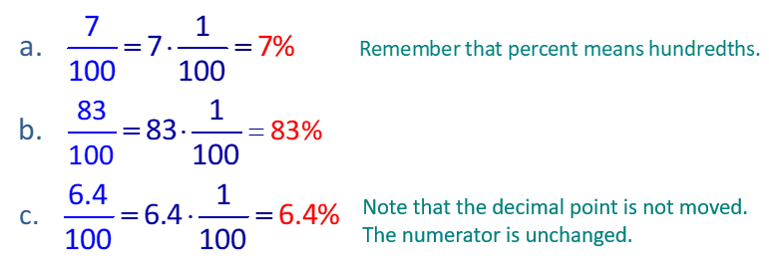
Example 1: Changing Fractions with Denominators of 100 to Percents₁
Change each fraction to a percent.

Slide 4
Example 1: Changing Fractions with Denominators of 100 to Percents₂

Slide 5
Procedure: To Change a Decimal Number to a Percent
1. Move the decimal point two places to the right.
2. Write the % sign.

Slide 6
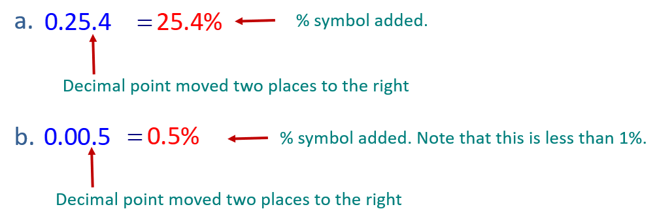
Example 2: Changing Decimal Numbers to Percents₁
Change each decimal number to percent.
Solution

Slide 7
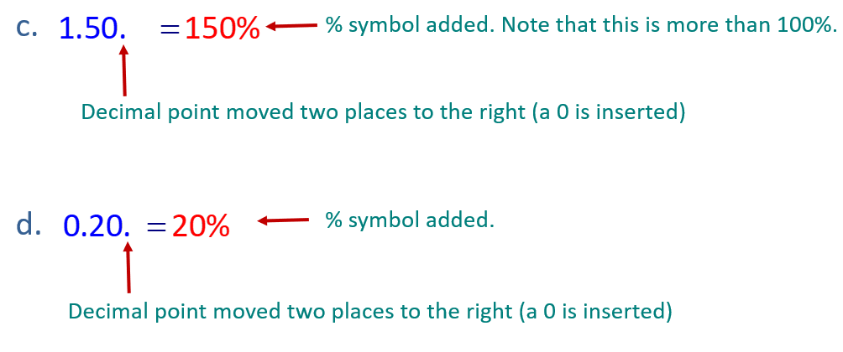
Example 2: Changing Decimal Numbers to Percents₂

Slide 8
Procedure: To Change a Percent to a Decimal Number
1. Move the decimal point two places to the left.
2. Delete the % sign.

Slide 9
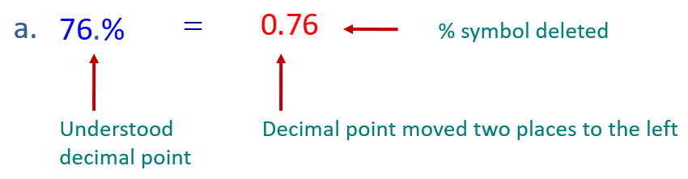
Example 3: Changing Percents to Decimal Numbers₁
Change each percent to a decimal number.

Slide 10
Example 3: Changing Percents to Decimal Numbers₂
Note that when moving the decimal point two places to the left, two zeros were added as placeholders.

Slide 11
Definition: Relationships Between Decimal Numbers and Percents
A decimal number that is
a. less than 0.01 is less than 1%.
b. between 0.01 and 0.10 is between 1% and 10%.
c. between 0.10 and 1.00 is between 10% and 100%.
d. more than 1 is more than 100%.

