Slide 1
Section 1.R.3
Estimating and Order of Operations with Decimal Numbers

Slide 2
Objectives
Estimate sums and differences with rounded decimal numbers.
Estimate products and quotients with rounded decimal numbers.
Use the order of operations to simplify expressions containing decimal numbers.
Notes:
2

Slide 3
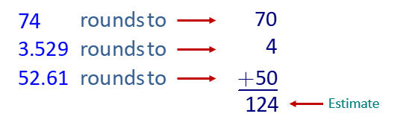
Example 1: Estimating Sums of Decimal Numbers₁
Estimate the sum; then find the actual sum.
74 + 3.59 + 52.61
Solution
First, estimate by adding rounded numbers.

Slide 4
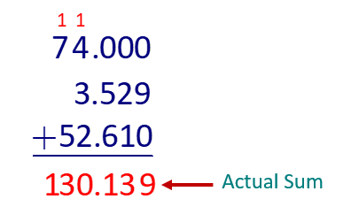
Example 1: Estimating Sums of Decimal Numbers₂
Now, find the actual sum.

Slide 5
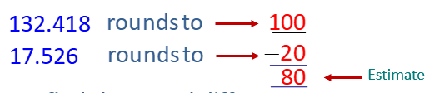
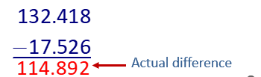
Example 2: Estimating Differences of Decimal Numbers
Estimate the difference; then find the actual difference.
132.418 − 17.56
Solution
First, estimate by subtracting rounded numbers.
Now, find the actual difference.

Slide 6
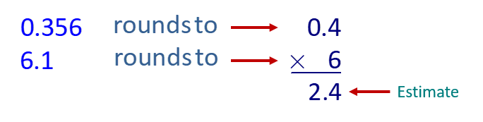
Example 3: Estimating Products of Decimal Numbers₁
Estimate the product; then find the actual product.
Solution
First, estimate by multiplying rounded numbers.

Slide 7
Example 3: Estimating Products of Decimal Numbers₂
Now, find the actual product and use the estimation to help place the decimal point.
The estimated product, 2.4, helps verify that we placed the decimal point correctly in the product, 2.1716 since both numbers are close to 2.

Slide 8
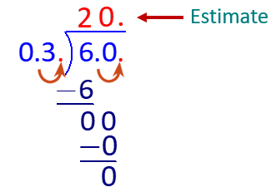
Example 4: Estimating Quotients of Decimal Numbers₁
Estimate the quotient; then find the actual quotient to the nearest hundredth.
6.2 ÷ 0.302
Solution
First, estimate by dividing rounded numbers. (6.2 rounds to 6 and 0.302 rounds to 0.3.)

Slide 9
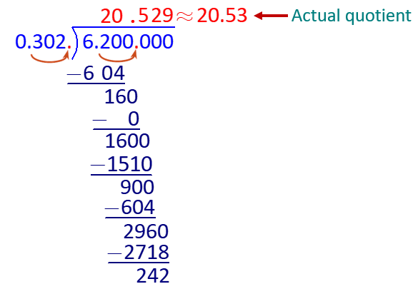
Example 4: Estimating Quotients of Decimal Numbers₂
Now, find the actual quotient to the nearest hundredth.
The estimated value, 20, is very close to the rounded quotient, 20.53, so we can be confident in the accuracy of our calculations.

Slide 10
Example 5 Application: Estimating with Decimal Numbers₁
You can buy a car for $15,000 cash or you can make a down payment of $3750 and then pay $1093.33 each month for 12 months. How much can you save by
paying cash?
Solution
Step 1: Find the amount paid in monthly payments by multiplying the amount of each payment by 12. In this case, judgment dictates that we use 12 and do not round to 10, since we do not want to lose two full monthly payments in our estimate.

Slide 11
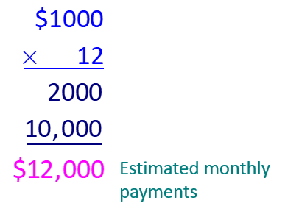
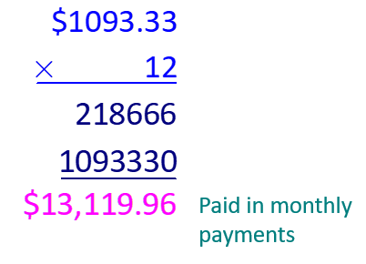
Example 5 Application: Estimating with Decimal Numbers₂
Estimate
Actual Amount

Slide 12
Example 5 Application: Estimating with Decimal Numbers₃
Step 2: Find the total amount paid by adding the down payment to the answer in Step 1.
Estimate
Actual Amount

Slide 13
Example 5 Application: Estimating with Decimal Numbers₄
Step 3: Find the savings by subtracting $15,000 (the cash price) from the answer to Step 2.
Estimate
Actual Amount
Thus, you can save $1869.96 by paying cash.

Slide 14
Example 5 Application: Estimating with Decimal Numbers₅
Check
The estimated $1000 saved by paying cash is reasonably close to the actual savings of $1869.96, so we can be confident in the accuracy of our calculations. The amount saved by paying cash is also a reasonable portion of the total price of the car.

Slide 15
Example 6: Using the Order of Operations with Decimal Numbers
Simplify:
Solution

Slide 16
Example 7: Using the Order of Operations with Decimal Numbers
Simplify:
Solution
Solution

