Slide 1
Section 1.R.2
Introduction to Decimal Numbers

Slide 2
Objectives
Read and write decimal numbers.
Compare decimal numbers.
Round decimal numbers.

Slide 3
Procedure: To Read or Write a Decimal Number
1. Read (or write) the whole number.
2. Read (or write) the word “and” in place of the decimal point.
3. Read (or write) the fraction part as a whole number. Then, name the fraction part with the name of the place of the last digit on the right.

Slide 4
Note
If there is no whole number part, then 0 can be written to the left of the decimal point.
For example, .6 can be written as 0.6 and in most cases 0.6 is preferred.

Slide 5
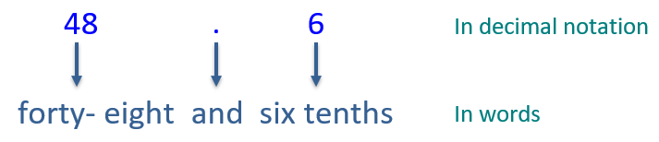
Example 1: Reading and Writing Decimal Numbers
in decimal notation and
Write the mixed number
in words.
Solution
And indicates the decimal point; the digit 6 is in the tenths position.

Slide 6
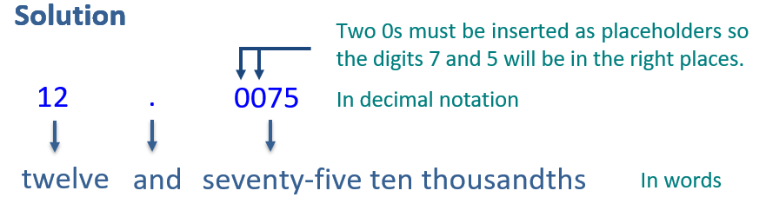
Example 2: Reading and Writing Decimal Numbers
And indicates the decimal point; the digit 5 is in the ten-thousandths position.

Slide 7
Attention!
The letters ths (or th) at the end of a word indicate a fraction part (a part to the right of the decimal point).
six hundred = 600 two hundred thousand = 200,000
six hundredths = 0.06 two hundred-thousandths = 0.00002

Slide 8
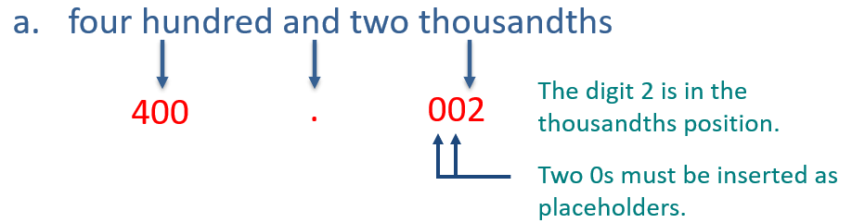
Example 3: Reading and Writing Decimal Numbers₁
Write each number in decimal notation. Note how and indicates the decimal point.
a. four hundred and two thousandths
b. four hundred two thousandths
Solution

Slide 9
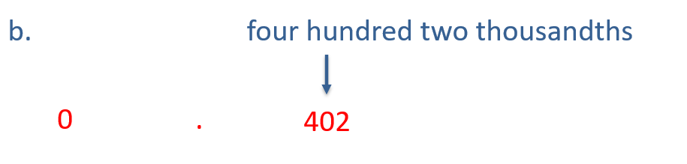
Example 3: Reading and Writing Decimal Numbers₂

Slide 10
Procedure: To Compare Two Decimal Numbers
1. Moving left to right, compare digits with the same place value. (Insert 0s to the right to continue comparison if necessary.)
2. When one compared digit is larger, then the corresponding number is larger.

Slide 11
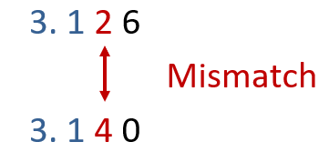
Example 4: Comparing Decimal Numbers₁
Which number is larger: 3.126 or 3.14?
Solution
Comparing digits with the same place value from left to right (until we find a mismatch) gives the following.
Because 4 > 2, the number 3.14 is greater than 3.126. That is, 3.14 > 3.126.

Slide 12
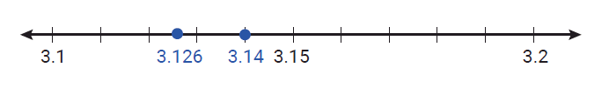
Example 4: Comparing Decimal Numbers₂
Graphing these values on a number line,
we have 3.14 > 3.126 and 3.14 lies to the right of 3.126.

Slide 13
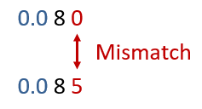
Example 5: Comparing Decimal Numbers₁
Which number is larger: 0.08 or 0.085?
Solution
Comparing digits with the same place value from left to right (until we find a mismatch) gives the following.
Because 5 > 0, we know that 0.085 > 0.08.

Slide 14

Example 5: Comparing Decimal Numbers₂
Graphing these values on a number line,
we have 0.085 > 0.08 and 0.085 lies to the right of 0.08.

Slide 15
Example 6: Comparing Decimal Numbers₁
Arrange the following three decimal numbers in order from smallest to largest: 6.67, 5.14, 6.28. Then, graph them on a number line.
Solution
Comparing digits with the same place value in 6.67, 5.14, and 6.28 (from left to right) gives the following.
In the ones place, 5 < 6 so 5.14 is smaller than both 6.67 and 6.28.
Then, in the tenths place, 2 < 6 so 6.28 is smaller than 6.67.

Slide 16

Example 6: Comparing Decimal Numbers₂
Thus, from smallest to largest, the numbers are 5.14, 6.28, 6.67.
Graphing the numbers on a number line, we have the following.

Slide 17
Procedure: Rounding Rule for Decimal Numbers₁
1. Look at the single digit one place value to the right of the digit in the place of desired accuracy.
a.͏ If this digit is less than 5, leave the digit in the desired place of accuracy as it is and replace all digits to the right with zeros. All digits to the left remain unchanged.
b. ͏If this digit is 5 or greater, increase the digit in the desired place of accuracy by one and replace all digits to the right with zeros. All digits to the left remain unchanged unless a 9 is made one larger. Then, the 9 is replaced by 0 and the next digit to the left is increased by 1.

Slide 18
Procedure: Rounding Rule for Decimal Numbers₂
2. Zeros to the right of the place of accuracy that are also to the right of the decimal point must be dropped. In this way, the place of accuracy is clearly understood. If a rounded number has a 0 in the desired place of accuracy, then that 0 remains.

Slide 19
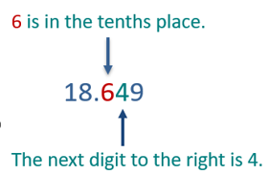
Example 7: Rounding Decimal Numbers
Round 18.649 to the nearest tenth.
Solution
Since 4 is less than 5, leave the 6 and replace 4 and 9 with 0s.
Now, the 6 is to the right of the decimal point and the 0s to the right of the 6 in 18.600 are dropped so t hat the place of accuracy is indicated by the 6.
Thus, 18.649 rounds to 18.6 to the nearest tenth.

Slide 20
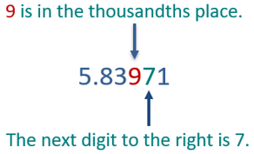
Example 8: Rounding Decimal Numbers
Round 5.83971 to the nearest thousandth.
Solution
Since 7 is greater than 5, increase 9 by one and replace 7 and 1 with 0s. (Increasing 9 by one gives 10, which affects the digit 3 as well.)
Thus, 5.83971 rounds to 5.840 to the nearest thousandth, and only two 0s are dropped.

Slide 21
Example 9: Rounding Decimal Numbers
Round 0.6753 to the nearest hundredth.
Solution
The digit in the hundredths position is 7.
The next digit to the right is 5.
Since 5 is greater than or equal to 5, change the 7 to 8 and replace 5 and 3 with 0s.
So, 0.6753 rounds to 0.68 to the nearest hundredth (with two 0s dropped).

