Slide 1
Section 1.R.1
Problem Solving with Whole Numbers

Slide 2
Objectives
Solve problems by using the basic strategy for solving word problems.
Solve word problems involving consumer applications.
Solve word problems involving geometric applications.
Solve word problems by finding the average of a set of numbers.

Slide 3
Procedure: Basic Strategy for Solving Word Problems
1. READ: Read the problem carefully.
2. SET UP: Draw any type of figure or diagram that might be helpful and decide what operations are needed.
3. SOLVE: Perform the operations to solve the problem.
4. CHECK: Check your work and check that your answer seems reasonable.

Slide 4
Example 1: Application: Adding Whole Numbers₁
Mary Ann is finalizing her spring break plans. First, she plans to visit her grandma, who lives 288 miles away. Then she plans to drive 145 miles to the beach and spend a couple days with her boyfriend before driving 203 miles home. How many total miles will Mary Ann drive on her spring break road trip?
Solution
Step 1: READ: Read the problem carefully. The key word total indicates addition.

Slide 5
Example 1: Application: Adding Whole Numbers₂
Step 2: SET UP: In this problem, the three amounts to be added are 288 miles, 145 miles, and 203 miles or
288 + 145 + 203 = total miles.
Step 3: SOLVE:
Total miles driven
Mary Ann will drive a total of 636 miles.

Slide 6
Example 1: Application: Adding Whole Numbers₃
Step 4: CHECK: Mary Ann will drive about 300 miles to her grandma’s house, 100 miles to the beach, and 200 miles home and
300 + 100 + 200 = 600,
so a total of 636 miles seems reasonable.

Slide 7
Example 2: Application: Multiplying Whole Numbers₁
The owner of a semi-pro baseball team orders baseballs from the manufacturer at the beginning of the season. The team is scheduled to play 32 games and they anticipate using 8 new baseballs each game. How many baseballs should the owner buy?
Solution
Step 1: READ: Read the problem carefully. The order for the entire season is found by multiplication.

Slide 8
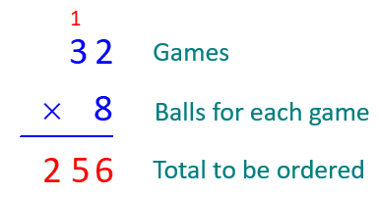
Example 2: Application: Multiplying Whole Numbers₂
Step 2: SET UP: To find the total number of baseballs to be ordered, multiply the number of games by the number of balls to be used in each game.
32 ⋅ 8 = total number of baseballs
Step 3: SOLVE:
The owner should order 256 baseballs for the season.

Slide 9
Example 2: Application: Multiplying Whole Numbers₃
Step 4: CHECK: The team plays about 30 games and uses about 10 balls per game and
30 ⋅ 10 = 300,
so a total order of 256 balls seems reasonable.

Slide 10
Example 3: Application: Dividing Whole Numbers₁
Nineteen friends and neighbors decided to buy tickets to a basketball game with the LA Lakers playing the Boston Celtics. Because they were buying a large number of tickets they got a special group price of $1558. If they decided to divide the amount equally, what did each of them pay for a ticket?
Solution
Step 1: READ: Read the problem carefully. The key word is divide (in the phrase "divide the amount equally").

Slide 11
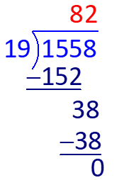
Example 3: Application: Dividing Whole Numbers₂
Step 2: SET UP: The amount to be divided equally among the 19 people is $1558. So the group price is to be divided by 19.
1558 ÷ 19 = price per ticket
Step 3: SOLVE:
Each person paid $82 for a ticket.

Slide 12
Example 3: Application: Dividing Whole Numbers₃
Step 4: CHECK: Because there are almost 20 people in the group and 20 ⋅ 80 = 1600, the individual price of $82 seems reasonable. This can be checked directly by multiplication.
19 ⋅ $82 = $1558

Slide 13
Example 4: Application: Calculating Loan Amounts₁
Mr. Lukin bought a used car for $8000. Taxes of $640 and license fees of $320 were then added to the purchase price. He made a down payment of $2000 and financed the rest through his credit union. What was the amount of his loan from the credit union?
Solution
READ: Read the problem carefully. Mr. Lukin’s expenses are given and he made a down payment. One key word is added (indicated the sum of the price, taxes, and license fees).

Slide 14
Example 4: Application: Calculating Loan Amounts₂
Then we need to realize a down payment is subtracted from the expenses. This difference will be the loan amount.
Step 2: SET UP: In this problem, find the total of the expenses by adding the price, the taxes, and the license fees.
$8000 + $640 + $320 = total expenses
Then subtract the down payment ($2000).
The result will be the amount of the loan.

Slide 15
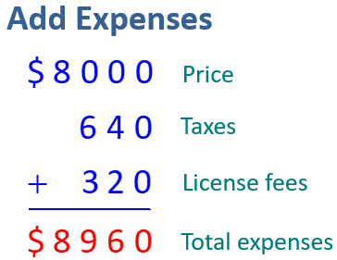
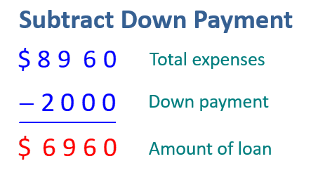
Example 4: Application: Calculating Loan Amounts₃
Step 3:
SOLVE:
After a down payment of $2000, Mr. Lukin's loan will be $6960.

Slide 16
Example 4: Application: Calculating Loan Amounts₄
Step 4: CHECK: With a price of $8000 and a down payment of $2000, the loan amount should be close to $6000. Because of the extra fees, the actual loan amount of $6960 seems reasonable.

Slide 17
Example 5: Application: Balancing a Checking Account₁
In January, Kathleen opened a checking account and deposited $2500. During the month, she made another deposit of $800 and made debit card purchases of $132, $425, $196, and $350. What was the balance in her account at the end of the month?
Solution
Step 1: READ: Read the problem carefully. To balance a checking account, the total of the debit card purchases is subtracted from the total of the deposits.

Slide 18
Example 5: Application: Balancing a Checking Account₂
Step 2: SET UP: There are two deposits to be added ($2500 and $800). The total of the debit card purchases ($132, $425, $196, and $350) is subtracted from the deposits. The result will be the balance at the end of the month.

Slide 19
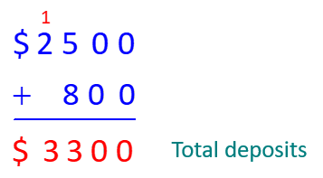
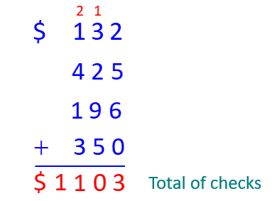
Example 5: Application: Balancing a Checking Account₃
Step 3:
SOLVE:
Total Deposits
Total Debit Card Purchases
Now subtract to find the balance.

Slide 20
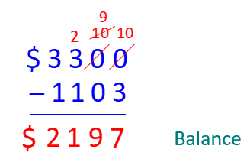
Example 5: Application: Balancing a Checking Account₄
Kathleen's balance is $2197.
Step 4: CHECK: The deposits are about $3000 and the checks are about $1000. So, a balance of $2197 is reasonable.

Slide 21
Example 6: Application: Finding the Area of Rectangles₁
A rectangular picture is mounted in a rectangular frame. If the size of picture (inside the frame) is 14 inches by 20 inches and the frame is 16 inches by 22 inches, what is the area of the frame?
Solution
Step 1: READ: Read the problem carefully. Remember that the area of a rectangle is found by multiplying length times width.
Step 2: SET UP: In this case, a figure is very helpful. Include the dimensions of the rectangles.

Slide 22
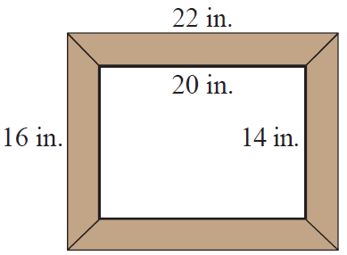
Example 6: Application: Finding the Area of Rectangles₂
Find the area of the larger rectangle (the picture and frame) by multiplying 16 ⋅ 22. Then find the area of the smaller rectangle (just the picture) by multiplying 14 ⋅ 20. The area of the frame will be the difference between the two areas.14 ⋅ 16

Slide 23
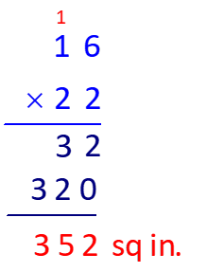
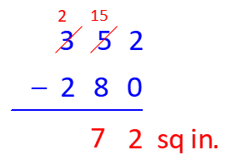
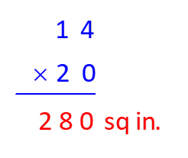
Example 6: Application: Finding the Area of Rectangles₃
Step 3: SOLVE:
Larger Area
Smaller Area
Area of Frame
The area of the frame is 72 sq in.

Slide 24
Example 6: Application: Finding the Area of Rectangles₄
Step 4: CHECK: An area of 72 sq in. for the frame seems reasonable. The area of the picture itself is not much different from the area of the outer rectangle.

Slide 25
Procedure: To Find the Average of a Set of Numbers
1. Find the sum of the given set of numbers.
2. Divide this sum by the number of numbers in the set. This quotient is called the average of the given set of numbers.

Slide 26
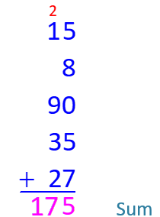
Example 7: Calculating an Average₁
Find the average of the following set of numbers: 15, 8, 90, 35, 27.
Solution
Step 1: First, find the sum of the numbers.

Slide 27
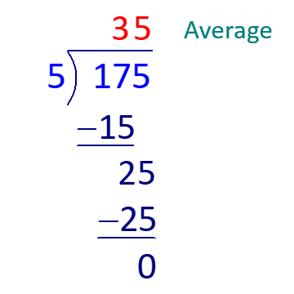
Example 7: Calculating an Average₂
Step 2: Now, divide the sum by 5, since we have a list of five numbers.
The average of the set of numbers is 35.

Slide 28
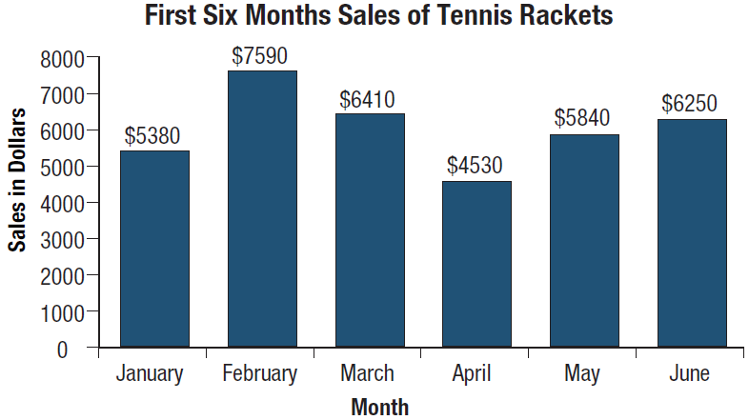
Example 8: Application: Calculating an Average₁
Top-Notch Sporting Goods recorded its profits for tennis rackets for six months. The following bar graph indicates the profits for each of the months from January to June.

Slide 29
Example 8: Application: Calculating an Average₂
a. What month had the highest profits?
b. What month had the lowest profits?
c. What is the average monthly profit over the six months?
Solution
a. From the bar graph, we can see that the month with the highest profits was February with $7590.
b. April was the month with the lowest profits with $4530.

Slide 30
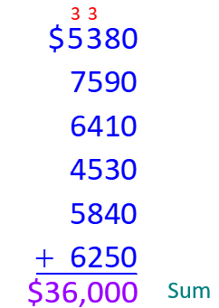
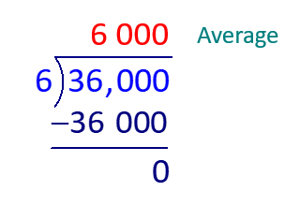
Example 8: Application: Calculating an Average₃
c. The average monthly profit can be found by finding the sum of the profits for each month and dividing by 6.
Add profits
Divide by 6

Slide 31
Example 8: Application: Calculating an Average₄
The average monthly profit for the six months was $6000 per month.
(In this case, we see that the average can be very useful. The store manager can use the monthly profits for planning and budgeting.)

Slide 32
Example 9: Application: Calculating an Average₁
Five people in a survey reported the following incomes for one year: $35,000; $41,000; $58,000; $72,000; $214,000. What was the average annual income for these five people?

Slide 33
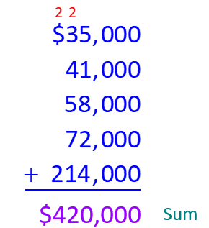
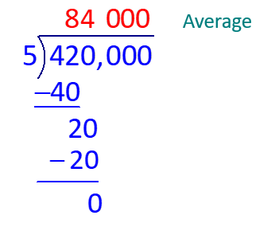
Example 9: Application: Calculating an Average₂
Solution
Add incomes
Divide by 5
The average annual income was $84,000.

Slide 34
Example 9: Application: Calculating an Average₃
Note: Because of one large income, the average income was much higher than the income of the other four people. Judging the importance of an average, particularly in a case like this, is up to the reader of the information.

Slide 35
Example 10: Application: Calculating an Average₁
On an English exam, two students scored 95, five scored 86, one scored 82, one scored 78, and six scored 75. What was the average score for the class?
Solution
There were fifteen students in the class. We can multiply as follows rather than add all fifteen scores.

Slide 36
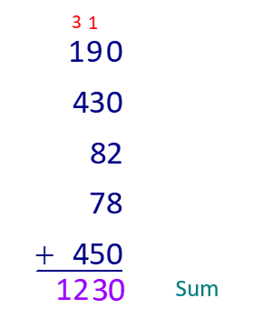
Example 10: Application: Calculating an Average₂
Next, we add the five products to find the sum of all of the scores.

Slide 37
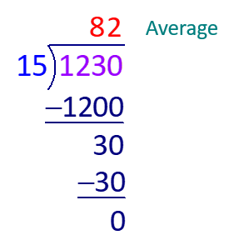
Example 10: Application: Calculating an Average₃
Finally, divide by 15 because the total represents 15 scores.
The average score for the class was 82.

