Slide 1
Section 12.R.2
Graphing Linear Equations in Two Variables

Slide 2
Objectives
Graph linear equations by plotting points on the line.
Graph linear equations by finding and plotting their x- and y-intercepts.
Graph horizontal and vertical lines.
Notes:
2

Slide 3
Definition: Standard Form of a Linear Equation
Any equation of the form
A x + B y = C,
where A, B, and C are real numbers and A and B are
not both equal to 0, is called the standard form of a
linear equation.

Slide 4
Notes: Graphing Linear Equations by Plotting Points
Note that in the standard form A x + B y = C, A and B
may be positive, negative, or 0, but A and B cannot
both equal 0.

Slide 5
Procedure: To Graph a Linear Equation in Two Variables₁
1. Locate any two points that satisfy the equation. (Choose values for x and y that lead to values that are easily calculated for the other variable. Remember that there are an infinite number of choices for either x or y. Once a value for x or y is chosen, the corresponding value for the other variable is found by substituting into the equation.)
2. Plot these two points on a Cartesian coordinate system.

Slide 6
Procedure: To Graph a Linear Equation in Two Variables₂
3. Draw a line through these two points. (Note: Every point on that line will satisfy the equation.)
4. To check: Locate a third point that satisfies the equation and check to see that it does indeed lie on the line.

Slide 7
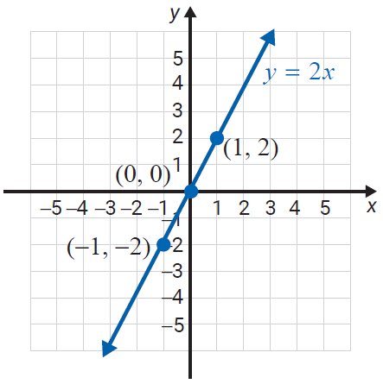
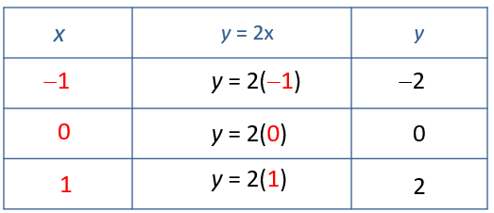
Example 1: Graphing a Linear Equation in Two Variables
Graph: y = 2x
Solution
Substitute −1, 0, and 1 for x.

Slide 8
Example 2: Graphing a Linear Equation in Two Variables₁
Graph: 2x + 3y = 6
Solution
Make a table with headings x and y and, whenever possible, choose values for x or y that lead to values that are easily calculated for the other variable. (Values chosen for x and y are colored and bolded.)

Slide 9
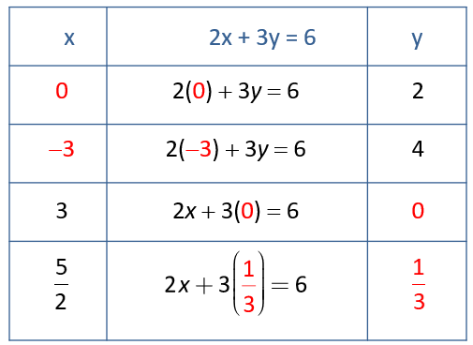
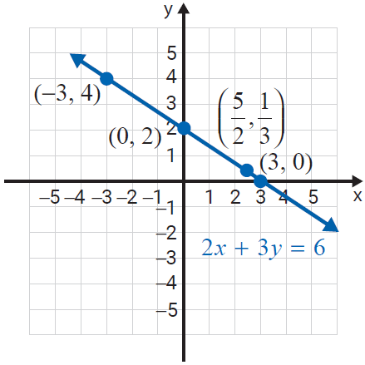
Example 2: Graphing a Linear Equation in Two Variables₂

Slide 10
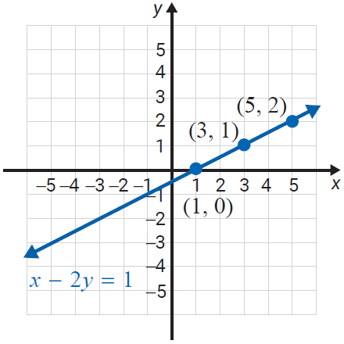
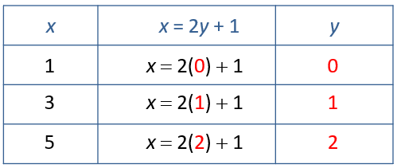
Example 3: Graphing a Linear Equation in Two Variables
Graph: x − 2y = 1
Solution
Solve the equation x = 2y + 1 for x and substitute 0, 1, and 2 for y.

Slide 11
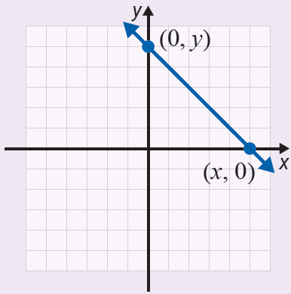
Procedure: Intercepts
1. To find the y-intercept
(where the line crosses the
y-axis), substitute x = 0
and solve for y.
2. To find the x-intercept
(where the line crosses
the x-axis), substitute
y = 0 and solve for x.

Slide 12
Notes: Using x- and y-Intercepts to Graph Linear Equations
In general, the intercepts are easy to find because substituting 0 for x or y leads to an easy solution for the other variable. However, when the intercepts result in a point with fractional (or decimal) coordinates and estimation is involved, then a third point that satisfies the equation should be found to verify that the line is graphed correctly.

Slide 13
Example 4: Using Intercepts to Graph Linear Equations₁
Graph x + 3y = 9 by locating the y-intercept and the x-intercept.
Solution
Find the y‑intercept:
Find the x‑intercept:

Slide 14
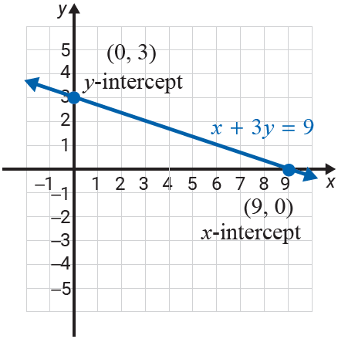
Example 4: Using Intercepts to Graph Linear Equations₂
Plot the two intercepts and draw the line that contains them.

Slide 15
Example 5: Using Intercepts to Graph Linear Equations₁
Graph 3x − 2y = 12 by locating the y-intercept and the x-intercept.
Solution
Find the y‑intercept:
Find the x‑intercept:

Slide 16
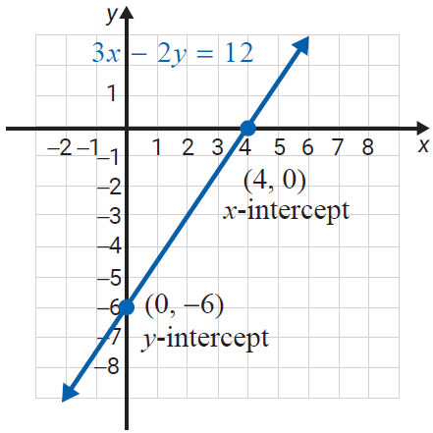
Example 5: Using Intercepts to Graph Linear Equations₂
Plot the two intercepts and draw the line that contains them.

Slide 17
Example 6: Using Intercepts to Graph Equations₁
Graph x − 5y = 5 by locating the y-intercept and the
x-intercept.
Solution
Find the y-intercept:

Slide 18
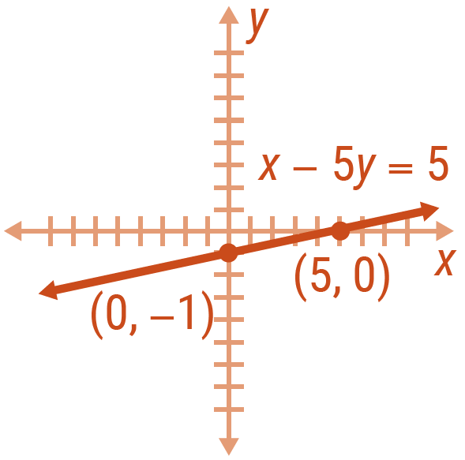
Example 6: Using Intercepts to Graph Equations₂
Find the x-intercept:
Plot the two intercepts and draw the line that
contains them.

Slide 19
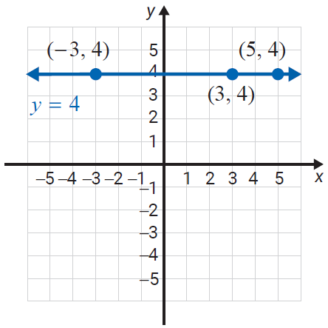
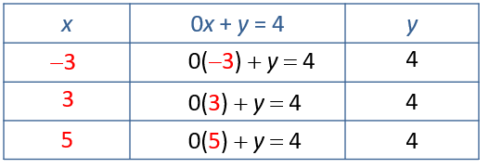
Example 7: Graphing Horizontal Lines
Graph the line y = 4 (or 0x + y = 4)
Solution
Choose three values for x; for example, −3, 3, and 5. As
indicated in the following table,
y = 4 in each case. The graph is a
horizontal line.

Slide 20
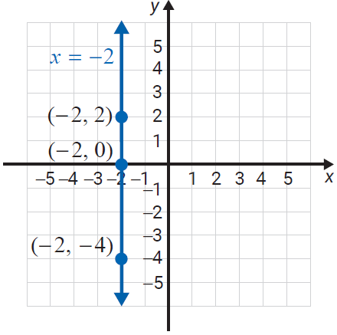
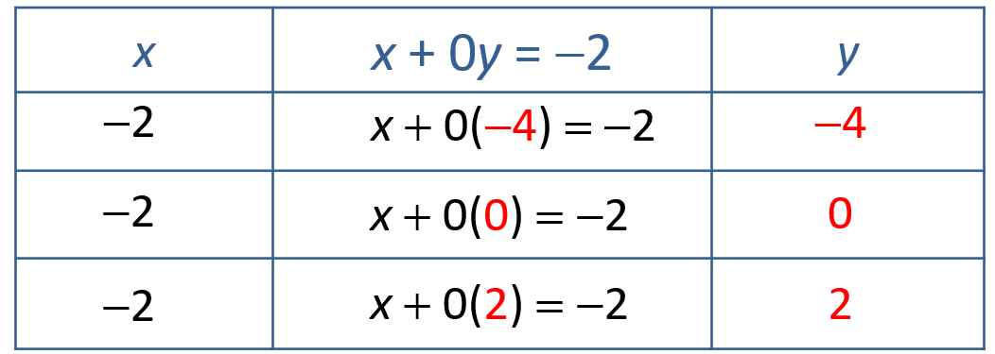
Example 8: Graphing Vertical Lines
Graph the line x = −2 (or x + 0y = −2)
Solution
Choose three values for y; for example, −4, 0, and 2. As
indicated in the following table,
x = −2 in each case. The graph is a
vertical line.

Slide 21
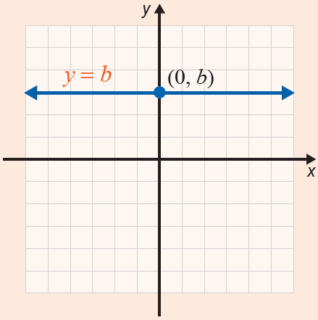
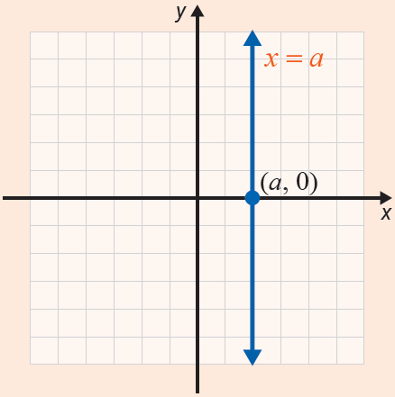
Definition: Horizontal and Vertical Lines
For real numbers a and b, the graph of
y = b is a horizontal line and x = a is a vertical line.

