Slide 1
Section 12.R.1
The Cartesian Coordinate System

Slide 2
Objectives
Relate ordered pairs of real numbers using an equation in two variables.
Plot ordered pairs of real numbers in the Cartesian coordinate system.
Find ordered pairs that satisfy a given linear equation.
Identify points on a graph.

Slide 3
Definition: One-to-One Correspondence
There is a one-to-one correspondence between points in a plane and ordered pairs of real numbers.

Slide 4
Notes: Plotting Ordered Pairs₁
Although this discussion is related to ordered pairs of real numbers, most of the examples use ordered pairs of integers. This is because ordered pairs of integers are relatively easy to locate on and read from a graph. Ordered pairs with fractions, decimals, or radicals must be located by estimating the positions of the points.

Slide 5
Notes: Plotting Ordered Pairs₂
The precise coordinates intended for such points can be difficult or impossible to read because large dots must be used so the points can be seen. Even with these difficulties, you should understand that we are discussing ordered pairs of real numbers and that points with fractions, decimals, and radicals as coordinates do exist and should be plotted by estimating their positions.

Slide 6
Example 1: Plotting Ordered Pairs₁
Plot (or graph) the set of ordered pairs.
Note: The listing of ordered pairs within the braces can be in any order.
Solution
To plot each ordered pair, start at the origin (0,0). For the x‑coordinate, move right if positive and move left if negative. For the y‑coordinate, move up if positive and move down if negative.

Slide 7
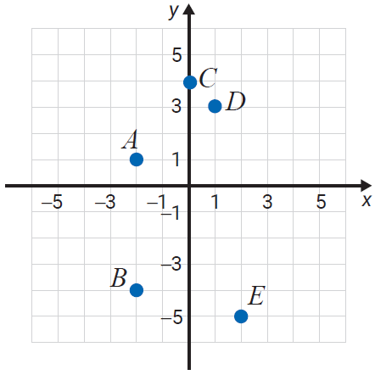
Example 1: Plotting Ordered Pairs₂
For A(−2, 1), move 2 units left and 1 unit up.
For B(−2, −4), move 2 units left
and 4 units down.
For C(0, 4), move no units left or
right and 4 units up.
For D(1, 3), move 1 unit right
and 3 units up.
For E(2, −5), move 2 units right
and 5 units down.

Slide 8
Example 2: Plotting Ordered Pairs₁
Plot (or graph) the set of ordered pairs.
Solution
To plot each ordered pair, start at the origin, and move as follows.
For A(−1,3), move 1 unit left and 3 units up.
For B(0,1), move no units left or right and 1 unit up.

Slide 9
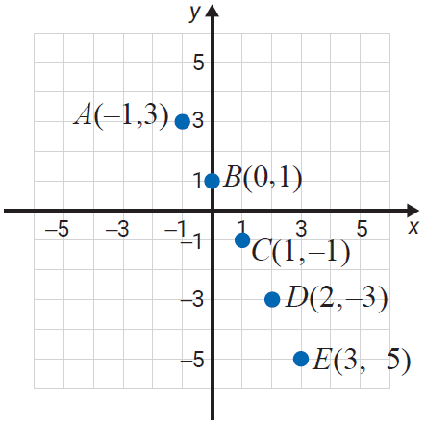
Example 2: Plotting Ordered Pairs₂
For C(1, −1), move
1 unit right and
1 unit down.
For D(2, −3), move
2 units right and
3 units down.
For E(3, −5), move
3 units right and
5 units down.

Slide 10

Example 3: Finding Ordered Pairs₁
Find the missing coordinates in the ordered pairs so that each point will satisfy the equation 2x + 3y = 12.
Solution
The missing values can be found by substituting the given values for x (or for y) into the equation 2x + 3y = 12 and solving for the other variable.

Slide 11
Example 3: Finding Ordered Pairs₂

Slide 12
Example 3: Finding Ordered Pairs₃

Slide 13
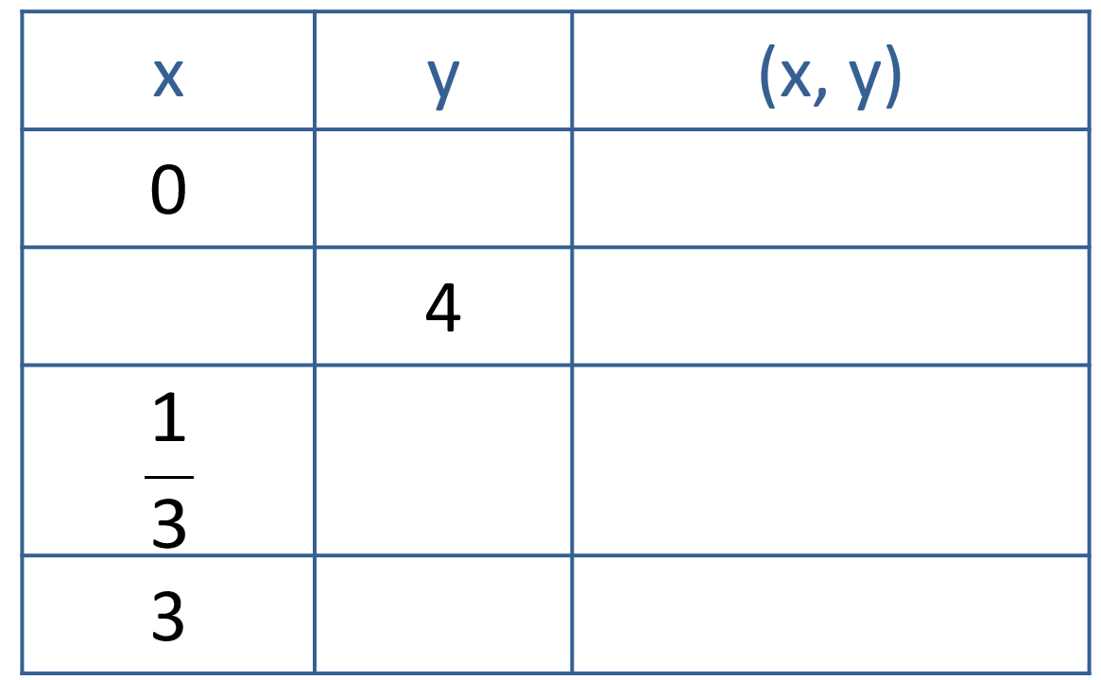
Example 4: Finding Ordered Pairs₁
Complete the table so that each ordered pair will satisfy the equation y = −3x + 1.
Solution
Substitute each given value for x or y into the equation
y = −3x + 1 to find the ordered pairs and complete the table.

Slide 14
Example 4: Finding Ordered Pairs₂

Slide 15
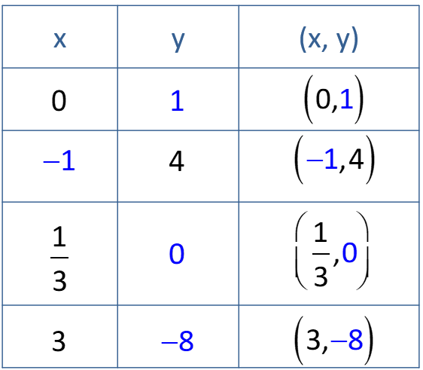
Example 4: Finding Ordered Pairs₃

Slide 16
Example 5: Determining Ordered Pairs₁
Determine which, if any, of the ordered pairs (0, −2),
satisfy the equation y = 3x − 2.
Solution
To determine whether an ordered pair is a solution to an equation, substitute the x‑coordinate for x and the y‑coordinate for y in the equation y = 3x − 2 to see if the result is a true statement.

Slide 17
Example 5: Determining Ordered Pairs₂
For the ordered pair (0, −2), let x = 0 and y = −2.
For the ordered pair

Slide 18
Example 5: Determining Ordered Pairs₃
For the ordered pair (2, 5), let x = 2 and y = 5.
So the ordered pairs
satisfy the equation, and the ordered pair (2, 5) does not.

Slide 19
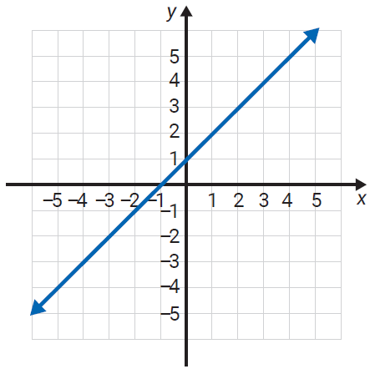
Example 6: Locating Points on the Graph of a Line₁
The graphs of two lines are given. Each line contains an infinite number of points. Use the grid to help you locate (or estimate) three points on each line.
a.
Solution
a. Three points on this graph are (−2, −1), (1, 2), and (3, 4). (Of course, there is more than one correct answer to this type of question. Use your own judgment.)

Slide 20
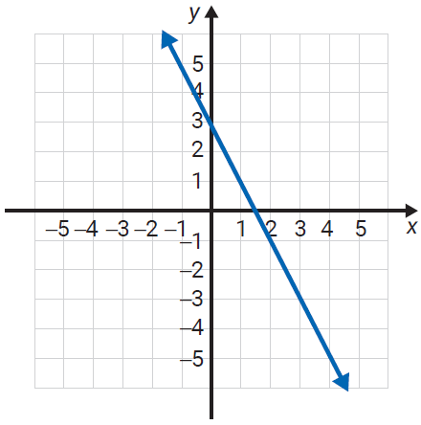
Example 6: Locating Points on the Graph of a Line₂
b.
Solution
b. Three points on this graph are (0, 3), (1, 1), and (2, −1). You may also estimate with fractions. For example, one point appears to be approximately

