Slide 1
Section 10.R.2
Applications: Scientific Notation

Slide 2
Objectives
Write decimal numbers in scientific notation.
Use scientific notation to help simplify decimal expressions.

Slide 3
Definition: Scientific Notation
If N is a decimal number, then in scientific notation
where 1 ≤ a < 10 and n is an integer.

Slide 4

Example 1: Writing Decimals in Scientific Notation₁
Write the following decimal numbers in scientific notation.
a. 8,720,000 b. 0.000000376
Solution
To check, move the decimal point 6 places to the
right and get the original number:

Slide 5
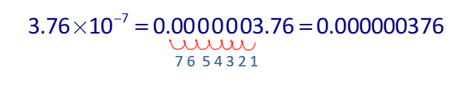
Example 1: Writing Decimals in Scientific Notation₂
To check, move the decimal point 7 places to the
left and get the original number:

Slide 6
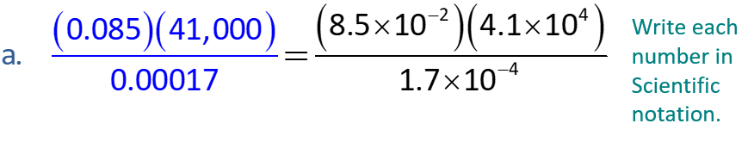
Example 2: Using Scientific Notation while Simplifying₁
Simplify the following expressions by first writing the decimal numbers in scientific notation and then using the properties of exponents.
Solution

Slide 7
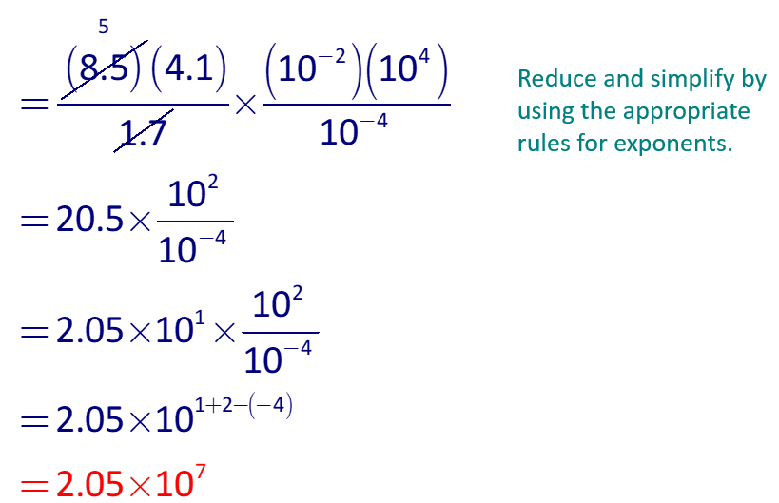
Example 2: Using Scientific Notation while Simplifying₂

Slide 8
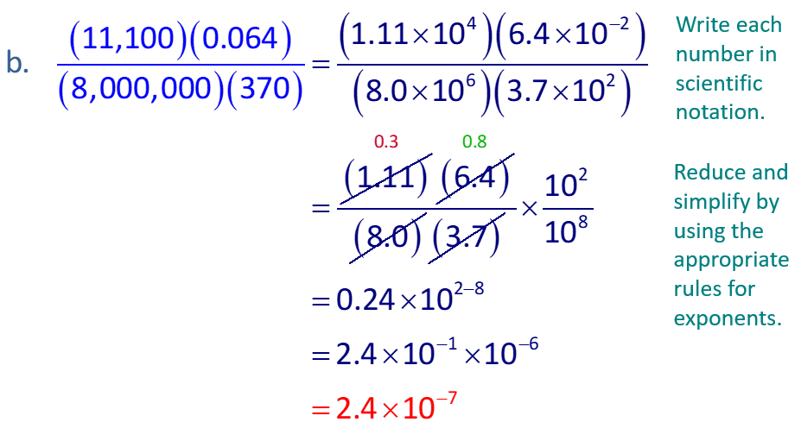
Example 2: Using Scientific Notation while Simplifying₃

Slide 9
Example 3: Application: Scientific Notation₁
meters per second.
Light travels approximately
How many meters per minute does light travel?
Solution
Since there are 60 seconds in one minute, multiply by 60.
Thus, light travels
meters per minute.

Slide 10
Example 3: Application: Scientific Notation₂
(Note: In decimal form, this is 18,000,000,000 meters
per minute. So, you can see why scientists prefer
scientific notation.)

Slide 11
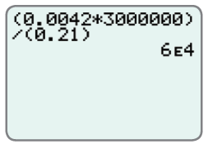
Example 4: Scientific Notation and Calculator₁
Use a graphing calculator to evaluate each expression. Leave the answer in scientific notation.
Solution
a. With a TI-84 Plus calculator (set in
scientific notation mode) the display
should appear as shown here. Note
that the E in the display indicates an
exponent with base 10.

Slide 12

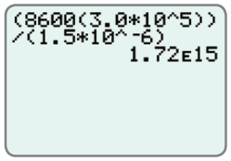
Example 4: Scientific Notation and Calculator₂
b. With a graphing calculator (set in scientific notation mode) the display should appear as shown here. Note: Remember, the caret key
is used to indicate an exponent and that the numerator and denominator must be set in parentheses.

Slide 13
Scientific Notation and Simplifying Expressions
Notes
You can press the MODE key and select SCI on the first line to have all decimal calculations in scientific notation.

Slide 14
Example 5: Application: Scientific Notation and Calculator₁
A light-year is the distance light travels in one year. Use a graphing calculator to find the length of a light-year in scientific notation if light travels 186,000 mile per second.
Solution
60 seconds = 1 minute
60 minutes = 1 hour
24 hours = 1 day
365 days = 1 year
Multiplication gives the following
display on your calculator.

Slide 15
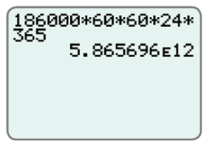
Example 5: Application: Scientific Notation and Calculator₂
Thus, a light-year is
or 5,865,696,000,000
miles (5 trillion, 865 billion, 696 million miles).

