Slide 1
Section 10.R.1
Translating English Phrases
and Algebraic Expressions

Slide 2
Objectives
Translate English phrases into algebraic expressions.
Translate algebraic expressions into English phrases.
Create word problems that fit a given equation.
Notes:
2

Slide 3
Example 1: Translating English Phrases into Algebraic Expressions₁

Slide 4
Example 1: Translating English Phrases into Algebraic Expressions₂

Slide 5
Example 1: Translating English Phrases into Algebraic Expressions₃

Slide 6
Example 1: Translating English Phrases into Algebraic Expressions₄

Slide 7
Example 1: Translating English Phrases into Algebraic Expressions₅

Slide 8
Example 1: Translating English Phrases into Algebraic Expressions₆

Slide 9
Translating English Phrases into Algebraic Expressions₁
Attention!
In Example 1a, the phrase “the sum of z and three” was
translated as z + 3. If the expression had been
translated as 3 + z, there would have been no
mathematical error because addition is commutative.
That is, z + 3 = 3 + z. However, in part e, the phrase “three less than the product of a number and five” must be translated as it was because subtraction is not
commutative.

Slide 10
Translating English Phrases into Algebraic Expressions₂
Attention! (cont.)
Thus,
“three less than five times a number” means 5n − 3
while “three less five times a number” means 3 − 5n.
Therefore, be very careful when writing and/or
interpreting expressions indicating subtraction. The same is true with expressions involving division.

Slide 11
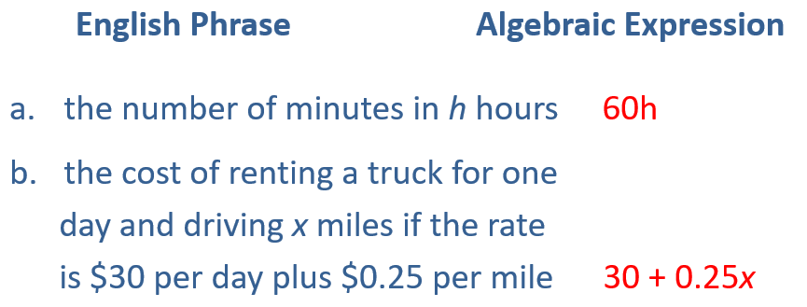
Example 2: Application: Translating English Phrases
Change each phrase into its equivalent algebraic expression

Slide 12
Example 3: Translating Algebraic Expressions into English Phrases₁
Change each algebraic expression into an equivalent English phrase. In each case translate the variable as “a number.”
Algebraic Expression Possible English Phrase
a. 5x the product of five and a number
b. 2n + 8 twice a number, increase by eight

Slide 13
Example 3: Translating Algebraic Expressions into English Phrases₂
three times the difference
between a number and two

Slide 14
Example 4: Translating Equations into Word Problems₁
For each equation, make up your own word problem that might use the equation in its solution. Remember that the variable can be translated into something like
“a number” or “some number.”

Slide 15
Example 4: Translating Equations into Word Problems₂
Solution
a. Some number is multiplied by 5 and the product is increased by 10. If the result is equal to −10, what is the number?
b. If 25 is added to the product of 3 and a number, the result will be equal to twice the sum of the same number and 6. What is the number?

Slide 16
Translating Equations into Word Problems
Notes
In Example 4, the “translations” are not unique. In fact, there are many ways to make up a problem for each equation. However, all word problems should result in the same equation. You should be able to show your “word problem” to your classmates and have them agree that the related equation will give the solution to the problem.

