Slide 1
Section 5.7
Geometry: Circles and Volume

Slide 2
Objectives
Know the definition of a circle.
Know the meanings of the terms center, radius, and diameter.
Be able to find the circumference and area of a circle.
Understand the concept of volume.
Be able to find the volumes of various geometric figures.

Slide 3
Finding the Circumference and Area of a Circle
Important Terms and Definitions for Circles
Circle: The set of all points in a plane that are some fixed distance from a fixed point called the center of the circle.
Radius: The fixed distance from the center of a circle to any point on the circle. (The letter r is used to represent the radius of a circle.)

Slide 4
Finding the Circumference and Area of a Circle
Important Terms and Definitions for Circles (cont.)
Diameter: The distance from one point on a circle through the center to the point directly opposite it. (The letter d is used to represent the diameter of a circle.)

Slide 5
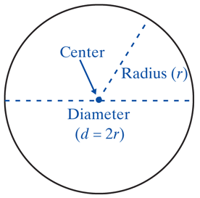
Finding the Circumference and Area of a Circle
Important Terms and Definitions for Circles (cont.)
Circumference: The perimeter of a circle.

Slide 6
Finding the Circumference and Area of a Circle
Formulas for Circles
For circumference:
For area:

Slide 7
Finding the Circumference and Area of a Circle
Note
π is the symbol used for the constant 3.1415926535…. This number is an infinite non-repeating decimal (an irrational number). For our purposes, we will use
π = 3.14 (accurate to hundredths). However, you should always be aware that 3.14 is only an approximation for π and that the related answers are only approximations.

Slide 8
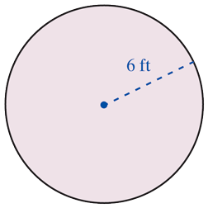
Example 1
Find a. the circumference and b. the area of a circle with a radius of 6 ft.
Solution
a. Using the formula for circumference:
The circumference is 37.68 ft.

Slide 9
Example 1 (cont.)
b. Using the formula for area:
The area is 113.04 ft².

Slide 10
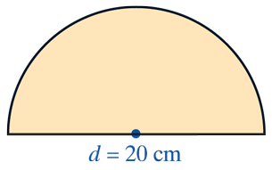
Example 2
Find the perimeter of a figure that is a semicircle (half of a circle) including its diameter. The diameter is 20 cm long.
Solution
Now we find the perimeter of the
figure by adding the length of the
semicircle (which is half of the
circumference of a circle) to the
Length of the diameter.

Slide 11
Example 2 (cont.)
Length of semicircle:
Perimeter of figure:

Slide 12
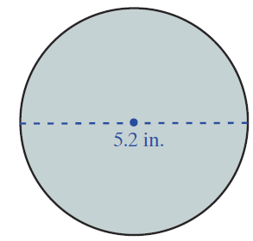
Example 3
Find a. the circumference and b. the area of a circle with a diameter of 5.2 in.
Solution
a. Using the formula for circumference:
The circumference is 16.328 in.

Slide 13
Example 3 (cont.)
b. Using the formula for area:
The area is 21.2264 in.²

Slide 14
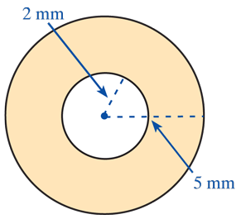
Example 4
Find the area of the washer (shaded portion) with dimensions as shown in the figure.
Solution
Subtract the area of the inside (smaller) circle from the area of the outside (larger) circle.

Slide 15
Example 4 (cont.)
area of washer

Slide 16
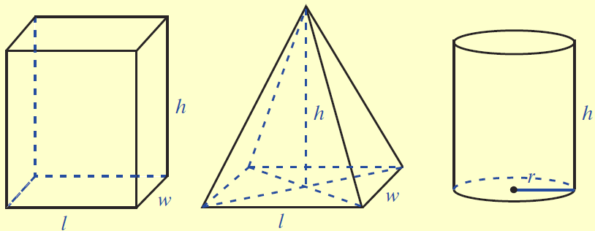
Formulas for Volume
Five Geometric Solids and the Formulas for Their Volumes:

Slide 17
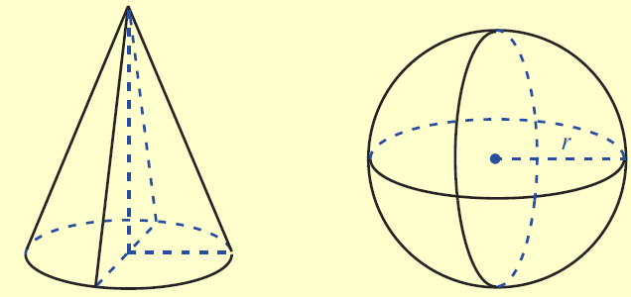
Formulas for Volume
Five Geometric Solids and the Formulas for Their Volumes:

Slide 18
Example 5
Find the volume of the rectangular solid with length
8 in., width 4 in., and height 1 ft. Write your answer in cubic inches and in cubic feet.

Slide 19
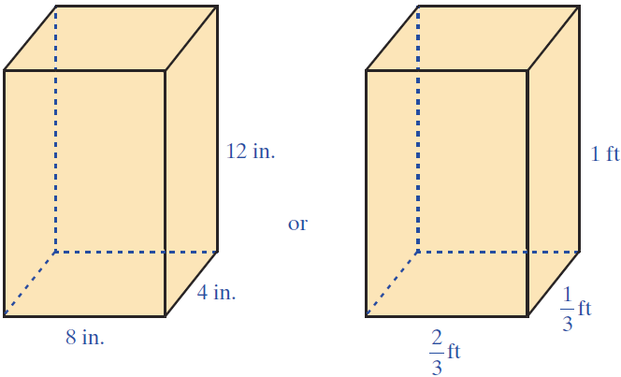
Example 5 (cont.)

Slide 20
Example 5 (cont.)
Solution

Slide 21
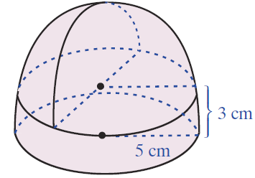
Example 6
Find the volume of the solid with the dimensions indicated. (Use π = 3.14.)
Solution
On top of the cylinder is a hemisphere (one-half of a sphere). Find the volume of the cylinder and hemisphere and add the results.

Slide 22
Example 6 (cont.)
(one-half volume of a sphere)

Slide 23
Practice Problems
Find the perimeter and area of the circle with the given radius length.
1. 11 mm 2. 3.8 yd
Find the volume of the following figures.
3. A cube with sides measuring 5 cm.
4. A rectangular solid with length 1.5 in., width 4 in., and height 10 in.

Slide 24
Practice Problems
5. A sphere with radius 3 cm.
6. A right circular cone with radius 20 mm and height
9 mm.

Slide 25
Practice Problem Answers
1. 69.08 mm; 379.94 mm²
2. 23.864 yd; 45.3416 yd²
3. 125 cm³
4. 60 in.³
5. 113.04 cm³
6. 3768 mm³

