Slide 1
Section 3.4
Slope and Forms of Linear Equations

Slide 2
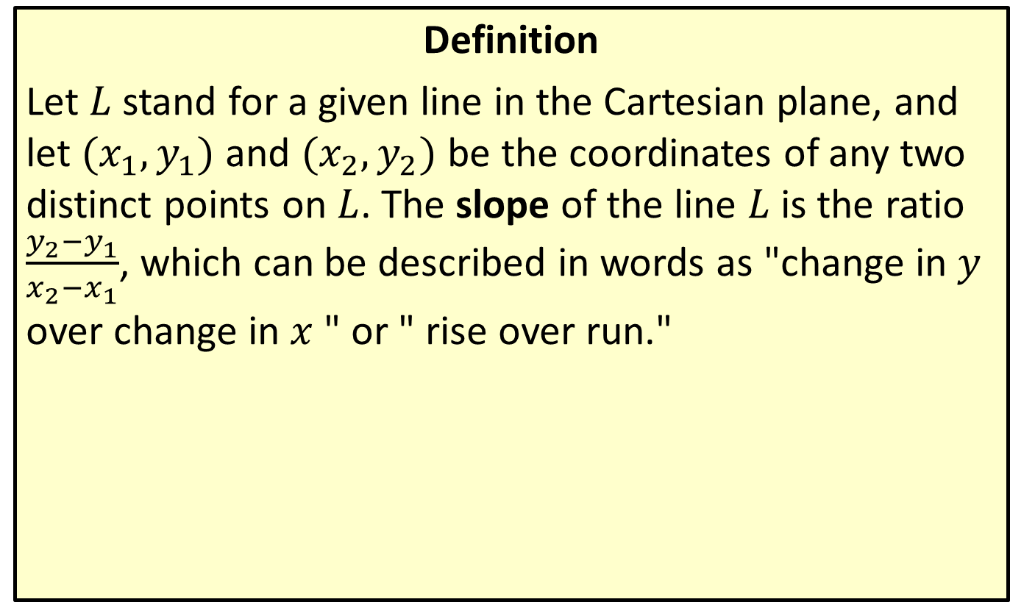
The Slope of a Line
Definition
Let $L$ stand for a given line in the Cartesian plane, and let $(x_{1},y_{1})$ and $(x_{2},y_{2})$ be the coordinates of any two distinct points on $L$. The slope of the line $L$ is the ratio $\frac{y_{2}−y_{1}}{x_{2}−x_{1}}$, which can be described in words as "change in $y$ over change in $x$ " or " rise over run."

Slide 3
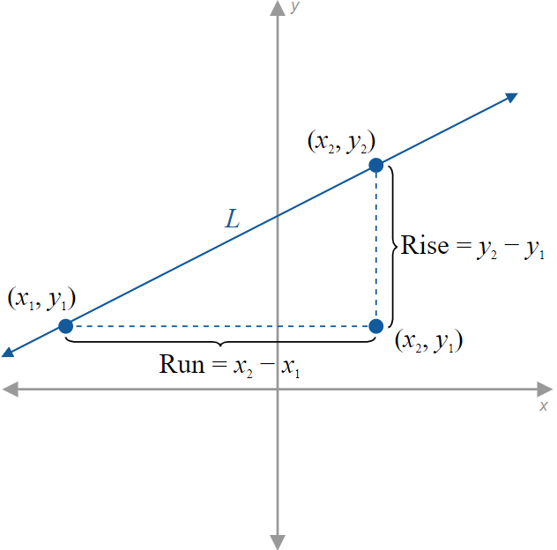
Figure 1: Rise and Run between Two Points

Slide 4
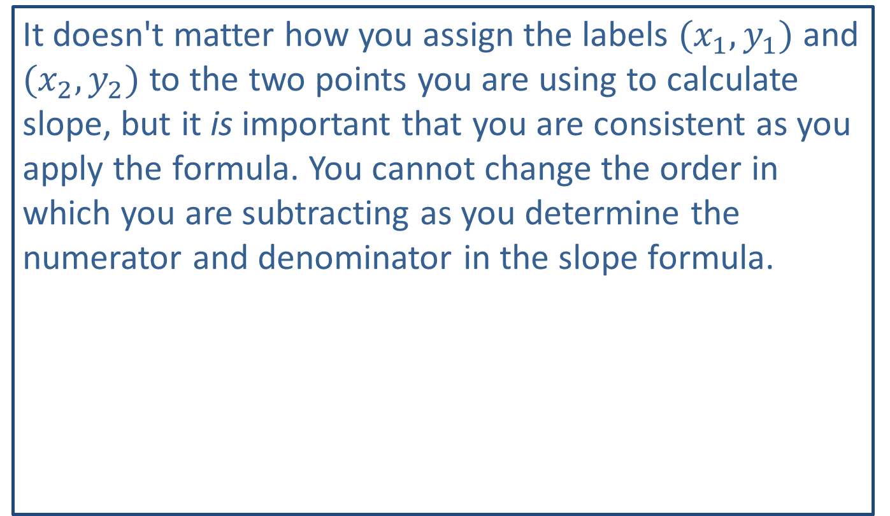
CAUTION!
It doesn't matter how you assign the labels $(x_{1},y_{1})$ and $(x_{2},y_{2})$ to the two points you are using to calculate slope, but it is important that you are consistent as you apply the formula. You cannot change the order in which you are subtracting as you determine the numerator and denominator in the slope formula.

Slide 5
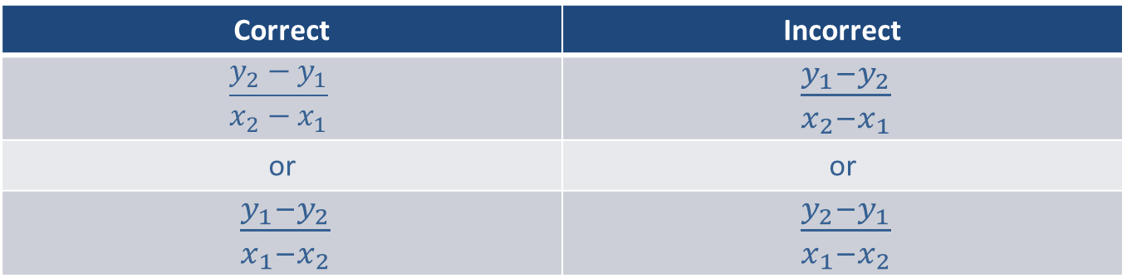
CAUTION! (cont.)
Correct | Incorrect
$$\frac{y_{2}−y_{1}}{x_{2}−x_{1}}$$ | $\frac{y_{1}−y_{2}}{x_{2}−x_{1}}$
or | or
$\frac{y_{1}−y_{2}}{x_{1}−x_{2}}$ | $\frac{y_{2}−y_{1}}{x_{1}−x_{2}}$

Slide 6
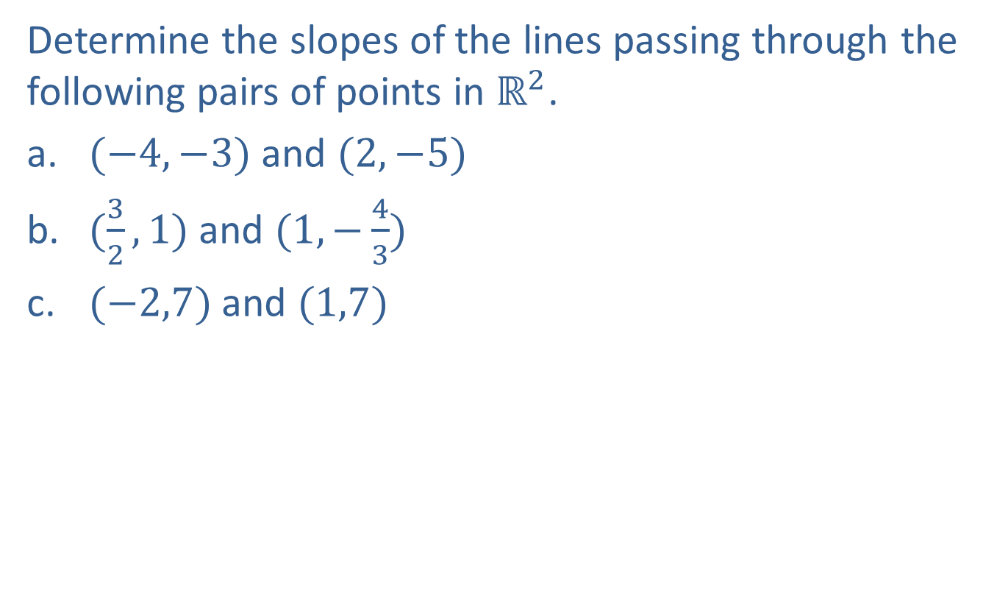
Example 1: Calculating the Slope of a Line
Determine the slopes of the lines passing through the following pairs of points in $ℝ^{2}$.
​$(−4,−3)$ and $(2,−5)$
​$(\frac{3}{2},1)$ and $(1,−\frac{4}{3})$
​$(−2,7)$ and $(1,7)$

Slide 7
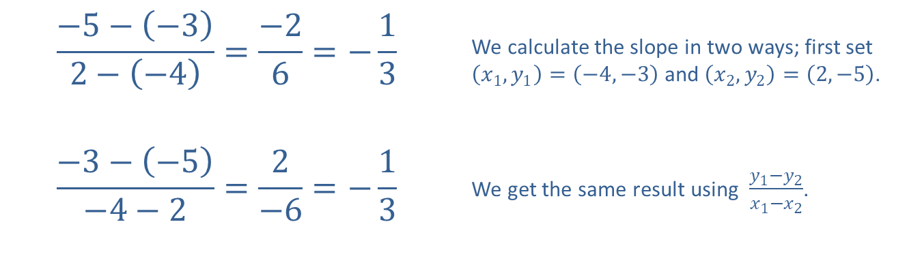
Example 1: Calculating the Slope of a Line (cont.)
Solution
​
$$\frac{−5−\left(−3\right)}{2−\left(−4\right)}=\frac{−2}{6}=−\frac{1}{3}$$ | We calculate the slope in two ways; first set $\left(x_{1},y_{1}\right)=\left(−4,−3\right)$ and $\left(x_{2},y_{2}\right)=\left(2,−5\right)$.
$$\frac{−3−\left(−5\right)}{−4−2}=\frac{2}{−6}=−\frac{1}{3}$$ | We get the same result using $\frac{y_{1}−y_{2}}{x_{1}−x_{2}}$.

Slide 8
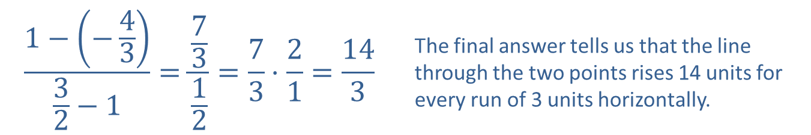
Example 1: Calculating the Slope of a Line (cont.)
$$\frac{1−\left(−\frac{4}{3}\right)}{\frac{3}{2}−1}=\frac{\frac{7}{3}}{\frac{1}{2}}=\frac{7}{3}⋅\frac{2}{1}=\frac{14}{3}$$ | The final answer tells us that the line through the two points rises 14 units for every run of 3 units horizontally.
​

Slide 9
Example 1: Calculating the Slope of a Line (cont.)
$$\frac{7−7}{−2−1}=\frac{0}{−3}=0$$ | These two points have the same $y$-coordinate and thus lie on a horizontal line.
​

Slide 10
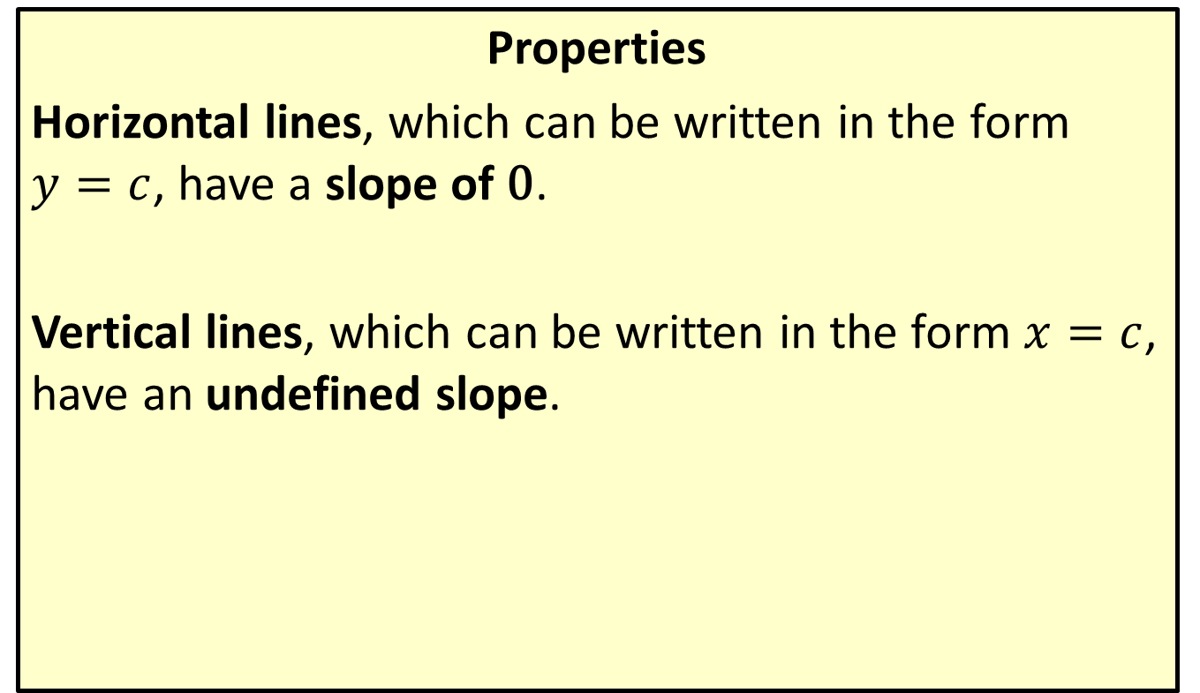
Slopes of Horizontal and Vertical Lines
Properties
Horizontal lines, which can be written in the form $y=c$, have a slope of 0.
Vertical lines, which can be written in the form $x=c$, have an undefined slope.

Slide 11

Example 2: Calculating the Slope of a Line
Determine the slopes of the lines defined by the following equations.
​$4x−3y=12$
​$2x+7y=9$
​$x=−\frac{3}{4}$
​$y=9$

Slide 12
Note:
Intercepts are often good points to use in calculating the slope, since they have at least one coordinate equal to zero.

Slide 13
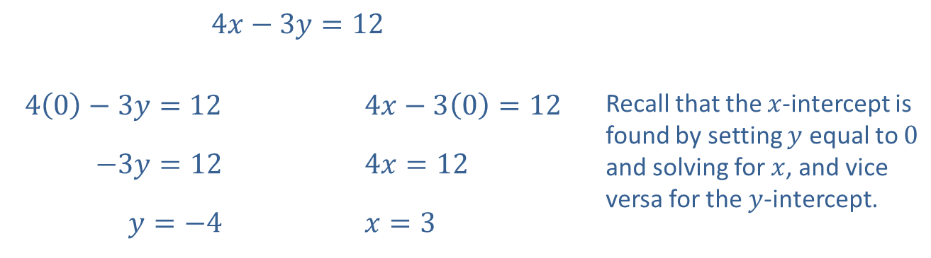
Example 2: Calculating the Slope of a Line (cont.)
Solution
​First, we find two points on the line by calculating the intercepts.
​
​$4x−3y=12$
​$4\left(0\right)−3y=12$ |  | ​$4x−3\left(0\right)=12$ | Recall that the $x$-intercept is found by setting $y$ equal to 0 and solving for $x$, and vice versa for the $y$-intercept.
​$−3y=12$ |  | ​$4x=12$
​$y=−4$ |  | ​$x=3$

Slide 14

Example 2: Calculating the Slope of a Line (cont.)
​$y$-intercept: $(0,−4)$
​$x$-intercept: $(3,0)$
Once we have two points, we apply the slope formula.
​slope $=\frac{−4−0}{0−3}=\frac{−4}{−3}=\frac{4}{3}$

Slide 15
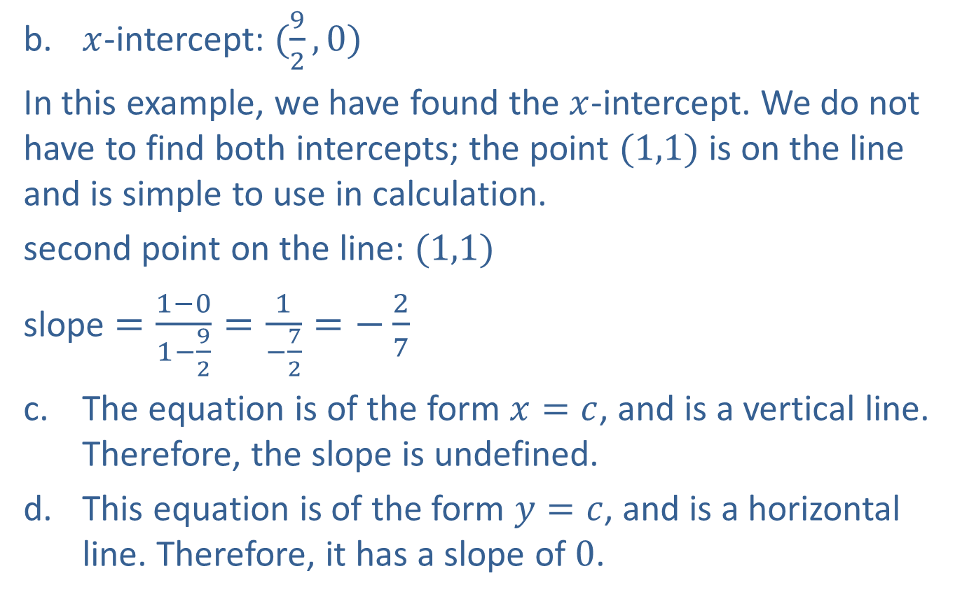
Example 2: Calculating the Slope of a Line (cont.)
​$x$-intercept: $(\frac{9}{2},0)$
In this example, we have found the $x$-intercept. We do not have to find both intercepts; the point $(1,1)$ is on the line and is simple to use in calculation.
​second point on the line: $(1,1)$
​slope $=\frac{1−0}{1−\frac{9}{2}}=\frac{1}{−\frac{7}{2}}=−\frac{2}{7}$
​The equation is of the form $x=c$, and is a vertical line. Therefore, the slope is undefined.
​This equation is of the form $y=c$, and is a horizontal line. Therefore, it has a slope of 0.

Slide 16
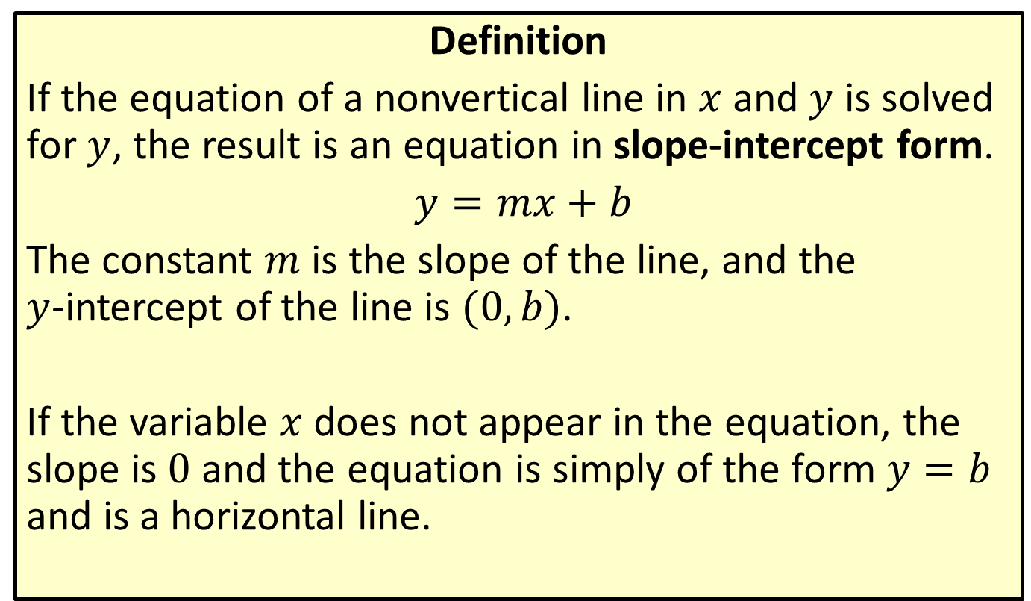
Slope-Intercept Form of a Line
Definition
If the equation of a nonvertical line in $x$ and $y$ is solved for $y$, the result is an equation in slope-intercept form.
$y=mx+b$
The constant $m$ is the slope of the line, and the
$y$-intercept of the line is $(0,b)$.
If the variable $x$ does not appear in the equation, the slope is 0 and the equation is simply of the form $y=b$ and is a horizontal line.

Slide 17

Example 3: Slope-Intercept Form of a Line
Use the slope-intercept form of the line to graph the equation $4x−3y=6$.

Slide 18
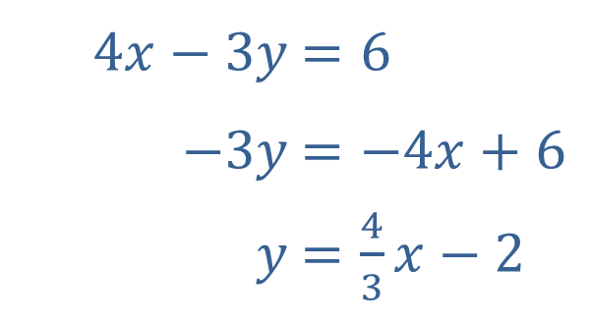
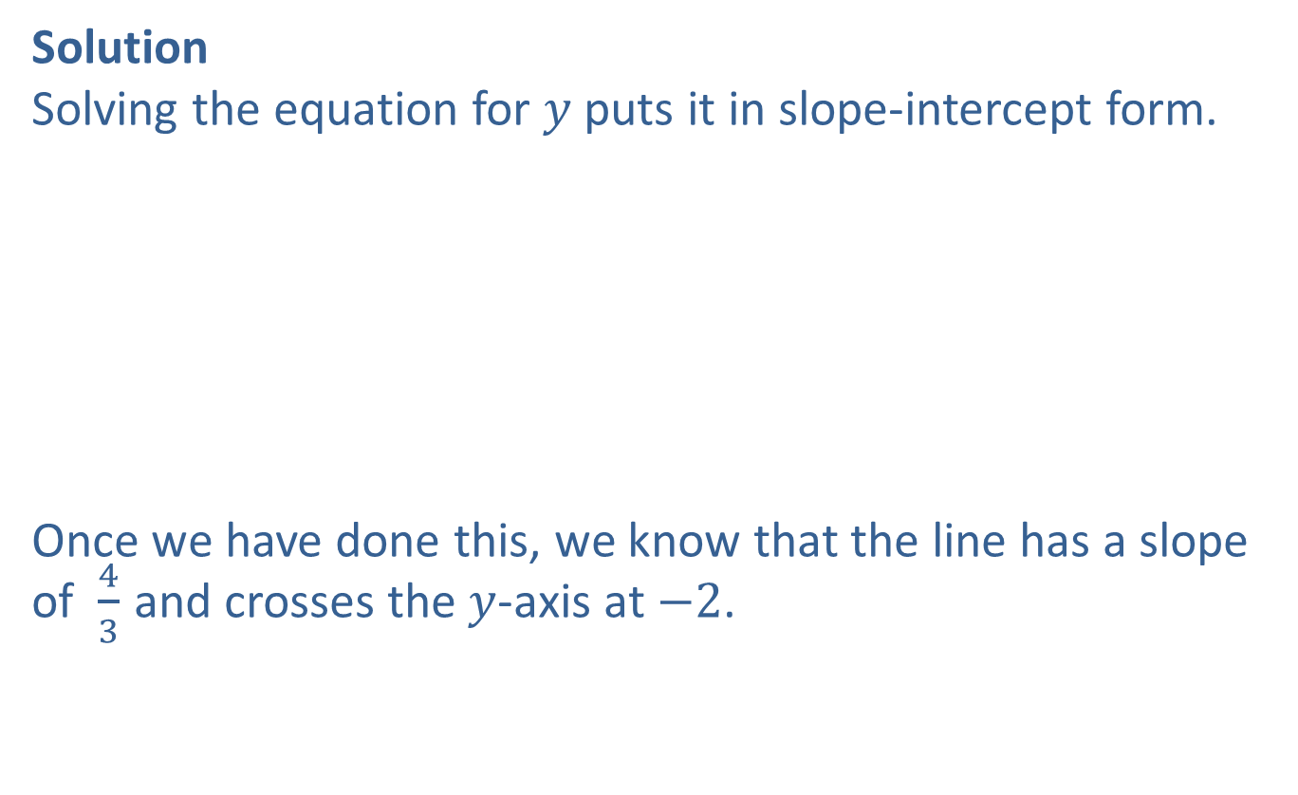
Example 3: Slope-Intercept Form of a Line (cont.)
Solution
Solving the equation for $y$ puts it in slope-intercept form.
Once we have done this, we know that the line has a slope of $\frac{4}{3}$ and crosses the $y$-axis at $−2$.
​
​$4x−3y$ | ​$=6$
​$−3y$ | ​$=−4x+6$
​$y$ | ​$=\frac{4}{3}x−2$

Slide 19
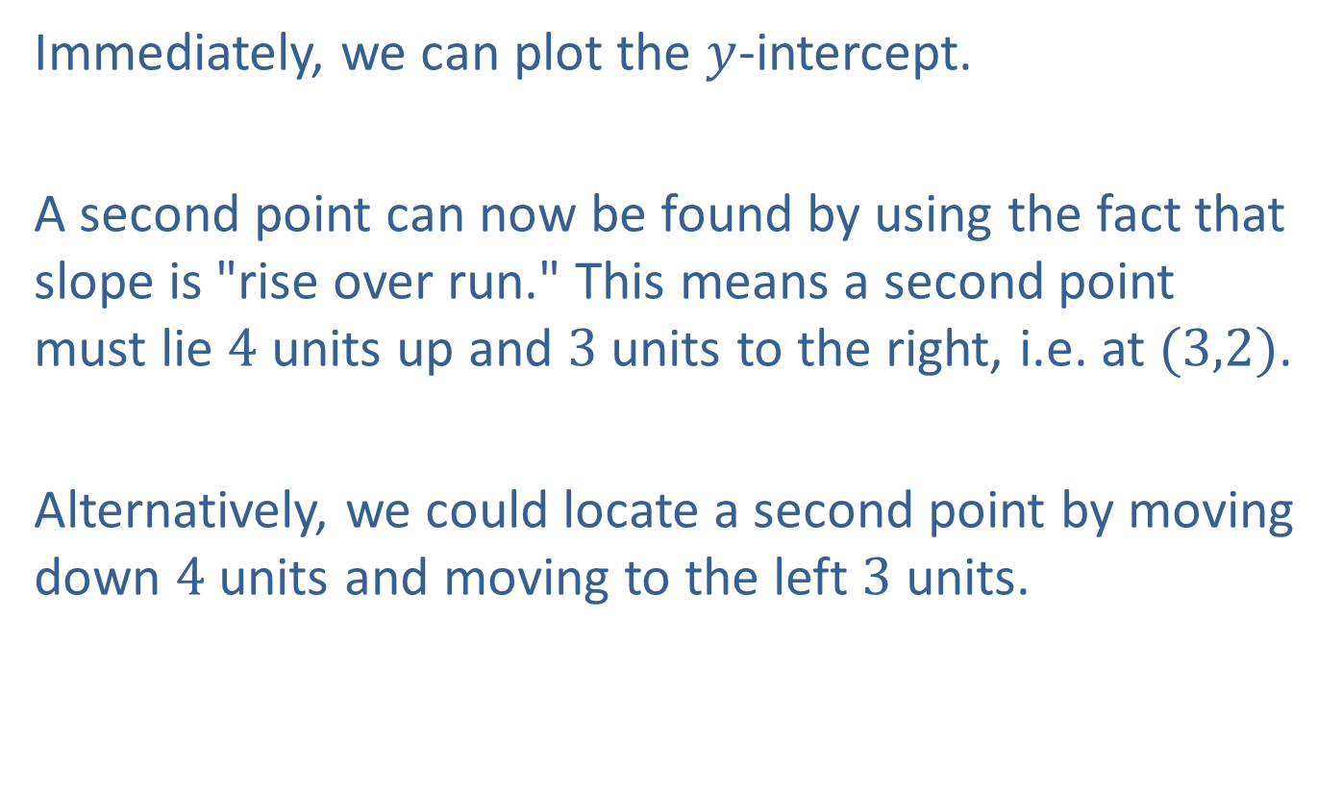
Example 3: Slope-Intercept Form of a Line (cont.)
Immediately, we can plot the $y$-intercept.
A second point can now be found by using the fact that slope is "rise over run." This means a second point must lie 4 units up and 3 units to the right, i.e. at $(3,2)$.
Alternatively, we could locate a second point by moving down 4 units and moving to the left 3 units.

Slide 20
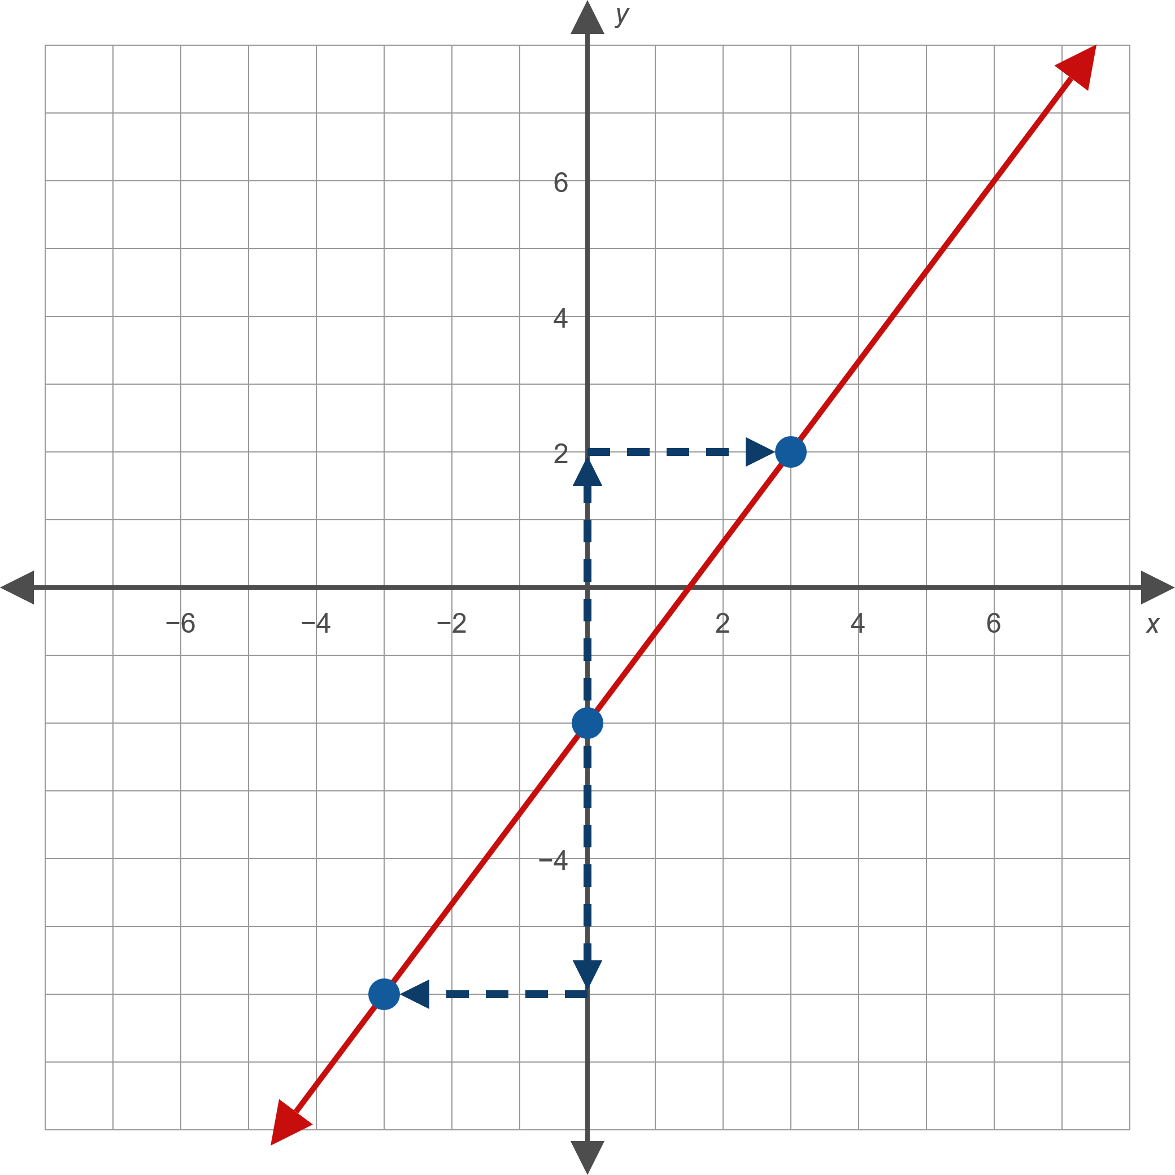
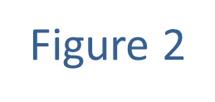
Example 3: Slope-Intercept Form of a Line (cont.)

Slide 21

Example 4: Slope-Intercept Form of a Line
Find the equation of the line that passes through the point $(0,3)$ and has a slope of $−\frac{3}{5}$. Then graph the line.

Slide 22
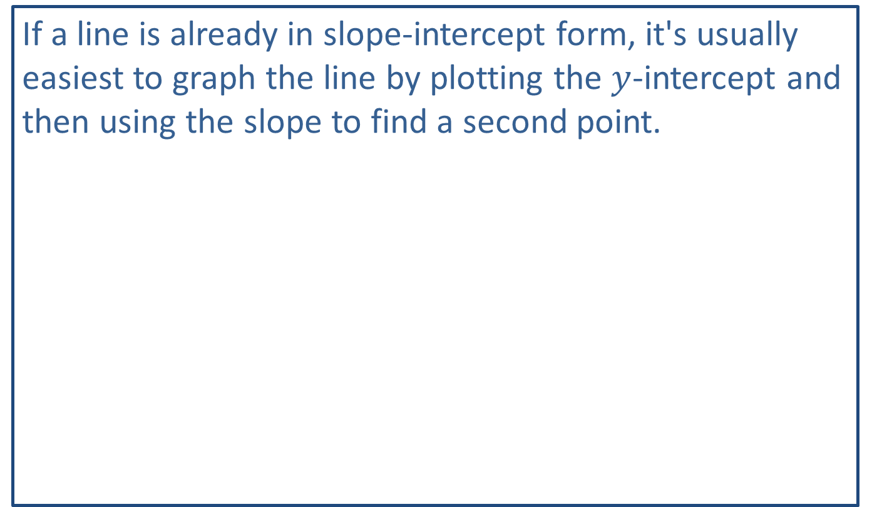
Note:
If a line is already in slope-intercept form, it's usually easiest to graph the line by plotting the $y$-intercept and then using the slope to find a second point.

Slide 23
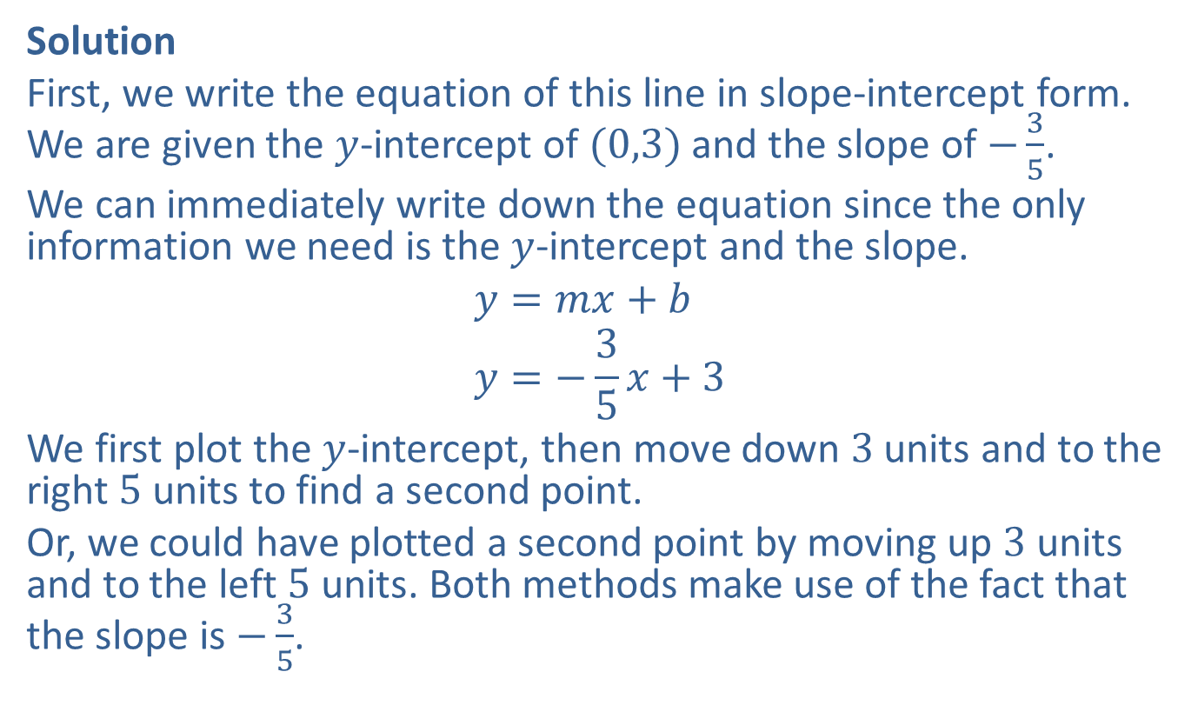
Example 4: Slope-Intercept Form of a Line (cont.)
Solution
First, we write the equation of this line in slope-intercept form. We are given the $y$-intercept of $(0,3)$ and the slope of $−\frac{3}{5}$.
We can immediately write down the equation since the only information we need is the $y$-intercept and the slope.
$$y=mx+b \\ y=−\frac{3}{5}x+3$$
We first plot the $y$-intercept, then move down 3 units and to the right 5 units to find a second point.
Or, we could have plotted a second point by moving up 3 units and to the left 5 units. Both methods make use of the fact that the slope is $−\frac{3}{5}$.

Slide 24
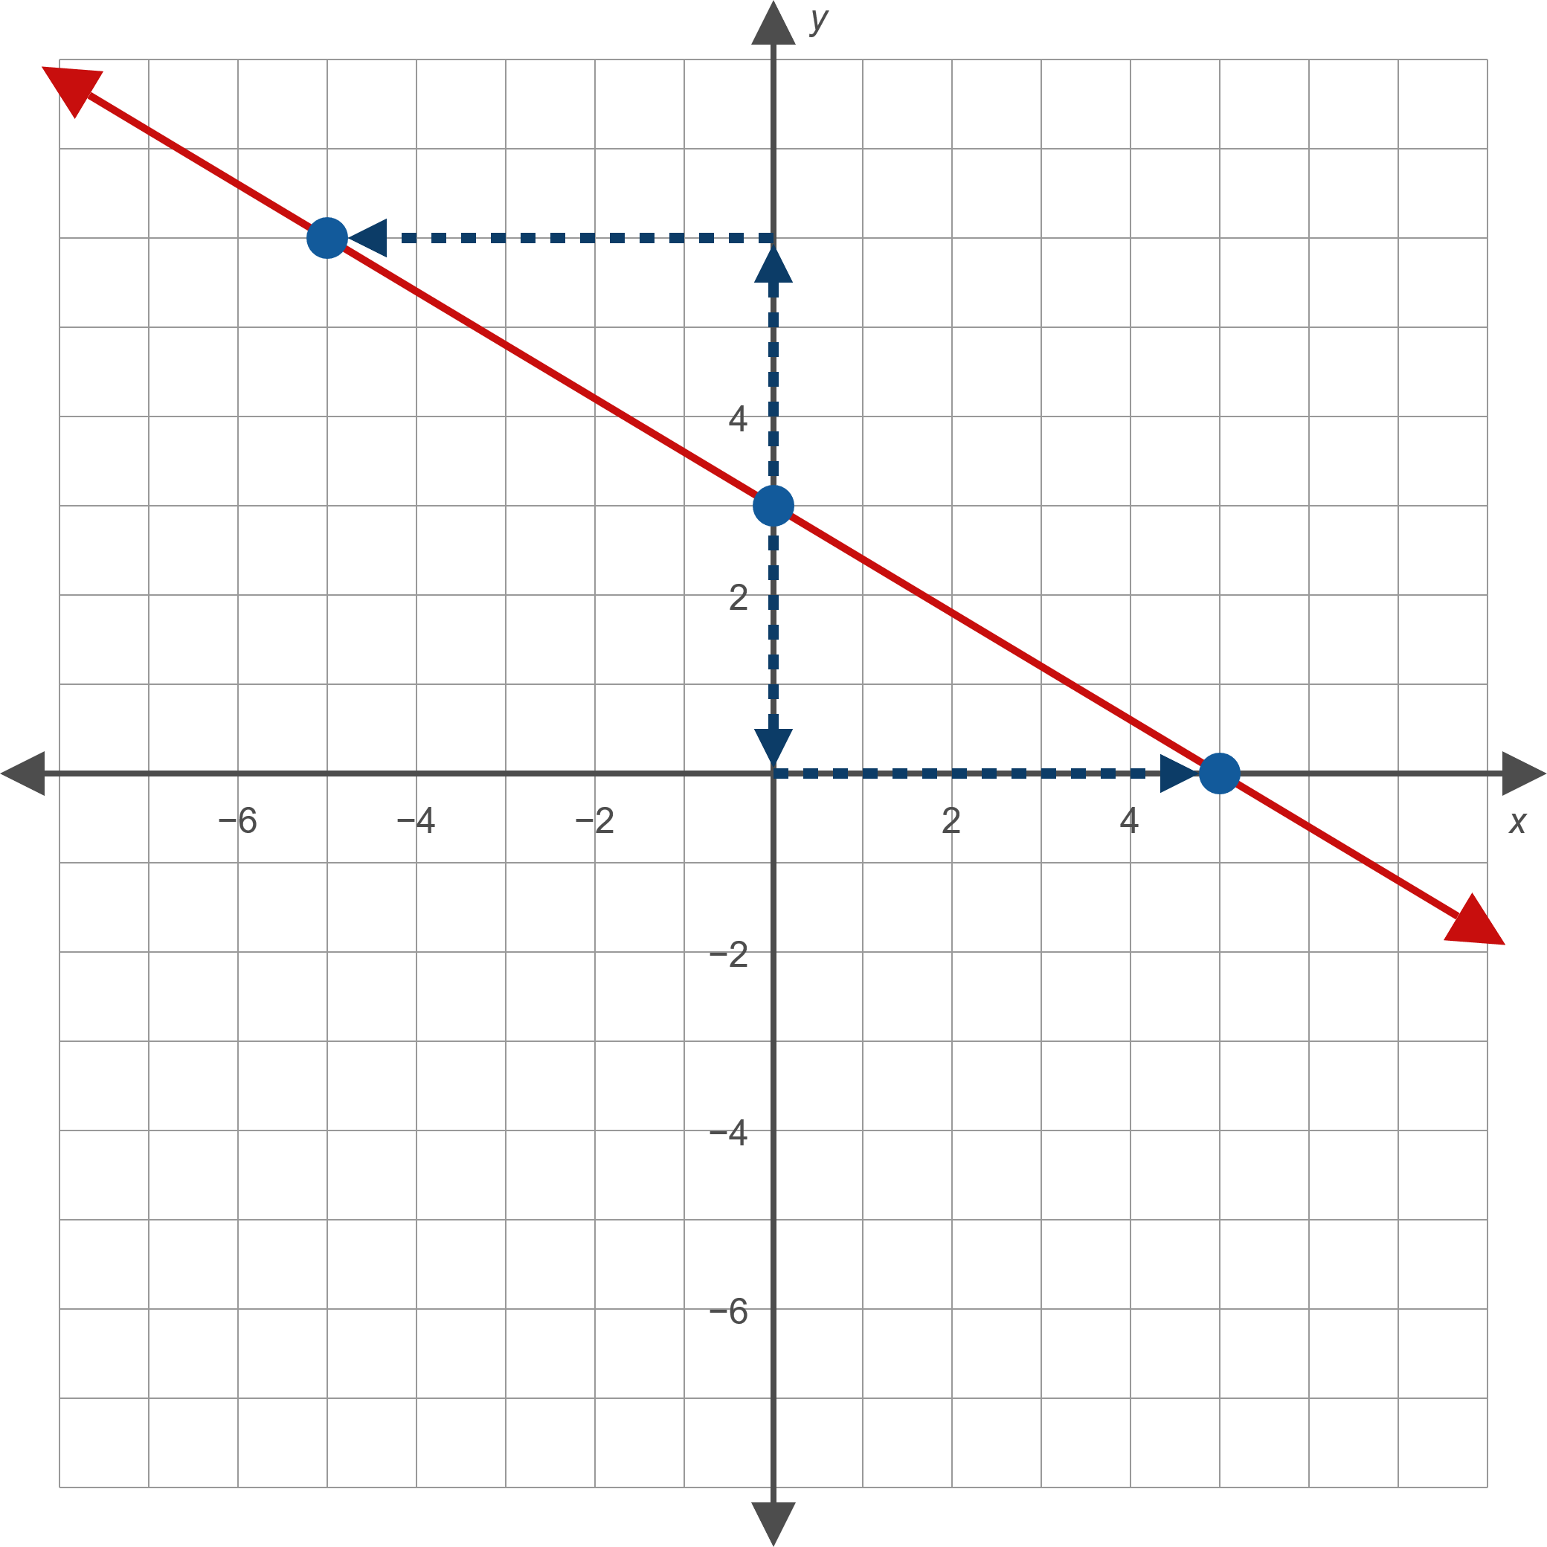
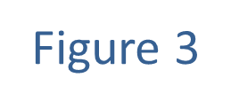
Example 4: Slope-Intercept Form of a Line (cont.)

Slide 25
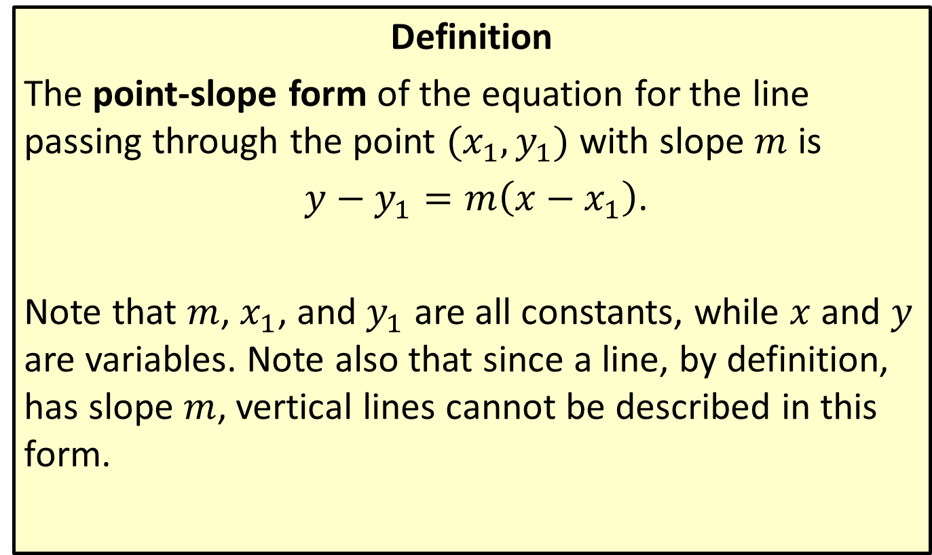
Point-Slope Form of a Line
Definition
The point-slope form of the equation for the line passing through the point $(x_{1},y_{1})$ with slope $m$ is
$y−y_{1}=m\left(x−x_{1}\right)$.
Note that $m$, $x_{1}$, and $y_{1}$ are all constants, while $x$ and $y$ are variables. Note also that since a line, by definition, has slope $m$, vertical lines cannot be described in this form.

Slide 26

Example 5: Using the Point-Slope Form of a Line
Find the equation, in slope-intercept form, of the line that passes through the point $(−2,5)$ with slope 3.

Slide 27
Note:
When asked for an equation in either standard form or slope-intercept form, it's frequently easiest to write the point-slope form and then convert the equation to the desired form.

Slide 28

Example 5: Using the Point-Slope Form of a Line (cont.)
Solution
Since we are given the slope of the line and a point on the line, we can substitute directly into the point-slope form, then solve for $y$ to obtain the slope-intercept form.

Slide 29
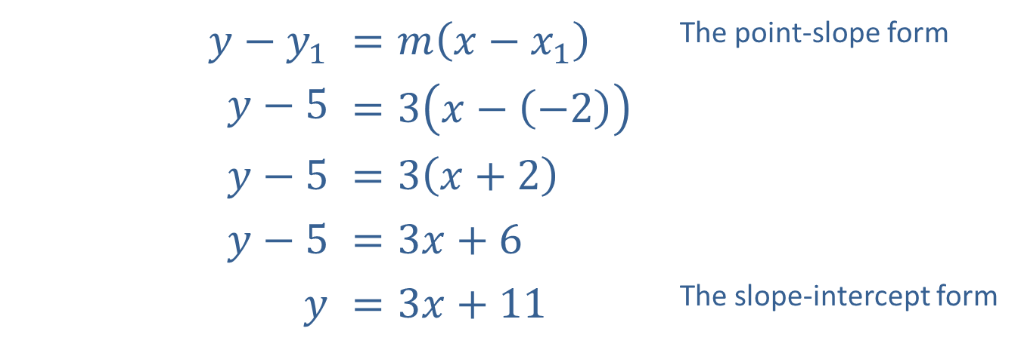
Example 5: Using the Point-Slope Form of a Line (cont.)
​$y−y_{1}$ | ​$=m\left(x−x_{1}\right)$ | The point-slope form
​$y−5$ | ​$=3\left(x−\left(−2\right)\right)$
​$y−5$ | ​$=3\left(x+2\right)$
​$y−5$ | ​$=3x+6$
$$y$$ | ​$=3x+11$ | The slope-intercept form

Slide 30

Example 6: Using the Point-Slope Form of a Line
Find the equation, in slope-intercept form, of the line that passes through the two points $(−3,−2)$ and $(1,6)$.

Slide 31
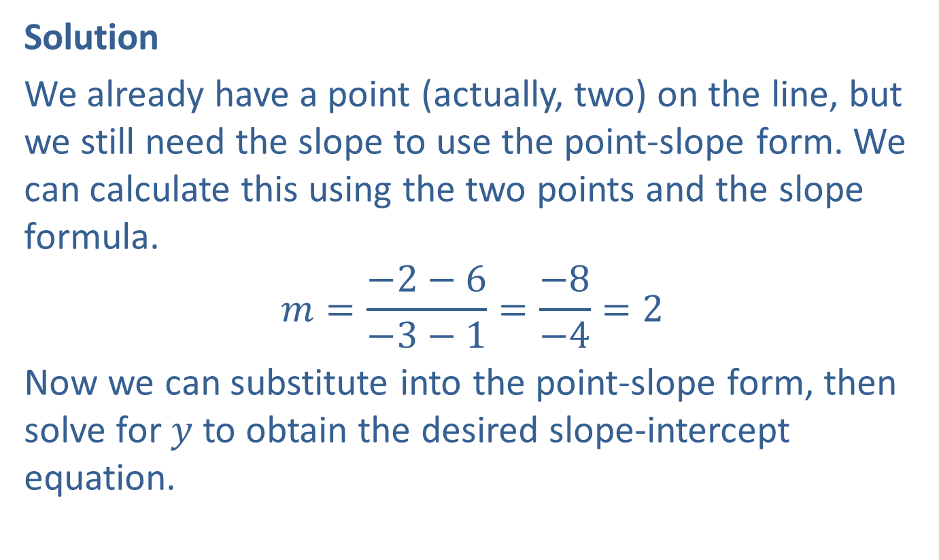
Example 6: Using the Point-Slope Form of a Line (cont.)
Solution
We already have a point (actually, two) on the line, but we still need the slope to use the point-slope form. We can calculate this using the two points and the slope formula.
$$m=\frac{−2−6}{−3−1}=\frac{−8}{−4}=2$$
Now we can substitute into the point-slope form, then solve for $y$ to obtain the desired slope-intercept equation.

Slide 32
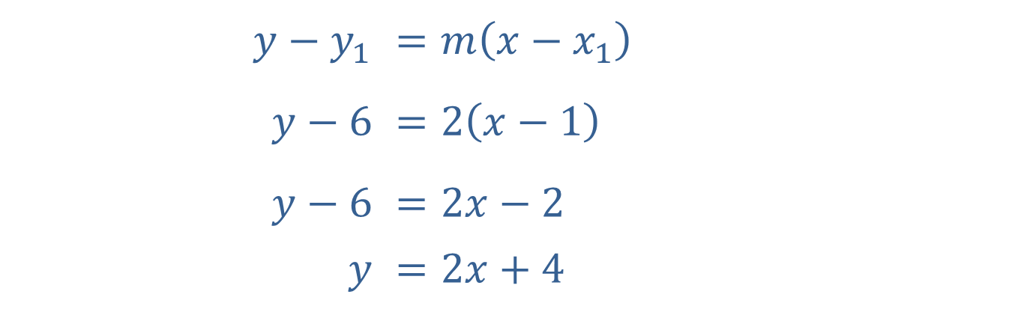
Example 6: Using the Point-Slope Form of a Line (cont.)
Note that no matter which point we substitute into the point-slope form, the resulting slope-intercept equation is the same.
​$y−y_{1}$ | ​$=m\left(x−x_{1}\right)$
​$y−6$ | ​$=2\left(x−1\right)$
​$y−6$ | ​$=2x−2$
$$y$$ | ​$=2x+4$

Slide 33
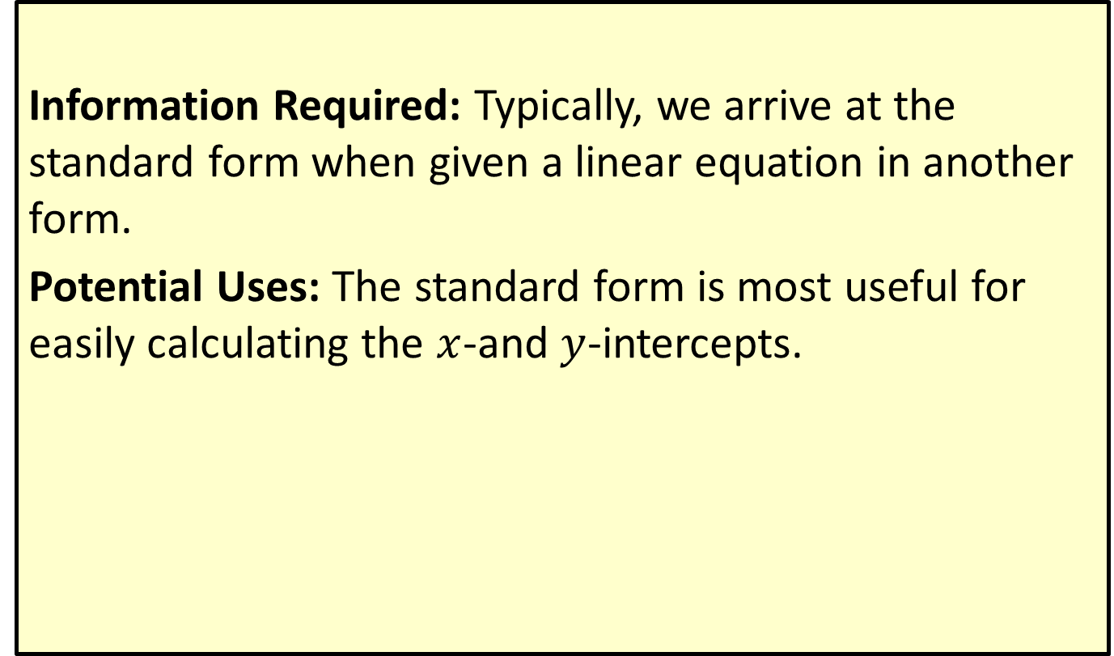

Standard Form: $ax+by=c$
Information Required: Typically, we arrive at the standard form when given a linear equation in another form.
Potential Uses: The standard form is most useful for easily calculating the $x$-and $y$-intercepts.

Slide 34
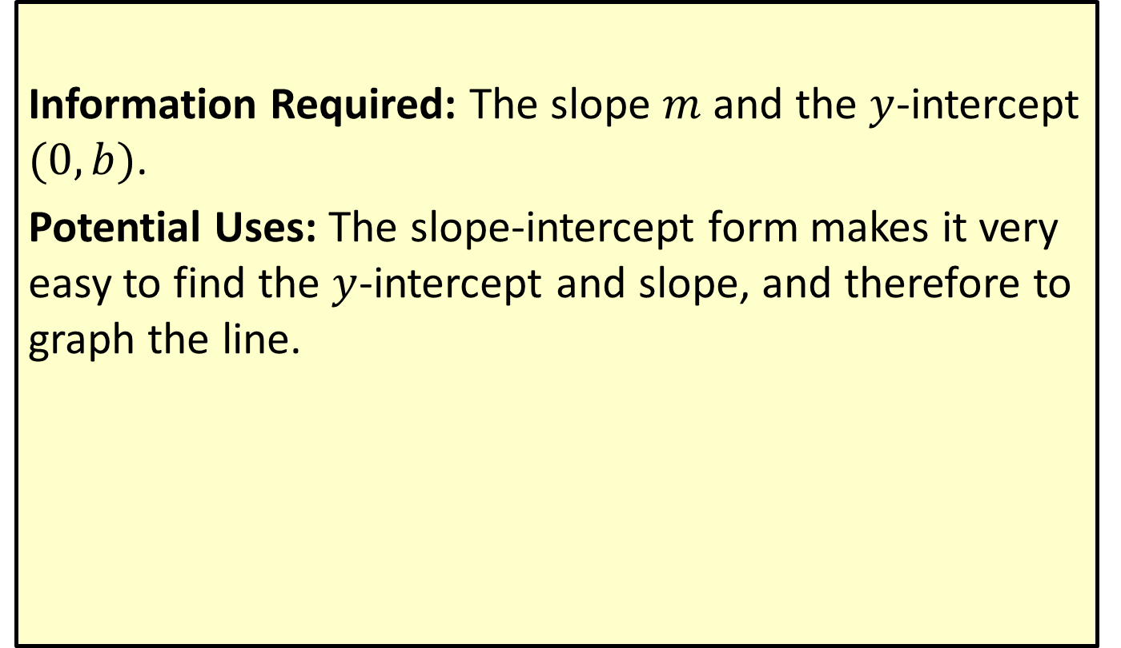

Slope-Intercept Form: $y=mx+b$
Information Required: The slope $m$ and the $y$-intercept $(0,b)$.
Potential Uses: The slope-intercept form makes it very easy to find the $y$-intercept and slope, and therefore to graph the line.

Slide 35
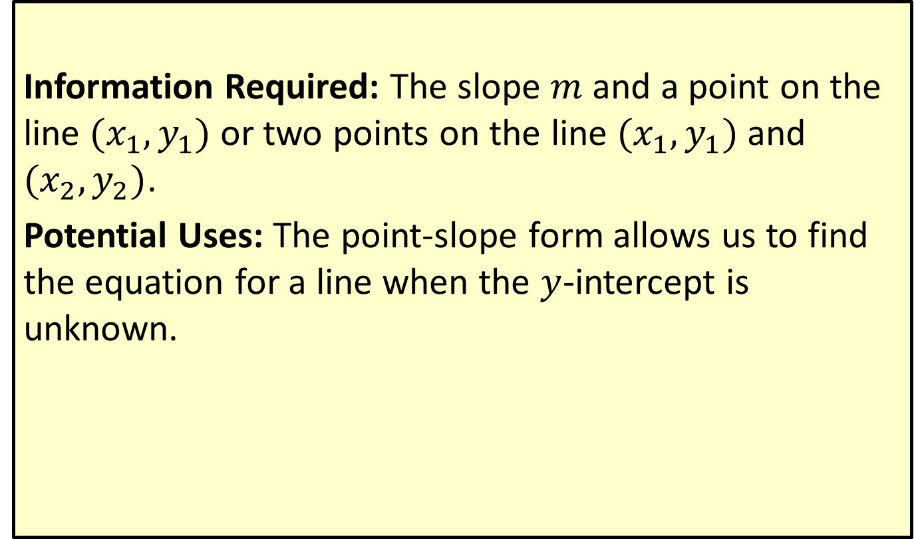

Point-Slope Form: $y−y_{1}=m\left(x−x_{1}\right)$
Information Required: The slope $m$ and a point on the line $(x_{1},y_{1})$ or two points on the line $(x_{1},y_{1})$ and $(x_{2},y_{2})$.
Potential Uses: The point-slope form allows us to find the equation for a line when the $y$-intercept is unknown.

