Slide 1
Section 3.3
Linear Equations in Two Variables

Slide 2
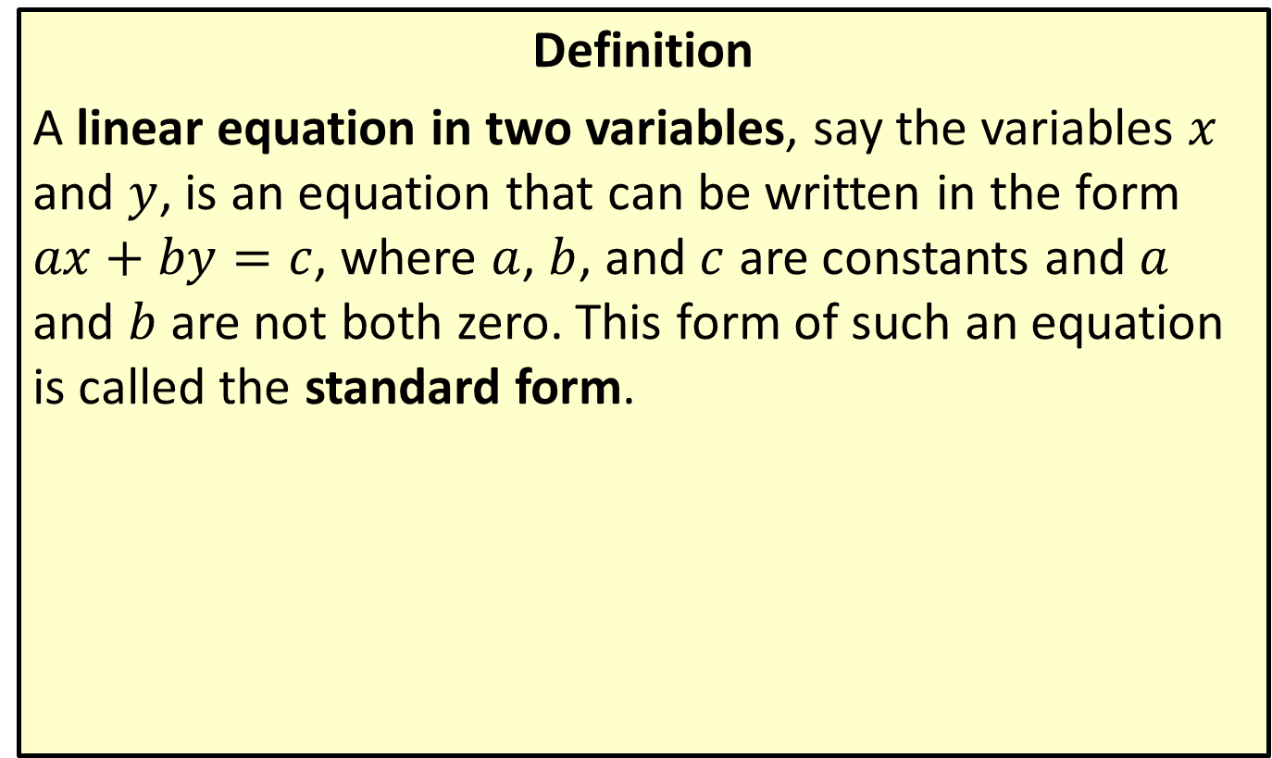
Linear Equations in Two Variables
Definition
A linear equation in two variables, say the variables $x$ and $y$, is an equation that can be written in the form $ax+by=c$, where $a$, $b$, and $c$ are constants and $a$ and $b$ are not both zero. This form of such an equation is called the standard form.

Slide 3
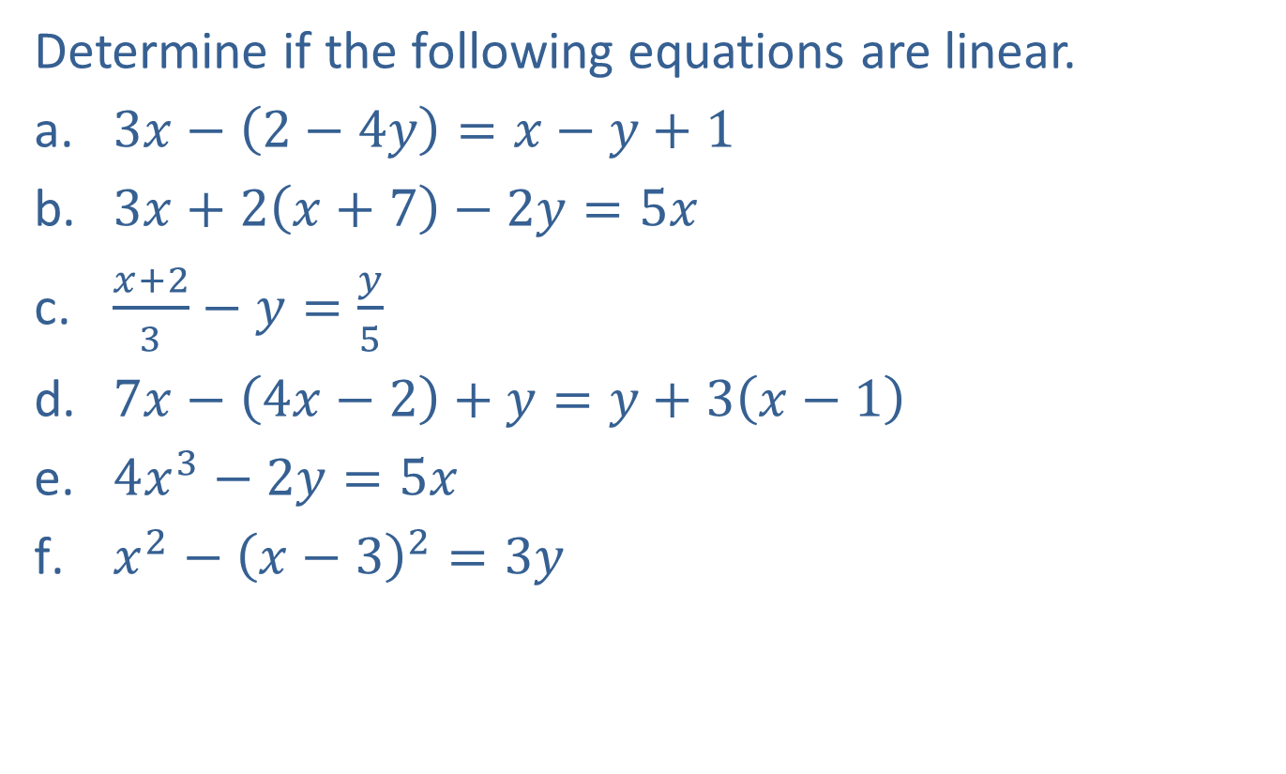
Example 1: Linear Equations in Two Variables
Determine if the following equations are linear.
​$3x−\left(2−4y\right)=x−y+1$
​$3x+2\left(x+7\right)−2y=5x$
​$\frac{x+2}{3}−y=\frac{y}{5}$
​$7x−\left(4x−2\right)+y=y+3\left(x−1\right)$
​$4x^{3}−2y=5x$
​$x^{2}−{\left(x−3\right)}^{2}=3y$

Slide 4
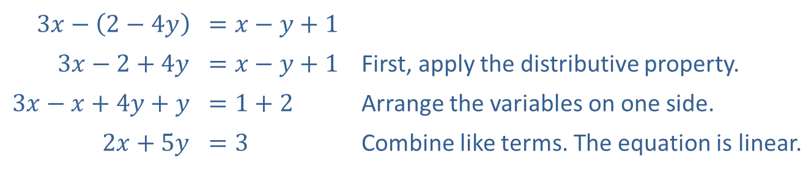
Example 1: Linear Equations in Two Variables (cont.)
Solution
​
​$3x−\left(2−4y\right)$ | ​$=x−y+1$
​$3x−2+4y$ | ​$=x−y+1$ | First, apply the distributive property.
​$3x−x+4y+y$ | ​$=1+2$ | Arrange the variables on one side.
​$2x+5y$ | ​$=3$ | Combine like terms. The equation is linear.

Slide 5
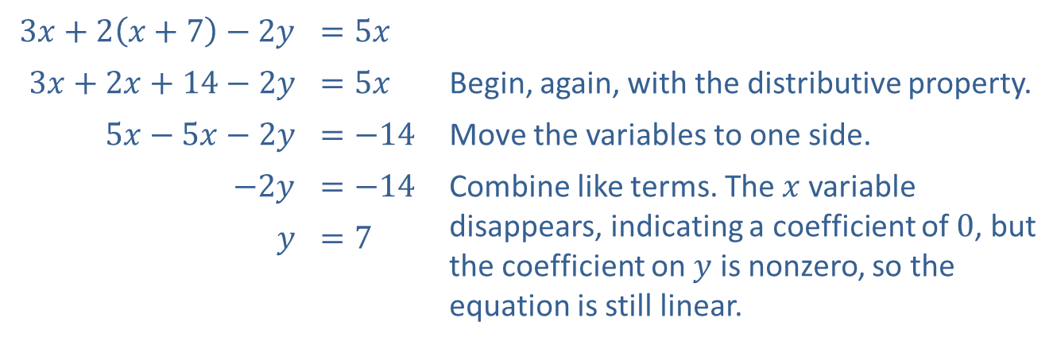
Example 1: Linear Equations in Two Variables (cont.)
​
​$3x+2\left(x+7\right)−2y$ | ​$=5x$
​$3x+2x+14−2y$ | ​$=5x$ | Begin, again, with the distributive property.
​$5x−5x−2y$ | ​$=−14$ | Move the variables to one side.
​$−2y$ | ​$=−14$ | Combine like terms. The $x$ variable disappears, indicating a coefficient of 0, but the coefficient on $y$ is nonzero, so the equation is still linear.
$$y$$ | ​$=7$

Slide 6
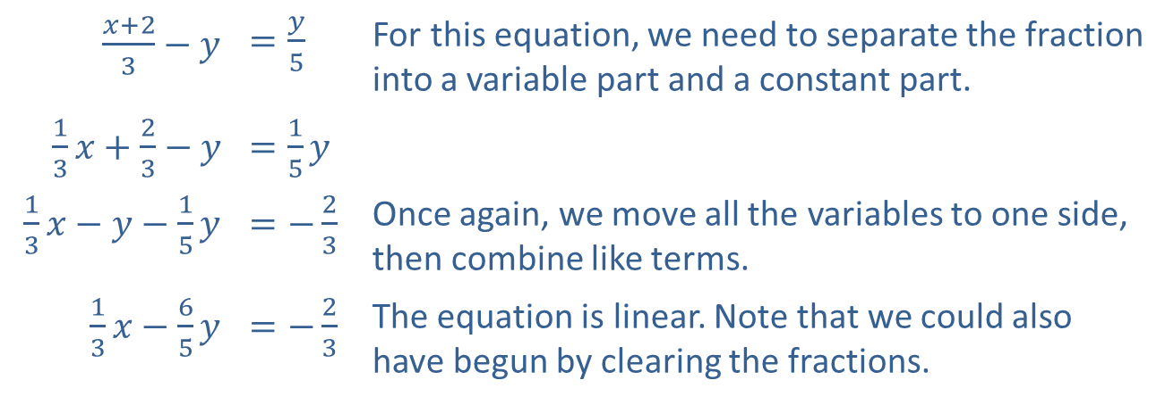
Example 1: Linear Equations in Two Variables (cont.)
​
​$\frac{x+2}{3}−y$ | ​$=\frac{y}{5}$ | For this equation, we need to separate the fraction into a variable part and a constant part.
​$\frac{1}{3}x+\frac{2}{3}−y$ | ​$=\frac{1}{5}y$
​$\frac{1}{3}x−y−\frac{1}{5}y$ | ​$=−\frac{2}{3}$ | Once again, we move all the variables to one side, then combine like terms.
​$\frac{1}{3}x−\frac{6}{5}y$ | ​$=−\frac{2}{3}$ | The equation is linear. Note that we could also have begun by clearing the fractions.

Slide 7
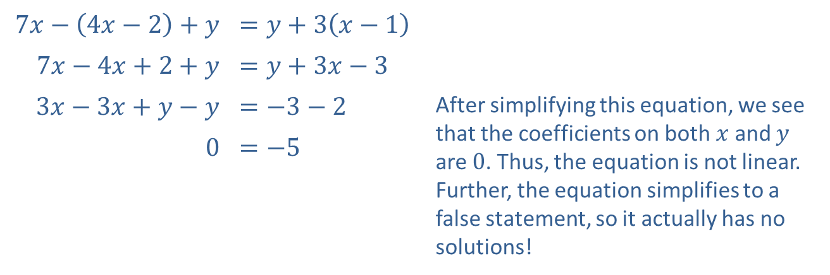
Example 1: Linear Equations in Two Variables (cont.)
​
​$7x−\left(4x−2\right)+y$ | ​$=y+3\left(x−1\right)$
​$7x−4x+2+y$ | ​$=y+3x−3$
​$3x−3x+y−y$ | ​$=−3−2$ | After simplifying this equation, we see that the coefficients on both $x$ and $y$ are 0. Thus, the equation is not linear. Further, the equation simplifies to a false statement, so it actually has no solutions!
​0 | ​$=−5$

Slide 8

Example 1: Linear Equations in Two Variables (cont.)
$4x^{3}−2y=5x$ The presence of the cubed term in this already simplified equation makes it not linear.​

Slide 9
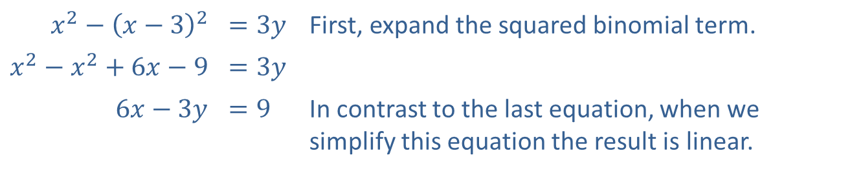
Example 1: Linear Equations in Two Variables (cont.)
​
​$x^{2}−{\left(x−3\right)}^{2}$ | ​$=3y$ | First, expand the squared binomial term.
​$x^{2}−x^{2}+6x−9$ | ​$=3y$
​$6x−3y$ | ​$=9$ | In contrast to the last equation, when we simplify this equation the result is linear.

Slide 10
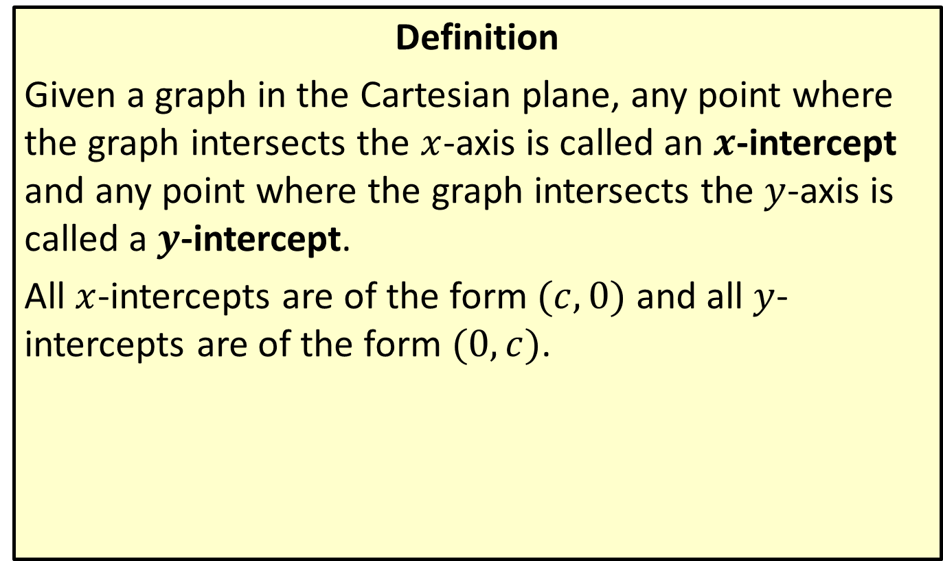

The $x$- and $y$-Intercepts
Definition
Given a graph in the Cartesian plane, any point where the graph intersects the $x$-axis is called an $x$-intercept and any point where the graph intersects the $y$-axis is called a $y$-intercept.
All $x$-intercepts are of the form $(c,0)$ and all $y$-intercepts are of the form $(0,c)$.

Slide 11

Example 2: Finding Intercepts and Graphing Linear Equations
Find the $x$- and $y$-intercepts of the given equations, and sketch their graphs.
​$3x−4y=12$
​$4x−\left(3−x\right)+2y=7$

Slide 12
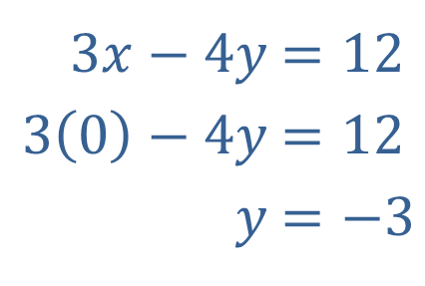

Example 2: Finding Intercepts and Graphing Linear Equations (cont.)
Solution
To find the two intercepts, first set $x$ equal to 0 and solve for $y$.
​
​
​​
​$3x−4y$ | ​$=12$
​$3\left(0\right)−4y$ | ​$=12$
​$y$ | ​$=−3$

Slide 13
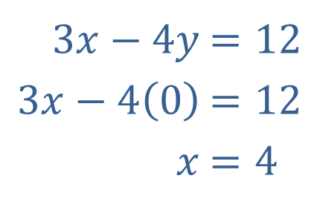
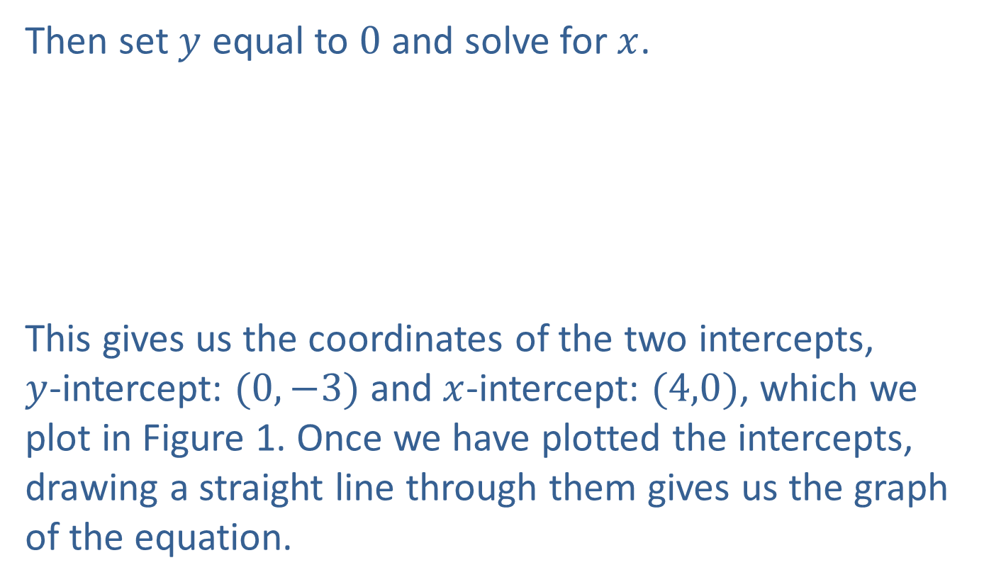
Example 2: Finding Intercepts and Graphing Linear Equations (cont.)
Then set $y$ equal to 0 and solve for $x$.
This gives us the coordinates of the two intercepts, $y$-intercept: $(0,−3)$ and $x$-intercept: $(4,0)$, which we plot in Figure 1. Once we have plotted the intercepts, drawing a straight line through them gives us the graph of the equation.
​$3x−4y$ | ​$=12$
​$3x−4\left(0\right)$ | ​$=12$
​$x$ | ​$=4$

Slide 14
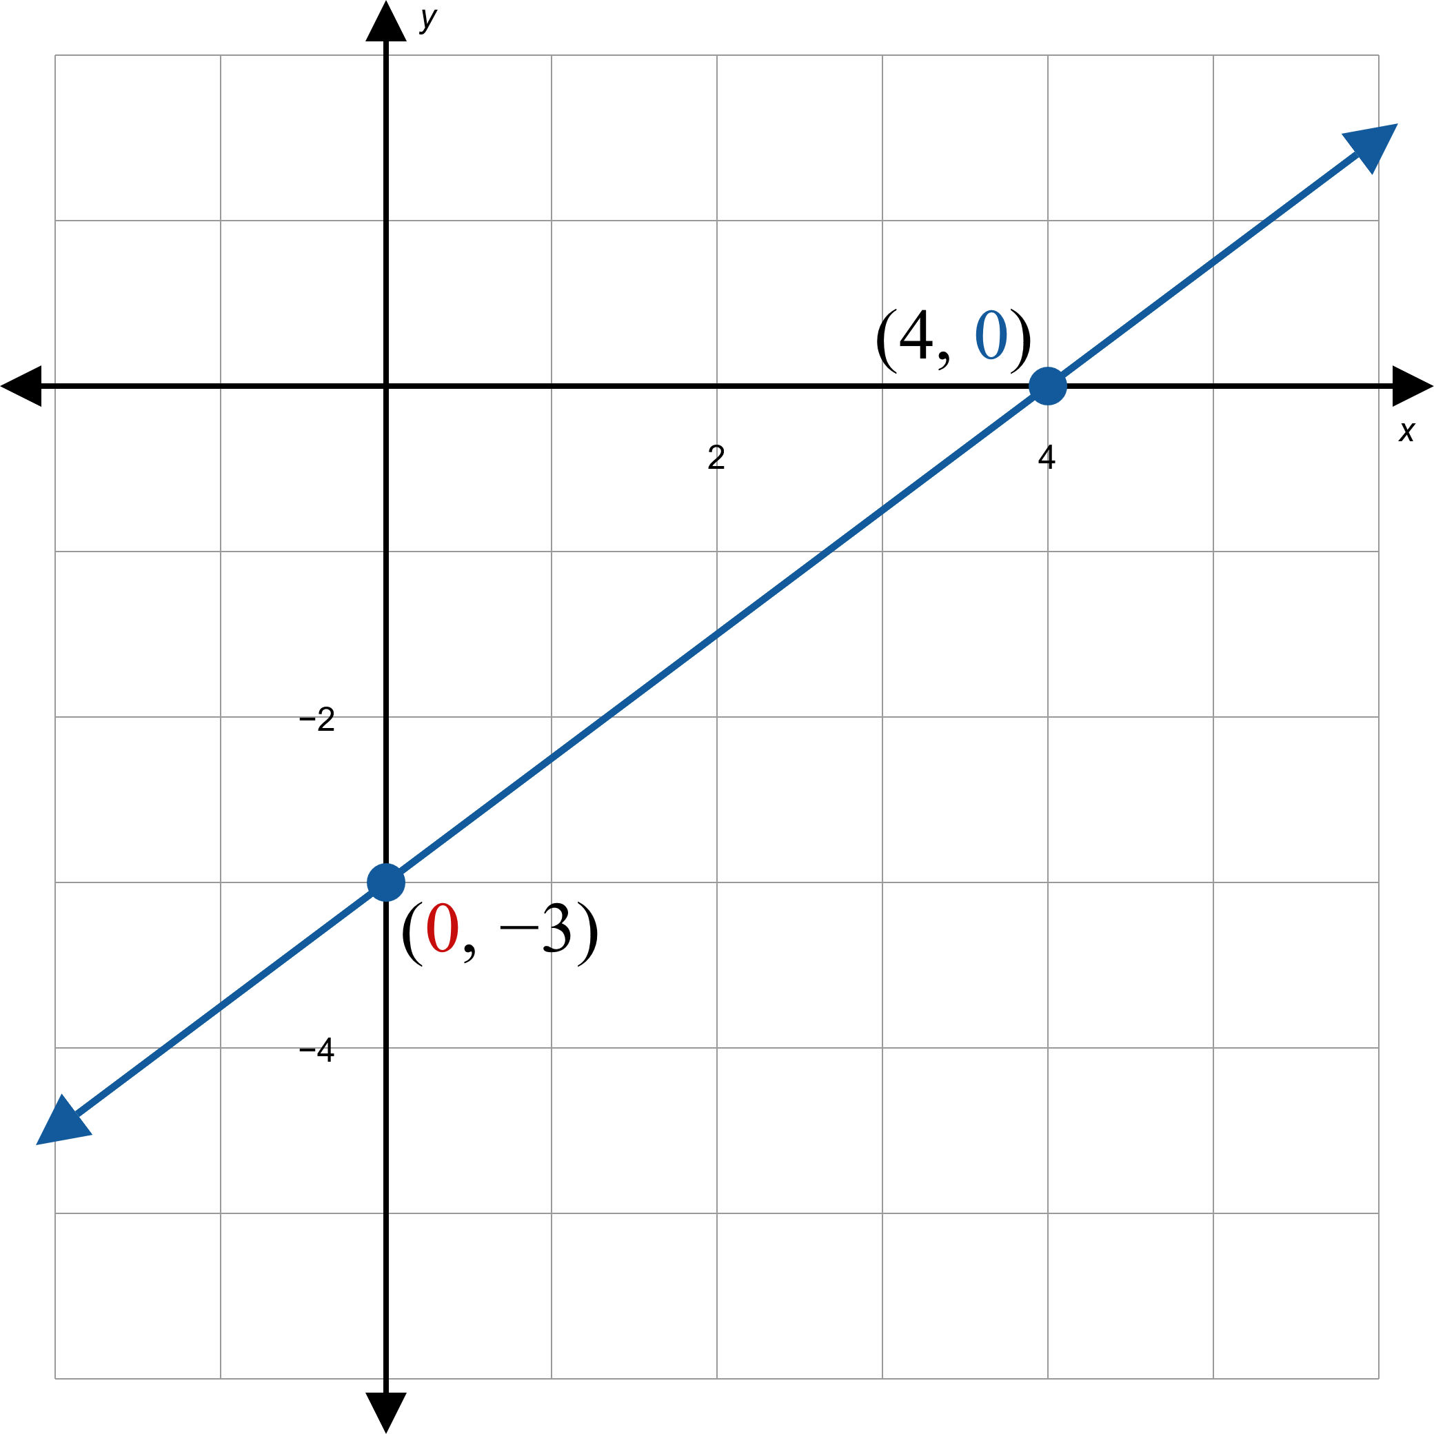
Example 2: Finding Intercepts and Graphing Linear Equations (cont.)
Figure 1

Slide 15
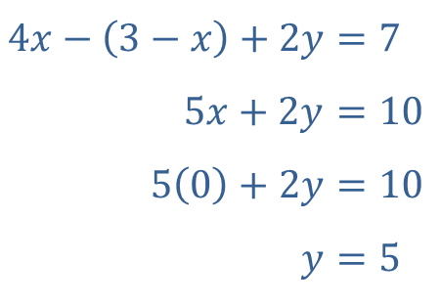
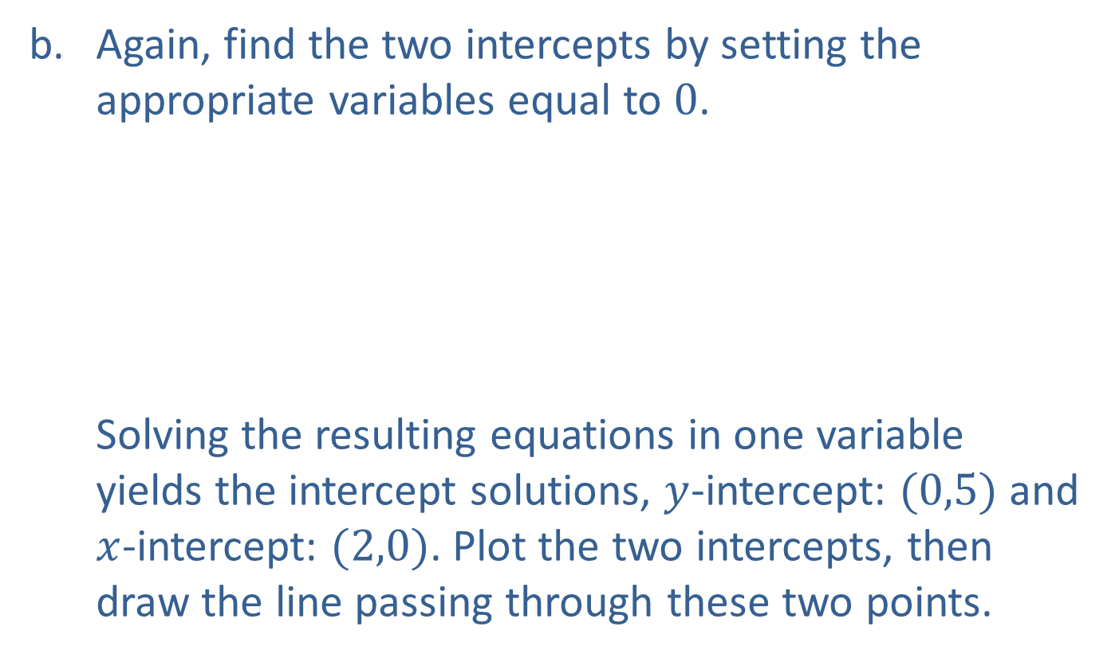
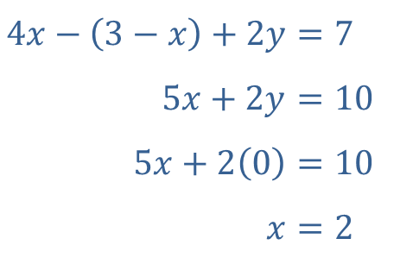
Example 2: Finding Intercepts and Graphing Linear Equations (cont.)
​Again, find the two intercepts by setting the appropriate variables equal to 0. Solving the resulting equations in one variable yields the intercept solutions, $y$-intercept: $(0,5)$ and $x$-intercept: $(2,0)$. Plot the two intercepts, then draw the line passing through these two points.
​$4x−\left(3−x\right)+2y$ | ​$=7$
​$5x+2y$ | ​$=10$
​$5\left(0\right)+2y$ | ​$=10$
​$y$ | ​$=5$
​$4x−\left(3−x\right)+2y$ | ​$=7$
​$5x+2y$ | ​$=10$
​$5x+2\left(0\right)$ | ​$=10$
​$x$ | ​$=2$

Slide 16
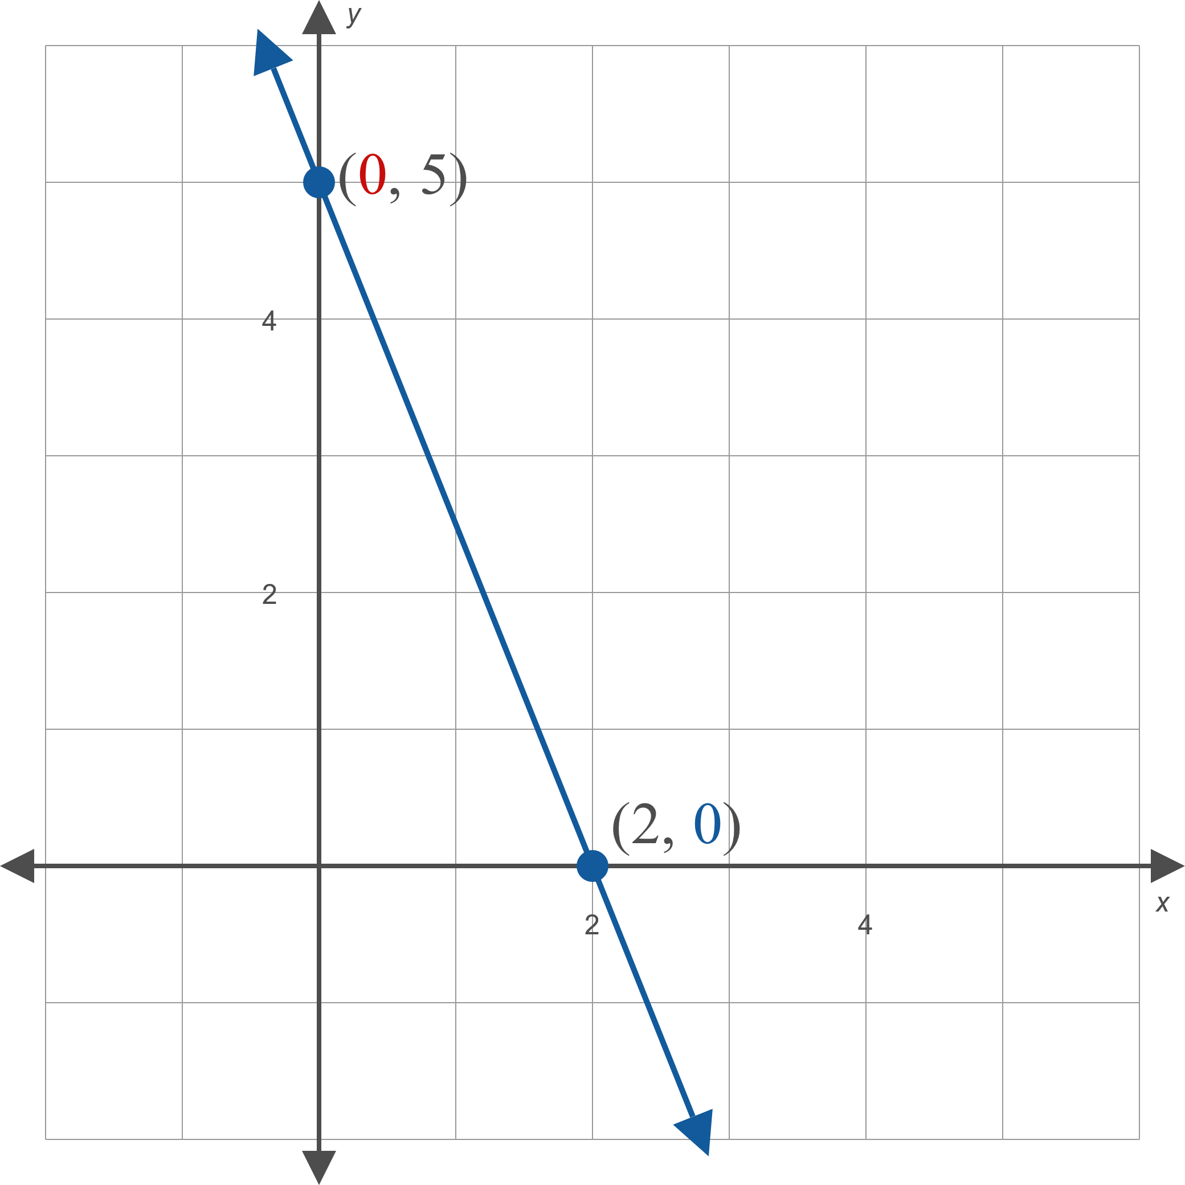
Example 2: Finding Intercepts and Graphing Linear Equations (cont.)
Figure 2

Slide 17

Example 3: Graphing Horizontal and Vertical Lines
Graph the following equations.
​$5x=0$
​$2x−2=3$
​$3x+2\left(x+7\right)−2y=5x$

Slide 18
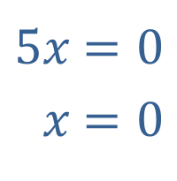
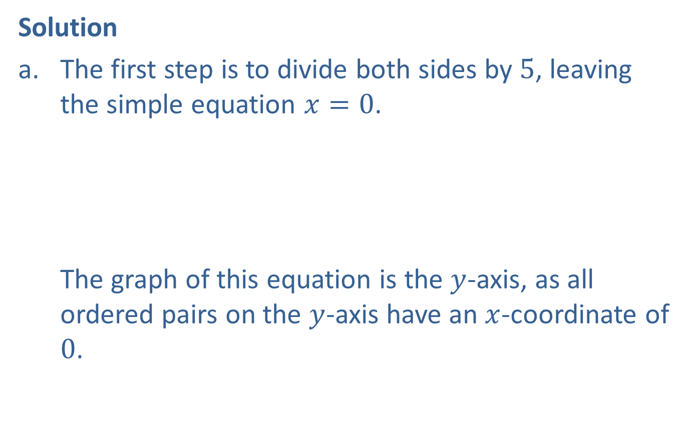
Example 3: Graphing Horizontal and Vertical Lines (cont.)
Solution
​The first step is to divide both sides by 5, leaving the simple equation $x=0$. The graph of this equation is the $y$-axis, as all ordered pairs on the $y$-axis have an $x$-coordinate of 0.
​
​$5x$ | ​$=0$
​$x$ | ​$=0$

Slide 19
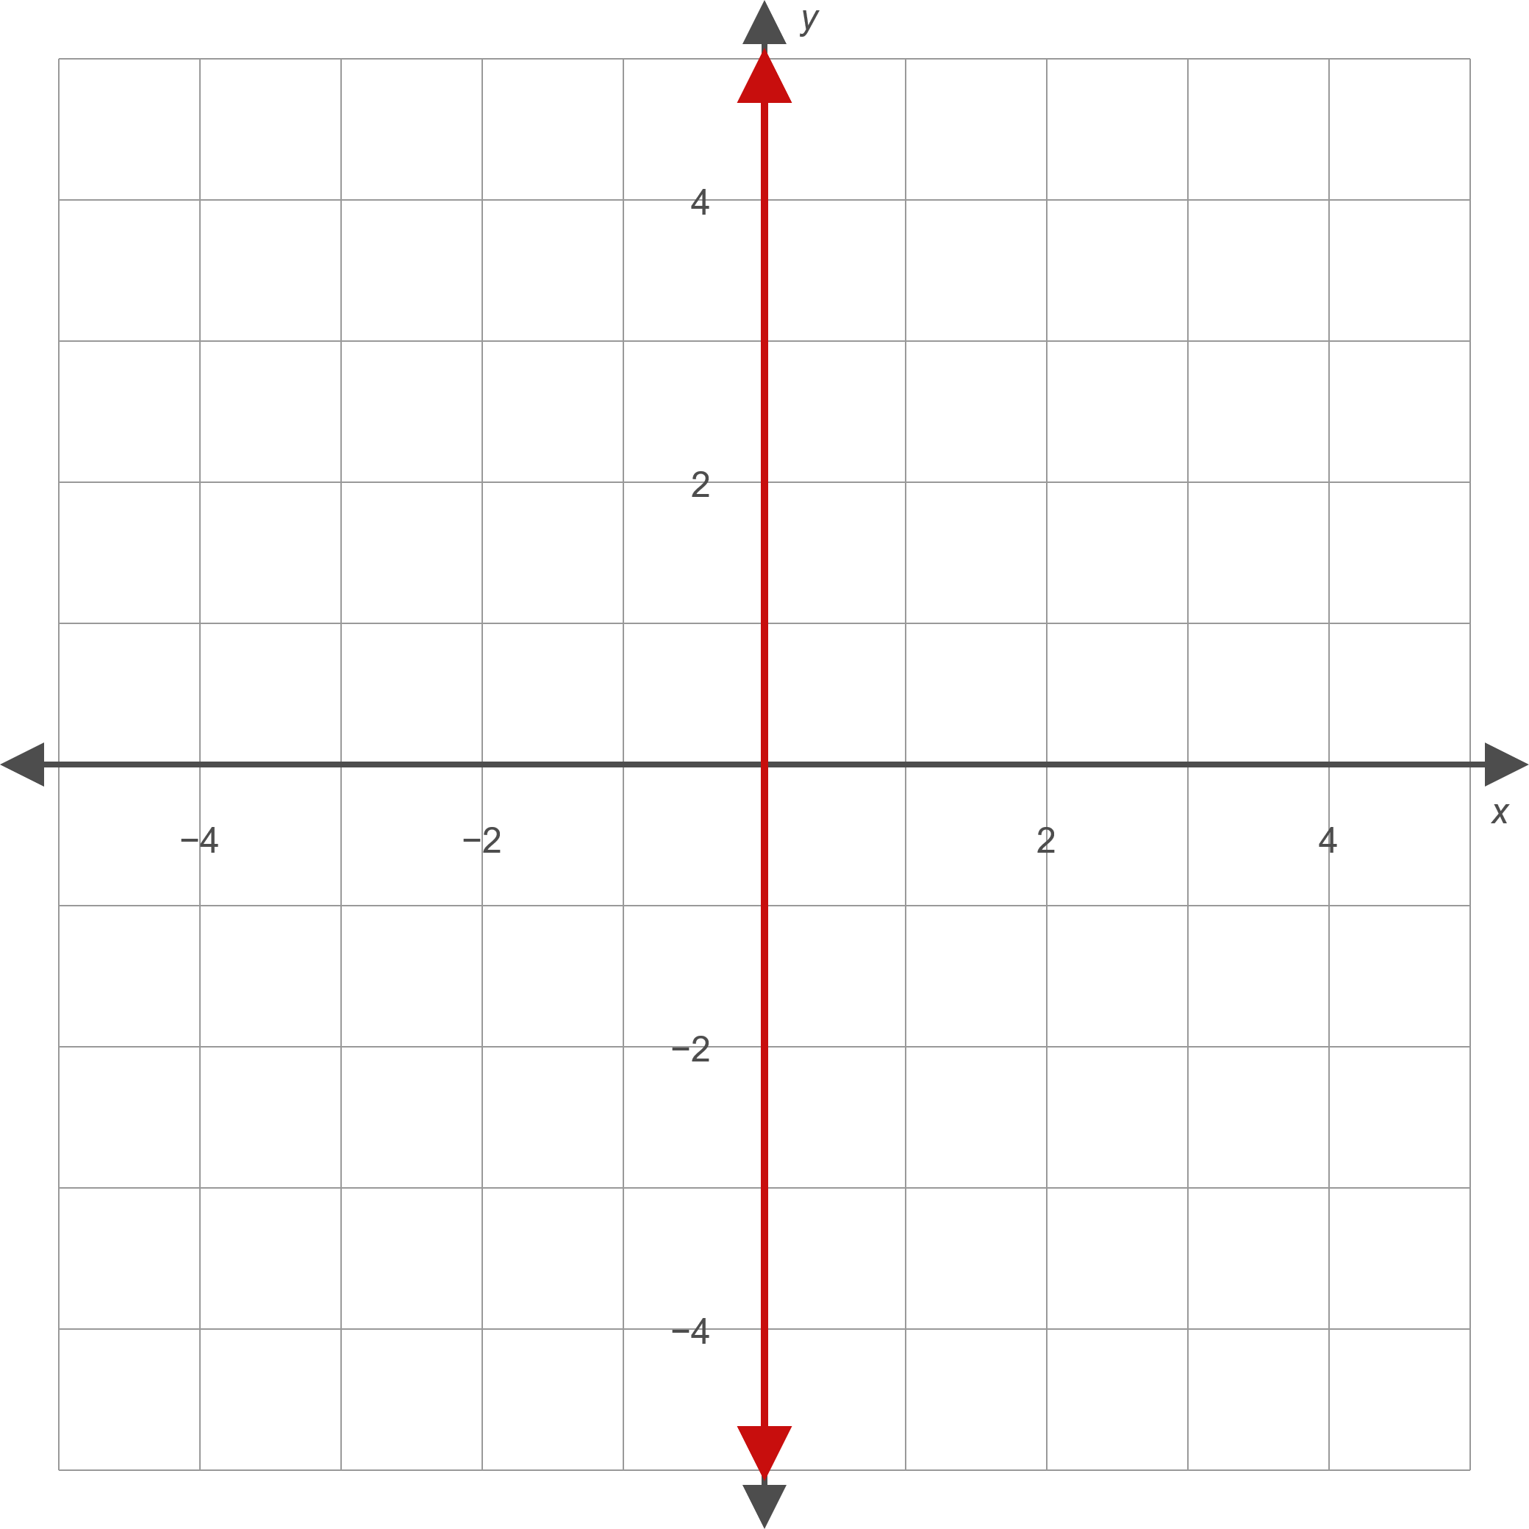
Example 3: Graphing Horizontal and Vertical Lines (cont.)
Figure 8

Slide 20

Example 3: Graphing Horizontal and Vertical Lines (cont.)
​The equation $x=0$ is unique in that it has an infinite number of $y$-intercepts (since each point on the graph is on the $y$-axis) and one $x$-intercept (the origin).
​Similarly, the equation $y=0$ has an infinite number of $x$-intercepts and one $y$-intercept.

Slide 21
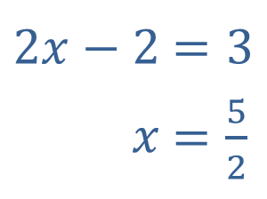

Example 3: Graphing Horizontal and Vertical Lines (cont.)
​Upon simplifying, note that this equation also represents a vertical line, this time passing through $\frac{5}{2}$ on the $x$-axis.
​
​
​$2x−2$ | ​$=3$
​$x$ | ​$=\frac{5}{2}$

Slide 22
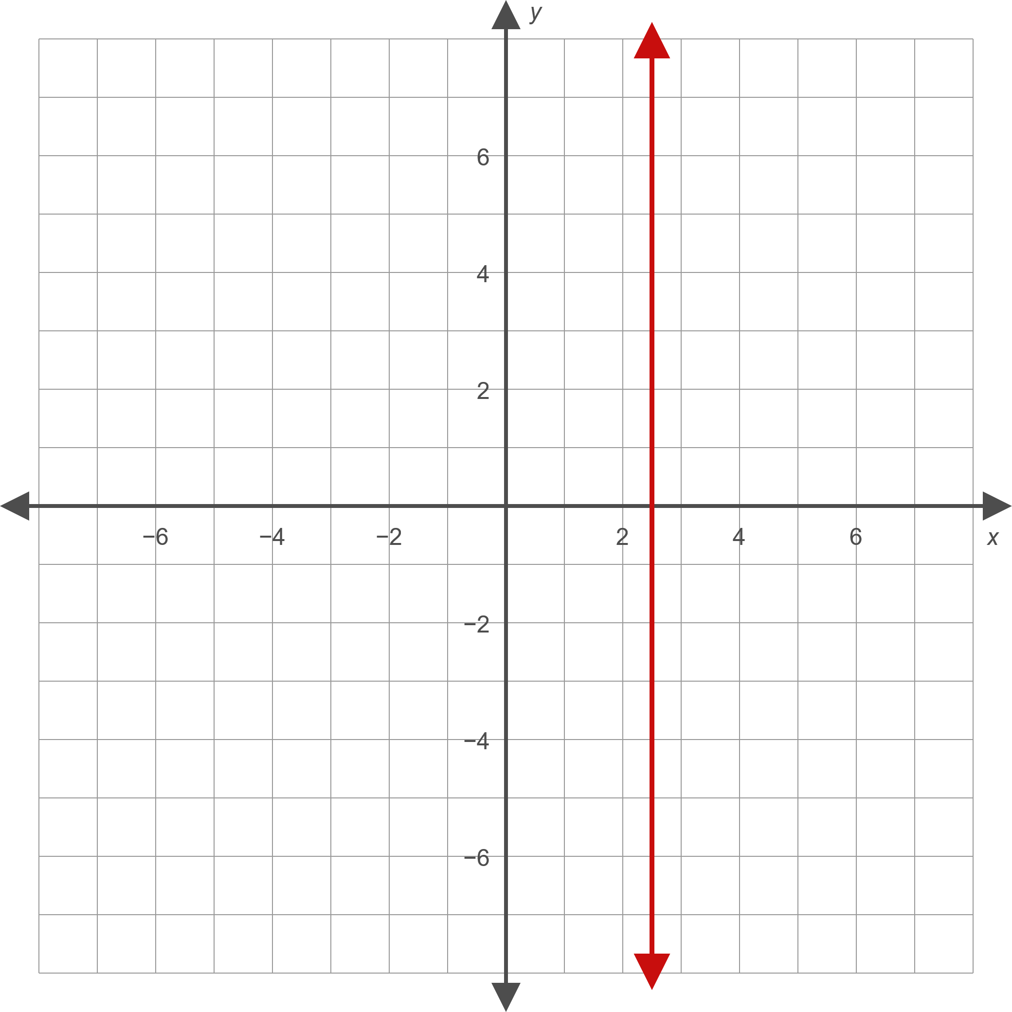
Example 3: Graphing Horizontal and Vertical Lines (cont.)
Figure 9

Slide 23
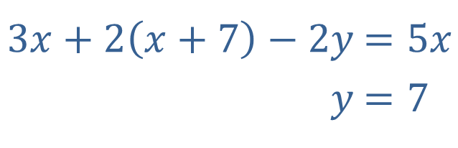
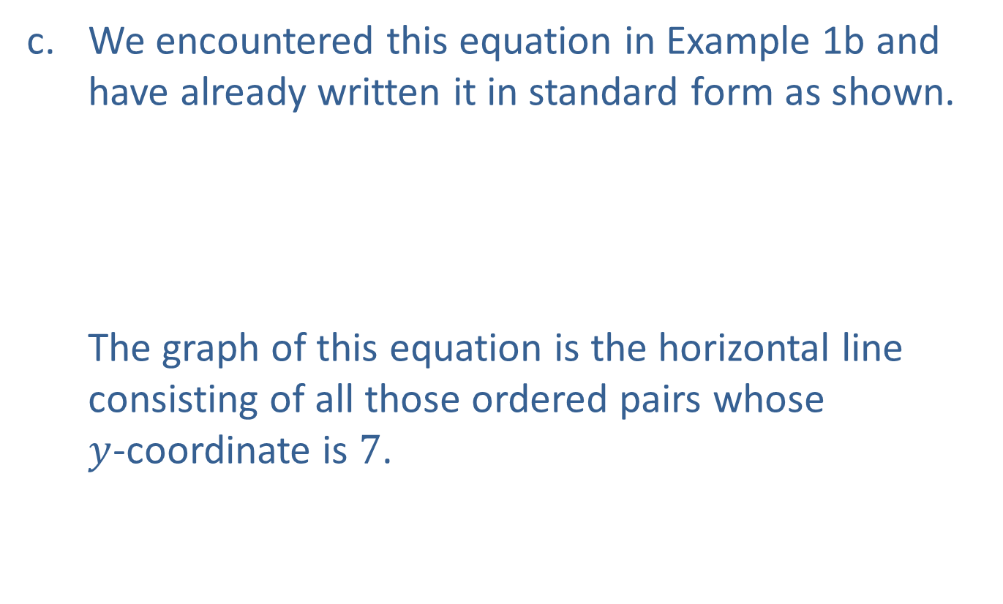
Example 3: Graphing Horizontal and Vertical Lines (cont.)
​We encountered this equation in Example 1b and have already written it in standard form as shown. The graph of this equation is the horizontal line consisting of all those ordered pairs whose $y$-coordinate is 7.
​$3x+2\left(x+7\right)−2y$ | ​$=5x$
​$y$ | ​$=7$

Slide 24
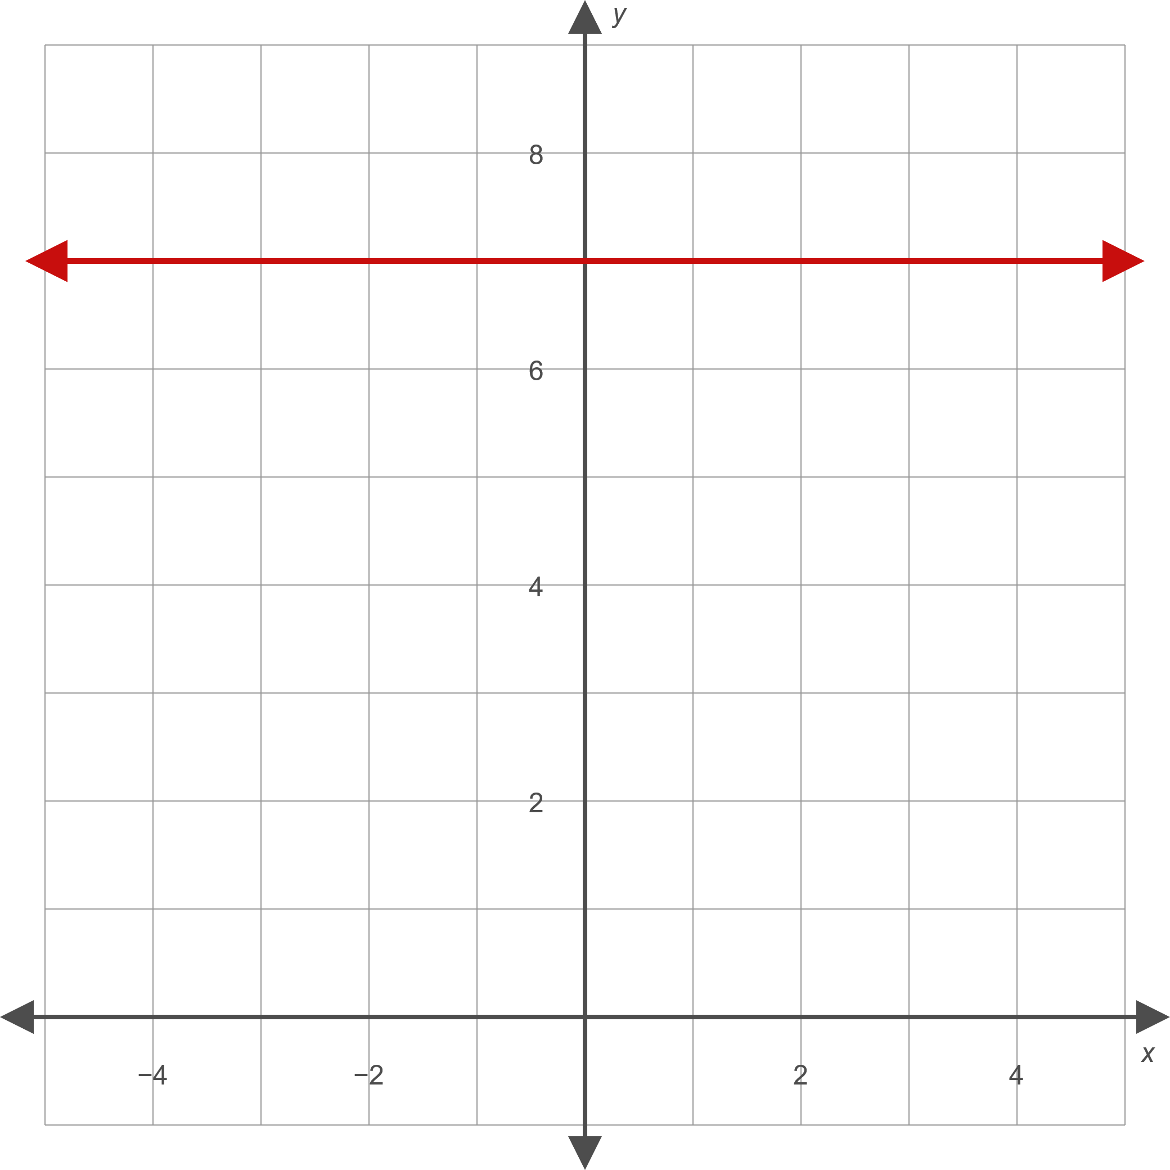
Example 3: Graphing Horizontal and Vertical Lines (cont.)
Figure 10

