Slide 1

Section 9.7
More on Graphing Quadratic Functions and Applications

Slide 2
Example 1: Graphing Quadratic Functions of the Form y = ax² + bx + c
Find the line of symmetry, the vertex, the x-intercepts (zeros), and y-intercept for the function Then, graph the function.
Solution

Slide 3
Example 1: Graphing Quadratic Functions of the Form y = ax² + bx + c (cont.)
In this form, we see that the line of symmetry is x = 5 and the vertex is at (5, −4). By setting y = 0, we can find the x-intercepts (zeros) of the function by solving for x.
This gives x = 7 or x = 3, and the zeros (x-intercepts) are at (7, 0) and (3, 0).

Slide 4
Example 1: Graphing Quadratic Functions of the Form y = ax² + bx + c (cont.)
To find the y-intercept, substitute x = 0 in the function.
The y-intercept is at (0, 21).

Slide 5
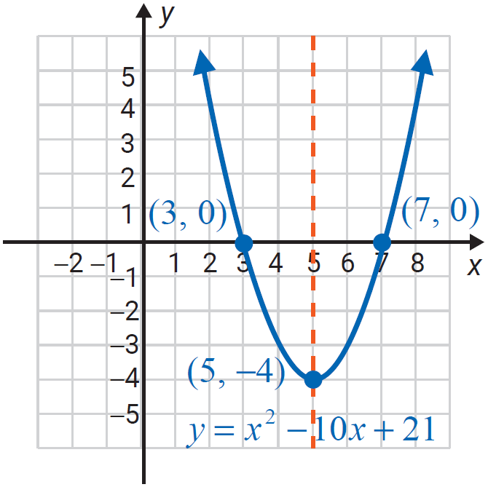
Example 1: Graphing Quadratic Functions of the Form y = ax² + bx + c (cont.)
The figure shows the graph with vertex, line of symmetry, and intercepts labeled. Note that the y-intercept lies outside of the given grid.
Summary:
line of symmetry is x = 5.
vertex: (5, −4)
x-intercepts: (3, 0) and (7, 0)
y-intercept: (0, 21)

Slide 6
Example 2: Graphing Quadratic Functions of the Form y = ax² + bx + c
Find the vertex, the line of symmetry, the x-intercepts, and y-intercept for the function Then, graph the function.
Solution

Slide 7
Example 2: Graphing Quadratic Functions of the Form y = ax² + bx + c (cont.)
In this form, we see that x = −2 is the line of symmetry and the vertex is at (−2, 3).
By setting y = 0, we can find the x-intercepts by solving for x.

Slide 8
Example 2: Graphing Quadratic Functions of the Form y = ax² + bx + c (cont.)
This gives x = −1 or x = −3 and the zeros (x-intercepts) are at (−3, 0) and (−1, 0).
To find the y-intercept, substitute x = 0 in the function.
The y-intercept is at (0, −9).

Slide 9
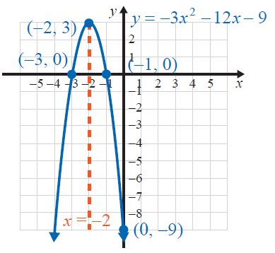
Example 2: Graphing Quadratic Functions of the Form y = ax² + bx + c (cont.)
The figure shows the graph with vertex, line of symmetry, and intercepts labeled.
Summary:
line of symmetry is x = −2.
vertex: (−2, 3)
x-intercepts: (−3, 0) and (−1, 0)
y-intercept: (0, −9)

Slide 10
Example 3: Graphing Quadratic Functions of the Form y = ax² + bx + c
For find the line of symmetry, vertex, x-intercepts, and y-intercept.
Solution
For we have a = −1, b = −4, and c = 2. If
then

Slide 11
Example 3: Graphing Quadratic Functions of the Form y = ax² + bx + c (cont.)
So the vertex is at (−2, 6) and the line of symmetry is x = −2.
If x = 0, then y = −(0)² −4 ⋅ 0 + 2 = 2 and the y-intercept is at (0, 2).
If y = 0, then
Quadratic formula

Slide 12
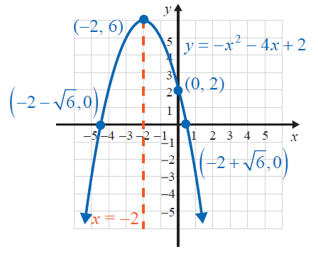
Example 3: Graphing Quadratic Functions of the Form y = ax² + bx + c (cont.)
The x-intercepts are at and
Summary:
line of symmetry is x = −2.
vertex: (−2, 6)
x-intercepts: and
y-intercept: (0, 2)

Slide 13
Example 4: Graphing Quadratic Functions of the Form y = ax² + bx + c
For find the line of symmetry, vertex, x-intercepts, and y-intercept.
Solution
For we have a = 2, b = −6, and c = 5.
If then

Slide 14
Example 4: Graphing Quadratic Functions of the Form y = ax² + bx + c (cont.)
So we have the vertex at and the line of
symmetry is
If x = 0, then and the y-intercept is at (0, 5).
If y = 0, then
Quadratic formula
Nonreal complex numbers

Slide 15
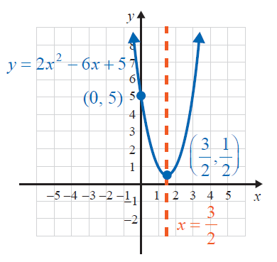
Example 4: Graphing Quadratic Functions of the Form y = ax² + bx + c (cont.)
There are no real zeros because the discriminant is negative. The graph will not cross the x-axis.
Summary:
vertex:
line of symmetry is
x-intercepts: none
y-intercept: (0, 5)

Slide 16
Definition: Minimum and Maximum Values
For
If a > 0, then the parabola opens upward and (h, k) is the lowest point and the y-value k is called the minimum value of the function.
If a < 0, then the parabola opens downward and (h, k) is the highest point and y-value k is called the maximum value of the function.

Slide 17
Example 5: Application: Finding Minimum and Maximum Values
A ball is thrown vertically upward from the ground with an initial velocity of 64 ft per second. Using the function where h is the height of the object after time t, v₀ is the initial velocity, and h₀ is the initial height, determine how long it will take for the ball to reach its maximum height and what that height will be.
Solution
For this problem, we are told that v₀ = 64 ft per second and h₀ = 0 ft (ground level), so the quadratic function modeling the path of the ball is

Slide 18
Example 5: Application: Finding Minimum and Maximum Values (cont.)
For this function a = −16, b = 64, and the maximum
height occurs at the point where
For t = 2,
Thus, it will take the ball 2 seconds to reach its maximum height of 64 feet.

Slide 19
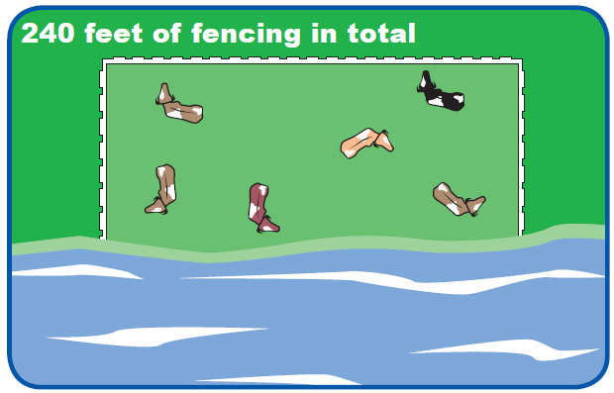
Example 6: Application: Finding Minimum and Maximum Values
A rancher is going to build three sides of a rectangular corral next to a river. He has 240 feet of fencing and wants to enclose the maximum area possible. What are the dimensions of the fencing that gives the corral its maximum area?

Slide 20
Example 6: Application: Finding Minimum and Maximum Values (cont.)
Solution
Let x represent the length of the two equal sides of the rectangular corral and 240 − 2x represent the length of the third side of the rectangular corral.
Since area equals length times width, the area A of the corral is represented by the quadratic function
The maximum area occurs at the point where

Slide 21
Example 6: Application: Finding Minimum and Maximum Values (cont.)
Two sides of the rectangle are 60 feet and the third side is 240 – 2(60) = 120 feet.
The maximum area possible is
60(120) = 7200 square feet.

